Slide 1
Path to Professional Registration

Slide 2
Mute your microphone when you are not talking.
Turn on your video camera when you are speaking.
Recorded call .
Questions will be answered at the end.
Unmute when you want to talk.
Post your question in the chat bar.
Raise your hand if you have a question or comment.

Slide 3
Agenda
Introduction
OAR forms
UKSPEC
Annual report forms
Engineering Practice Report (EPR)
Interview help
Relationship with mentor
Notes:
Introduce the mycareerpath tool

Slide 4
Speakers
Simon Steed, T&D Panel Chair and UK Buildings Group Manager at PM Group
Mike Powers, T&D Panel Member and Director at Clancy
Mitesh Chauhan, Senior Accreditation & Approvals Officer at CIBSE

Slide 5
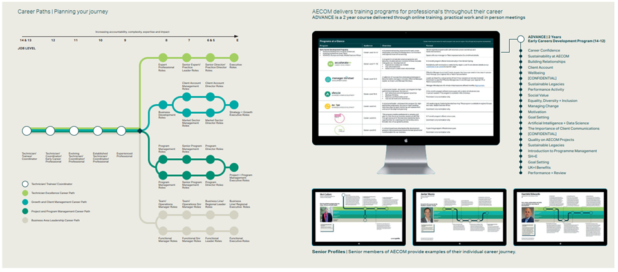
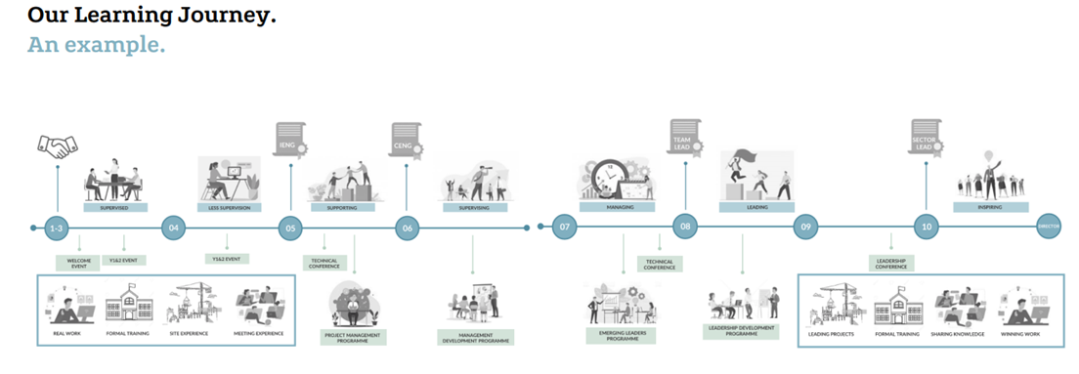
Introduction
Notes:
Life long learning
Everyone from directors
Everyone's journey is different
Top – AECOM
Bottom Hoare Lea

Slide 6
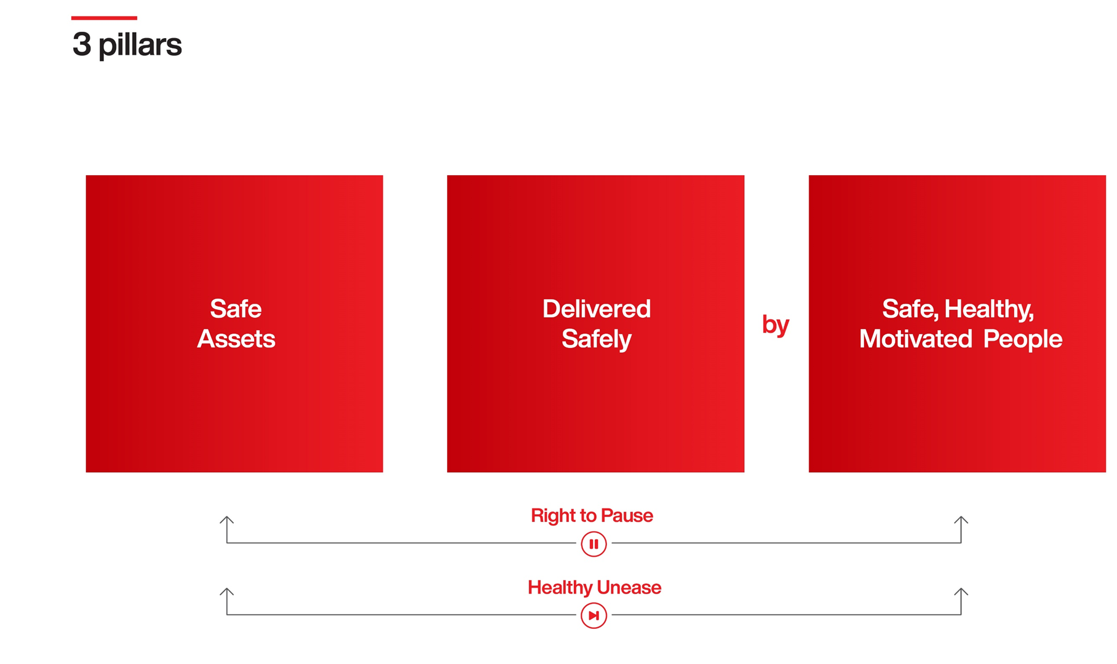
Safety Moment

Slide 7
UK-SPEC
The UK Standard for Professional Engineering Competence and Commitment (UK-SPEC) explains the requirements that people must meet to become registered as an Engineering Technician (EngTech), Incorporated Engineer (IEng) or Chartered Engineer (CEng).
It also includes examples of activities that demonstrate the required competence and commitment.
For the 3 Grades of Engineering registration there are 5 broad competencies and commitment (A to E) requiring 17 areas of evidence

Slide 8
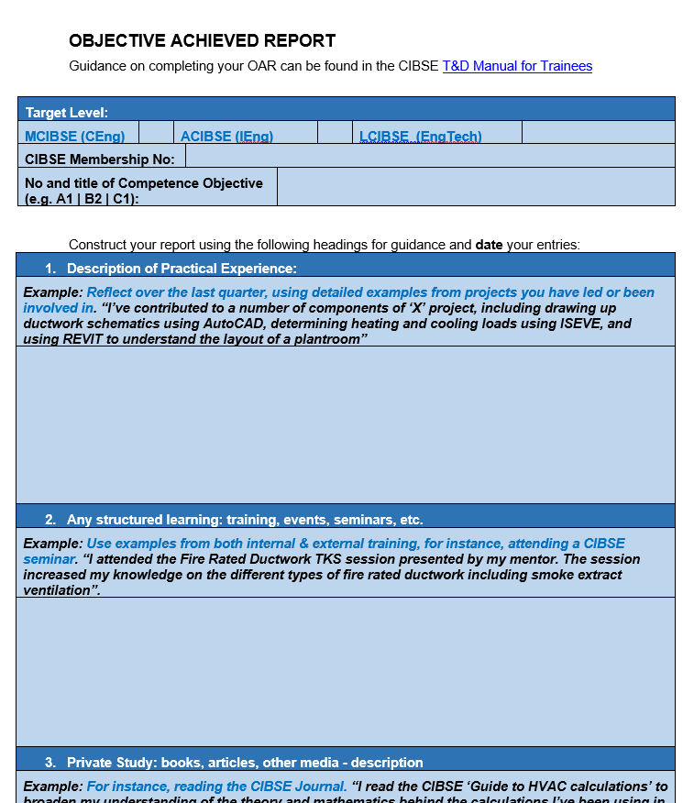
OARs
OAR forms should be created separately and uploaded to each individual UKSPEC and there can be multiple entries for each UKSPEC competency.
You must complete OARs as part of being on the T&D programme and have regular meeting (quarterly) with your mentor.
The OARs will provide the backbone of your Engineering Practice Report (ELR)
CIBSE audit trainees every year and you could be called up to submit your OARs
Notes:
Jordon from PM group to present
How to Complete the Objective Achieved Reports (OARs)
You should complete one OAR for each competence criteria you are required to meet. Identify the competence at the top of the form, and then fill in the following sections:
Practical Experience
Practical experience is likely to be the lengthiest section. Your entries here will record the various activities such as tasks, projects, meetings, etc., in which you have acquired the knowledge, experience or ability the competence specifies.
Record data about:
the event (date, place, purpose, people involved) and your role in it
Your analysis of how, and what, you learned. Do not be afraid to include negative experiences, such as a client meeting involving an argument, which enabled you to learn from your own mistakes or mistakes made by others
Where possible, use key words which refer back to the range statement or the competence itself. When reporting on the Interpersonal Skills competences (Section D), some examples from outside work may be appropriate.
i
Remember, it is not sufficient to record what you did – in each case, you must say what you learned and how it links to the Competence Objective.
Structured Learning
The structured learning section should record any courses, conferences, seminars or similar, giving the dates and locations, as well as the title and summary of content. (Course materials provided and your post-course evaluation will help you to focus on how well the course achieved its learning aims in your case).
Private Study
Under private study, note your reading from books, journals or elsewhere, relevant to the competence. You should also include any relevant research you have done. Again you should include an evaluation of the usefulness to you of what you have read.
Observations
The observations section asks you as trainee to take stock of your progress: it is recommended that you make an entry here annually.
The OAR forms have been designed to ensure that your activities are not only recorded but are reflected upon so that the process by which new skills and knowledge are acquired becomes a conscious one. In this way, aspiring building services engineers become reflective professionals, laying the foundations for future learning.
OARs should be considered live documents, to which further information can be added right up to the point of your membership application. Remember not to only use examples from your favourite projects – you may have gained valuable experience elsewhere.
Your OARs should be reviewed by your mentor at the quarterly meetings. Your mentor should provide written feedback which should be stored either in hard copy or electronically.

Slide 9
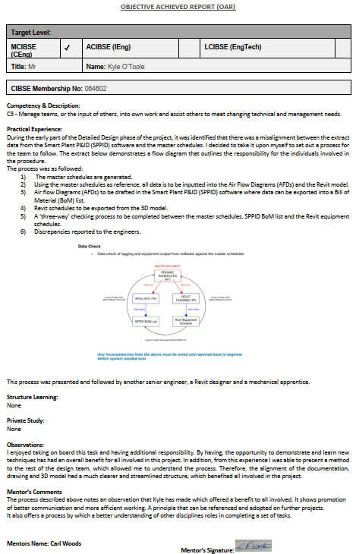
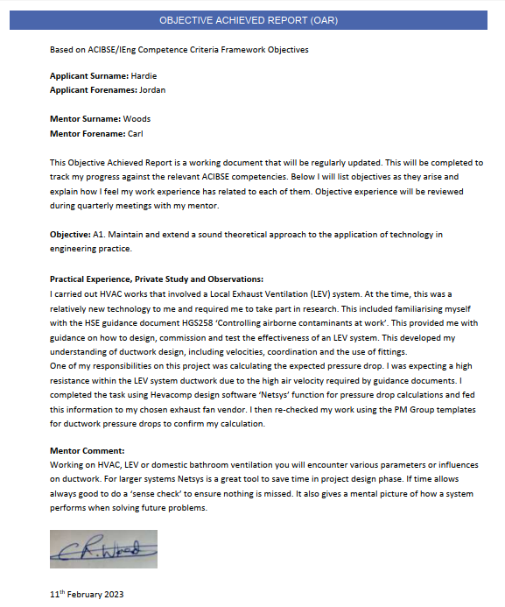
OARs
Notes:
Jordan to discuss
We’ve got a couple examples from our own OARs we thought it would be useful to share and explain how we interpreted a couple of the competencies and aligned it with our own experience
Example 1: The first one is related to practical experience in “managing teams or the input of others” in reference to CIBSE Competence Criteria “C3”. This is an example of a practical experience only objective. It’s important to note that this experience didn’t involve any structured learning or private study due to the nature of the experience. In this example the process of creating a new procedure for the team to follow was discussed. This didn’t necessarily require any structured learning of private study as it was focused on improving efficiency within a project.
Example 2: The second example involves both practical and private study which was in reference to competence criteria A1. "Maintain and extend a sound theoretical approach to the application of technology in engineering practice.“
This one involved a project experience but also learning the principles outlined in certain statutory regulations or guidance such as HSG 258 'Controlling airborne contaminants at work‘. These were examples we managed to develop and include into our submitted Engineering Practice Report, which will be covered later. It is just an example to say that not all experiences will contain practical experience, structured learning and private experience in them. It may be only one but that is fine.

Slide 10
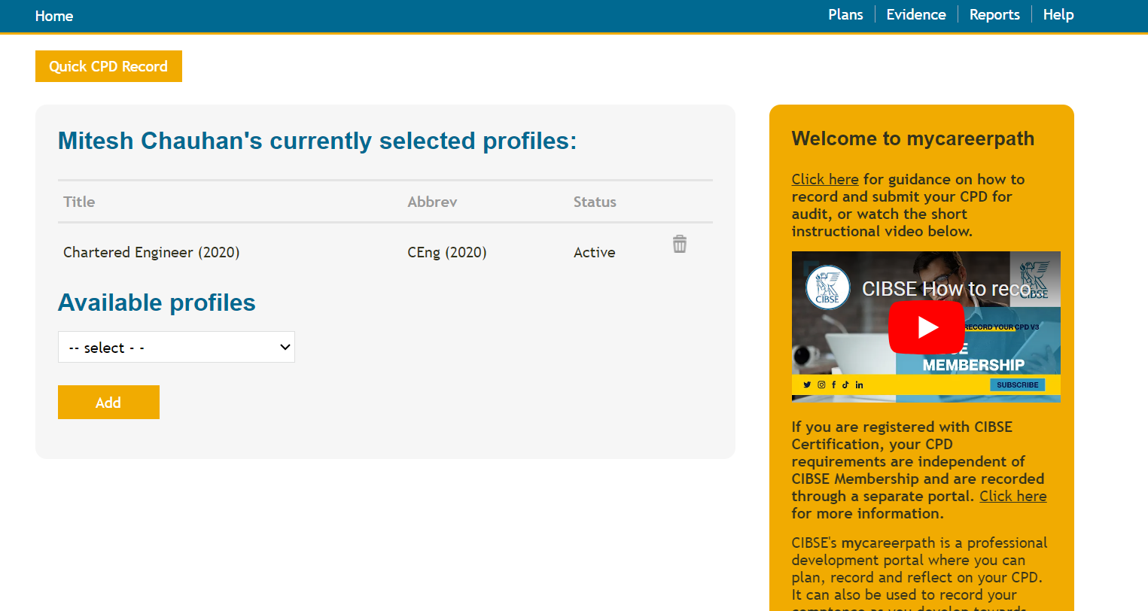
Record Keeping
CIBSE – MyCareerPath via website

Slide 11
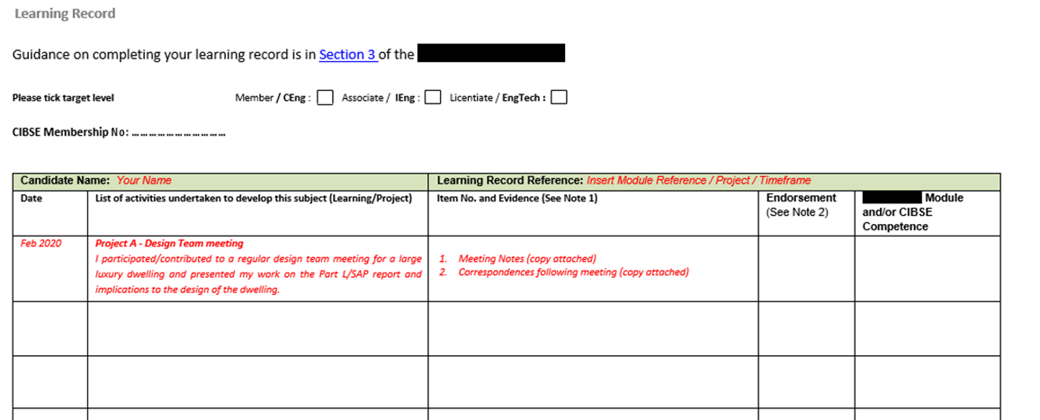
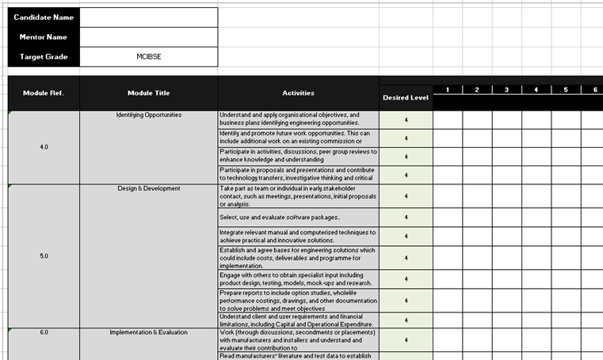
Record Keeping

Slide 12
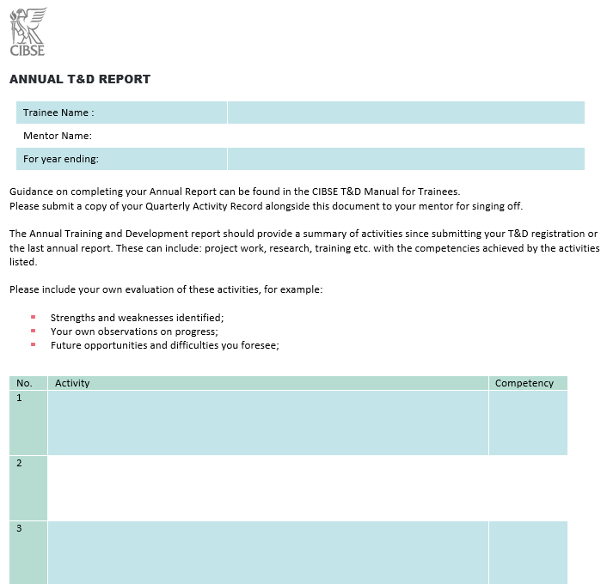
Annual Reports
At the end of each year of T&D, an Annual Report must be submitted to your mentor to enable them to monitor your progress. Combine the best examples from your OARs so far and include:
activities since submitting your T&D registration or the last annual report: nature of employment, work undertaken, training events, visits, study, reading, Competence Objectives addressed;
your own evaluation of these activities, for example, strengths and weaknesses identified;
activities envisaged for the coming year, for example, work in prospect, training/ visits/research planned, Competence Objectives to be tackled;
your own observations on progress, mentioning opportunities and difficulties you foresee;
general comments from your mentor on ‘work in progress’, reporting any particular difficulties encountered and/or indicating the future direction the two of you are planning towards completion of the Objectives.
Notes:
Jordan to present
It will help if you:
become familiar with the Competence Objectives you are working towards;
keep your own notes, e.g. a daily or weekly record of what you did at work, noting when links occur to you between your activity and one or more of the Objectives. This record is not to be submitted, but to be used as a reminder when you are completing your OARs;
update your OAR forms at least once a month;
schedule regular meetings with your mentor specifically to discuss your T&D activities;
take the documents to every appraisal, progress or career development meeting with your employer.
Jordan Notes:
Annual Reports
By participating in the CIBSE Training & Development scheme, you should submit an annual report which will be a summary of the best parts from your Objective Achieved Report that you have been updating throughout the year. By completing the Annual Reports, you will be in a good position for when you come to complete your final Engineering Practice Report.
By completing your annual report, it will help you become familiar with the competence criteria you are working towards.
Outside of the Objective Achieved Reports, you should aim to keep a record of notes that links you to one or more of the objectives. Note taking isn’t part of the formal process, but it is really useful when you are completing your Objective Achieved Report and Annual Report.
Shown on screen is a template of an annual report form which can be downloaded under useful documents for T&D from the CIBSE website. I’d suggest using this as it has been created for the purpose of leading up to the Engineering Practice Report which you will eventually submit.
Aside from your quarterly meetings with your mentors, it is valuable to have an annual meeting with your mentor to reflect on your learning so far and try to find gaps in your knowledge that they can assist you with.
It can also be useful to use your annual reports in appraisal meetings with your line manger as it will help discuss your career progression.

Slide 13
Writing your report

Slide 14
Engineering Practice Report (EPR)
The Final (Annual) Report can be completed once the trainee has reached the end of their time on the scheme and is close to applying for membership and registration. The Final Report only should be submitted to CIBSE.
The T&D Panel will then provide feedback to inform the trainee of the strengths and weaknesses of their report.
It is usually the case that only minimal revisions will be necessary to turn the final report into the full Engineering Practice Report needed for the membership application.
OARs
Annual Report
EPR submission
Quarterly mentoring meetings
OARs reviewed, discussed and signed off
Mentoring feedback recorded and incorporated into EPR
Submission provided to the mentor to summarise progress
Formal submission to CIBSE
Informal submission to sponsor/reviewee
Incorporate feedback
Notes:
Kyle O'Toole
Recently submitted MCIBSE IEng application, interview next month
Engineering Practice Report:
Upon completion of the T&D scheme and when feel you have met each of the 17 competencies set out by the Engineering Council’s UK-SPEC & CIBSE, you should be ready to start producing your Engineering Practice Report (EPR).
The Engineer Practice Report can either be set up by competency, or by work/project experience. In my experience, setting the report up by competency was the preferred option. I used the most relevant example or examples to demonstrate how I felt I hit each of the competencies.
I generated OARs, which were signed-off by my mentor and then incorporated them into my EPR. This made the whole process less intense and time consuming (not saying it was easy by any means).
Considerations;
Ensure you have read through the guidance for the grade your applying for
Put as much time as you can into your OARs, they really help with your EPR. I learnt the hard way initially as I never kept up to date initially, which made generating the report much harder
Allow plenty of time in advance for prepping and submitting your report (it takes longer than you envisage)
Consider your short, medium and longer term goals which make up your development action plan is required to be submitted alongside the report
When writing the report, break down the question into smaller more simplistic terms. For me personally, I found it difficult to fully understand what some of the competencies were asking of me, so I discussed this with peers/Simon, which really helped me
Word count is limited, so ensure that your writing style is precise and to the point. Otherwise, you will get to the end and realise your over the word count then need to strip content out (which is also time consuming)

Slide 15
Engineering Practice Report: the competence criteria
A
Engineering Knowledge
B
Theoretical and Practical Methods
C
Responsibility
D
Communication and Interpersonal Skills
E
Commitment to Engineering
Notes:
As part of your Associate or Member application we will look at your competence and commitment to building services engineering.
The Engineering Council has designed a list of competence criteria for each grade of membership. All applicants need to show that they can meet these requirements as part of their professional application. You will be required to write an Engineering Practice Report, where you look across your your career and provide the strongest examples you can think of to meet each of the 17 criteria.
I won’t go through each of the competencies today, but I’ll just quickly explain which kind of criteria sit within each section.
A and B are all about your technical skills and engineering knowledge, and how you apply these in the professional roles you have held. (How you solve Engineering problems)
C is looking at how your technical and commercial leadership / management skills, how you handle responsibilities, deal with tasks and other people. (Any direct/in-direct reports? – Don’t have to manage people – myth!)
D is looking at your communication and interpersonal skill (write technical reports/talk to suppliers – both internal & external)
E is about how you comply with the CIBSE code of conduct, your understanding of health and safety, ethics and how you keep yourself up-to-date with CPD. (this could be through going on a course or reading the CIBSE journal)
The difference between the competence criteria for ACIBSE and MCBISE is dependent on the level on which you’re working at. Generally speaking, an ACIBSE is someone who manages technology whereas an MCIBSE would be someone who optimizes technology.

Slide 16
Writing your Engineering Practice Report: Support
Nada Issa MCIBSE CEng
CIBSE
workshops
Report Review services
Sample reports
How to start your Engineering Practice Report webinar
Notes:
When you come to write this report, we have plenty of support initiatives in place for you.
Report review services: We can arrange a Teams call between you and one of our professional reviewers. They get sent a draft copy of your Engineering Practice Report in advance of the call and spend an hour or so going through your report with you over Teams.
Sample Reports – We also have several sample reports available on our website for all grades of professional membership.
How to start your Engineering Practice Report webinar: This on-demand webinar goes into further detail on what we’re looking for you to base your report on and provides examples from successful applicants.

Slide 17
Interview

Slide 18
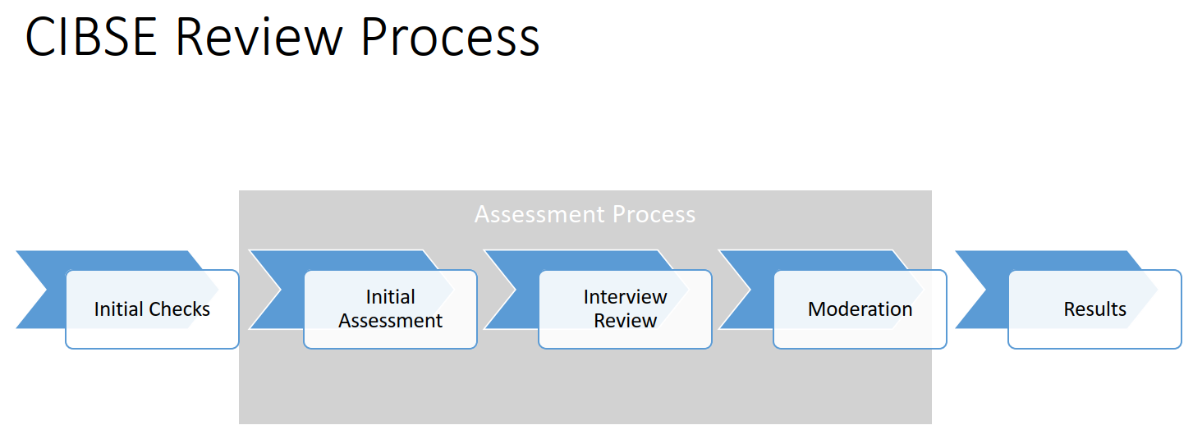
How the interview works
1 hour
Virtual – Microsoft Teams
5-minute introduction
15–20-minute presentation
30 minutes for questions
5-minute conclusion
Interview Guidance | CIBSE
Notes:
The Interview
After you have submitted your online application and your Engineering Practice Report has been checked, you will be invited to attend an interview. You will be notified two weeks prior to your interview date when your interview will take place.
The interview is your opportunity to verbally demonstrate an example for each of the competence criteria again. So, you will be verbally expanding your report to demonstrate your competence.
Your interview will last around one hour and will take place over Microsoft teams. You will be interviewed by two professional members of CIBSE who have undertaken special training. We will try our best to pair you with at least one individual from your discipline.
You will do a 15-20-minute presentation where you demonstrate the competencies. After your presentation, your interviewers will ask you questions for around 30 minutes and then you will have 5 minute to add anything you feel you have missed.
Support and guidance on the interview can be found on the website through this link (show interview guidance link).

Slide 19
Interview help
CIBSE Guidance
Review of presentation
Mock Interview
Feedback & Support
Interview Guidance (cibse.org)

Slide 20
Mentor relationship
Mentors are key to the process
Support/Guidance v Drive/Direction
Mentors must want and be able to commit
"Mentor Impact"
Trainees/Grads respond to mentor attitude
Mentor Pairing
Mentor Training or Experience

Slide 21
Questions

Slide 22
Finally…
CIBSE is here to help and support
Contact:
Mitesh Chauhan – MChauhan@CIBSE.org

