Slide 1
bvbn
Connor Garnett
Business Development Manager

Slide 2
Agenda
Heat Networks
Regulations
Thermal Energy Meters

Slide 3
Background:
Heat Networks use less energy and provide less carbon emissions
17,000 registered heat networks in the UK.
Heat Networks currently provide 2-3% of the UK’s Heat
Department for Energy Security and Net Zero (DESNZ)
Case study – Leeds heat network; Leeds university, Leeds museum, Leeds town hall, court and library
Notes:
Important to mention this is an overview of current thinking and not the final product.
A well-designed heat network uses vastly less energy when compared to individual gas-fired boilers. With the combination of renewable energy sources, carbon emissions are also lowered.
Currently around 17’000 heat networks registered in the UK, serving domestic, public and commercial buildings. This is set to increase, with the Department for Business, Energy and Industrial Strategy (BEIS)
Heat networks currently provide 2-3% of the UK’s Heat – The Governments net zero strategy recommendation proposes a 18% increase and is predicted to be roughly 43% by 2050.
In support of the market development, heat networks are to become regulated in 2025, similar to the gas and electricity utility.
The energy center; district distribution pipework; communal distribution pipework within the building; substations; consumer connections (heat interface units –HIUs); and consumer heat systems.

Slide 4
Heat Network (Metering and Billing) Regulations 2014:
What are the regulations?
Who does this apply to?
Three stipulations:
Notification – Network, capacity, buildings and customers
Metering – Point of entry, Final Customer meters
Billing - Actual Figures, Once a year.
Notes:
Bullet point 1 - The UK regulations relate to any distribution of thermal energy from a central
source to more than one end user, building or location for the purposes of heating,
cooling or hot water supply.
Bullet point 2 – The person or body ultimately responsible for supplying and charging these end
users (termed a ‘heat supplier’) and is obligated to meet three key stipulations, explained
on the point.
Notification: Regulation 3 states each heat supplier must inform OPSS about the location of any
district heat network or communal heating scheme - as well as its capacity and supply
figures. Each building forming part of the network must also be identified, along with
the number of customers using it – Renotification after every 4 years.
Metering:
Point of entry - The duty to install meters covers point of entry meters for buildings with one or more
customers connected to a heat network. Installing point of entry meters (also known
as ‘bulk’ meters) is mandatory
Final Customer meters: The duty to install meters also covers final customer meters in buildings with more
than one customer connected to a heat network. – Mandatory in new developments.
Billing - End users must be billed using actual meter readings (rather than estimates) at least
once a year.

Slide 5
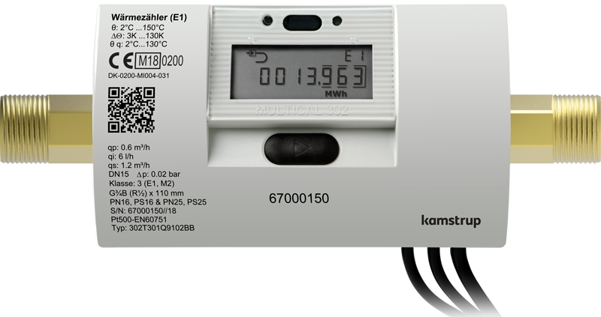
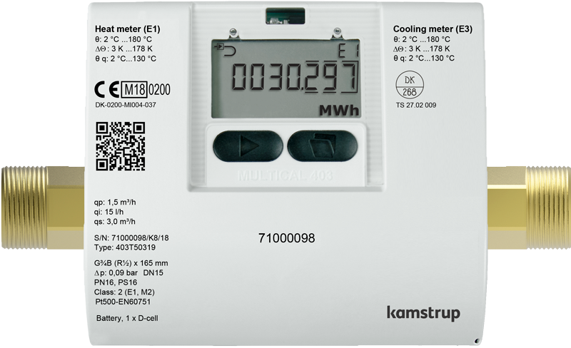
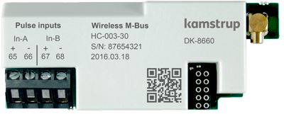
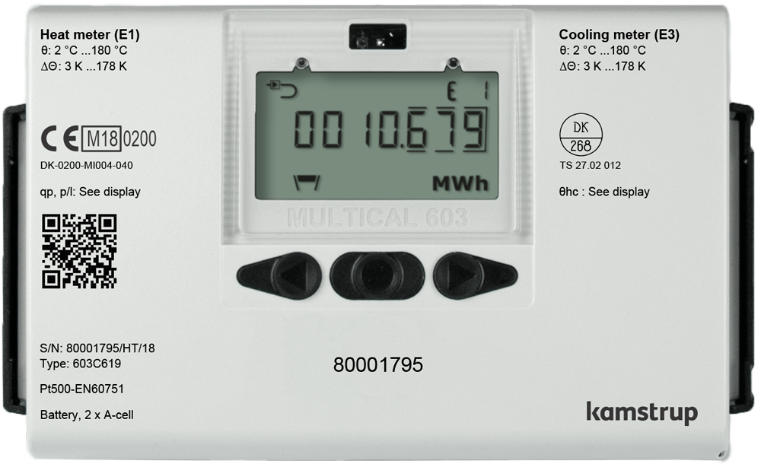
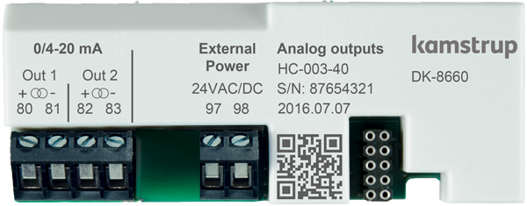
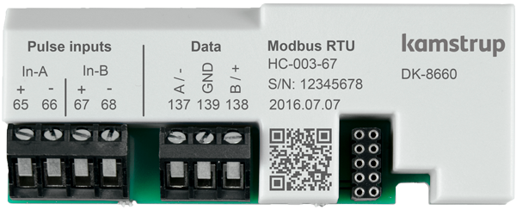
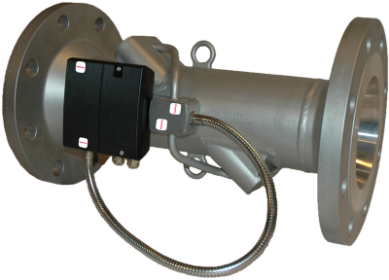
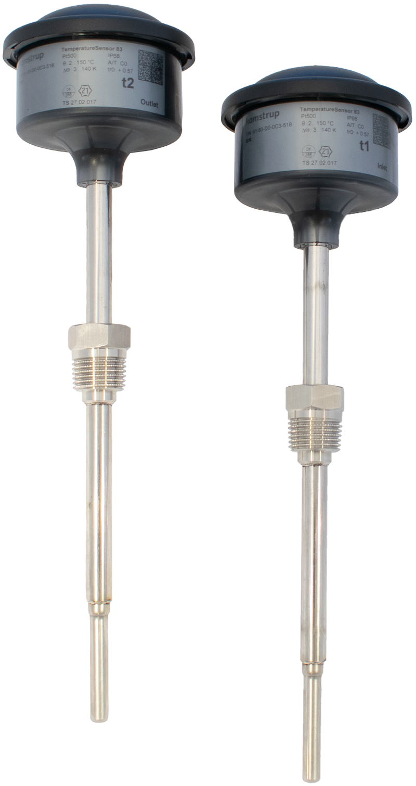
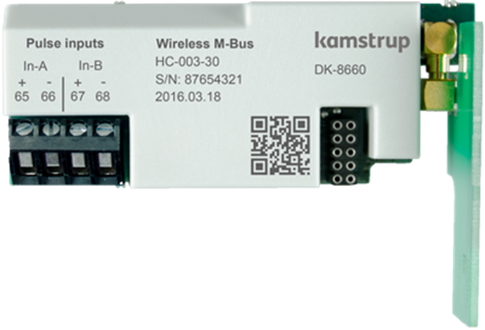
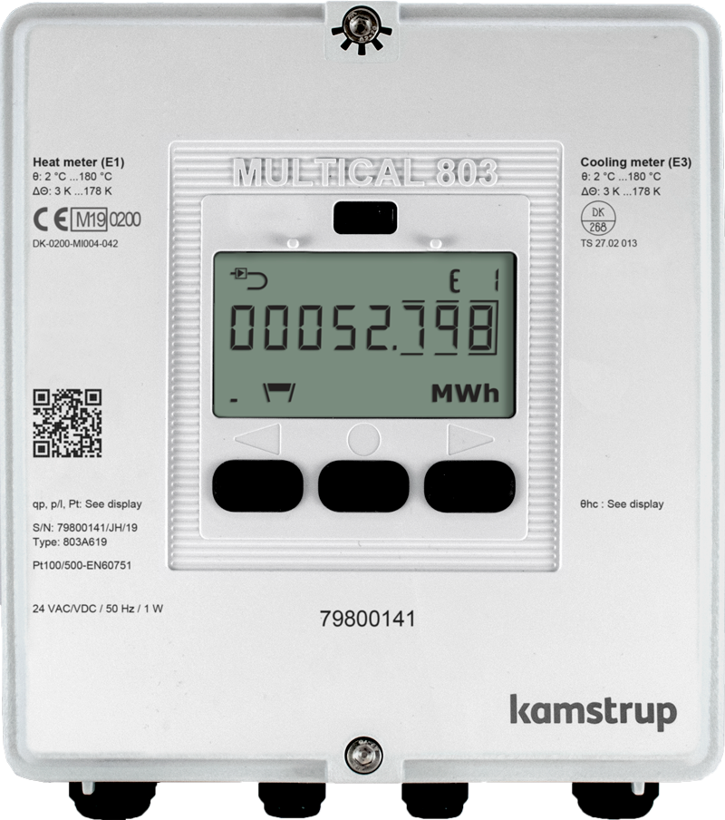
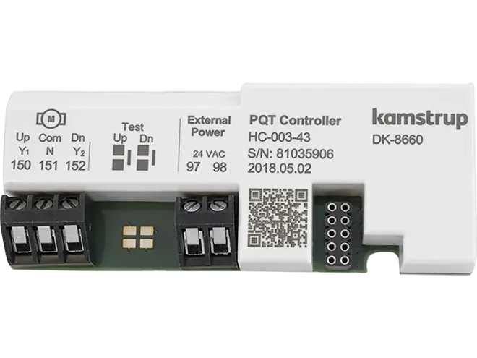
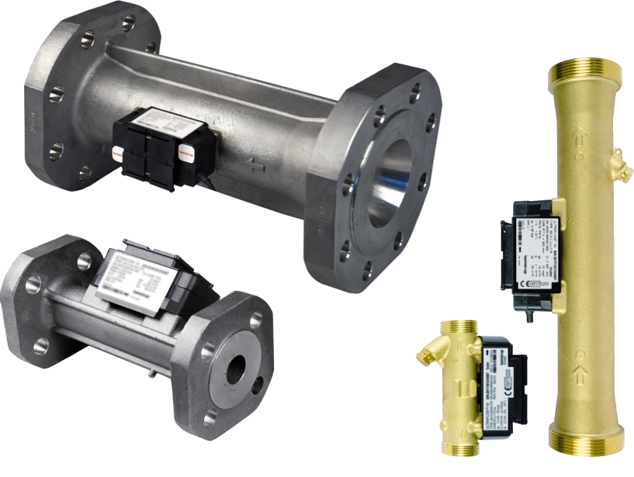
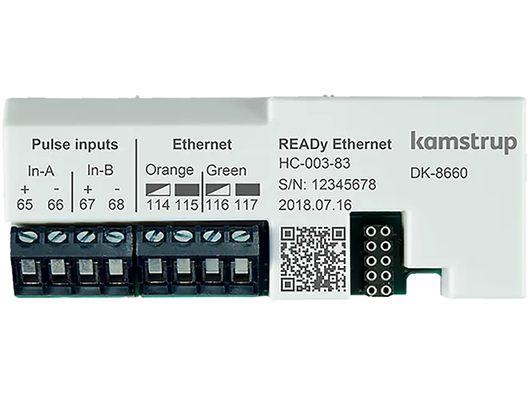
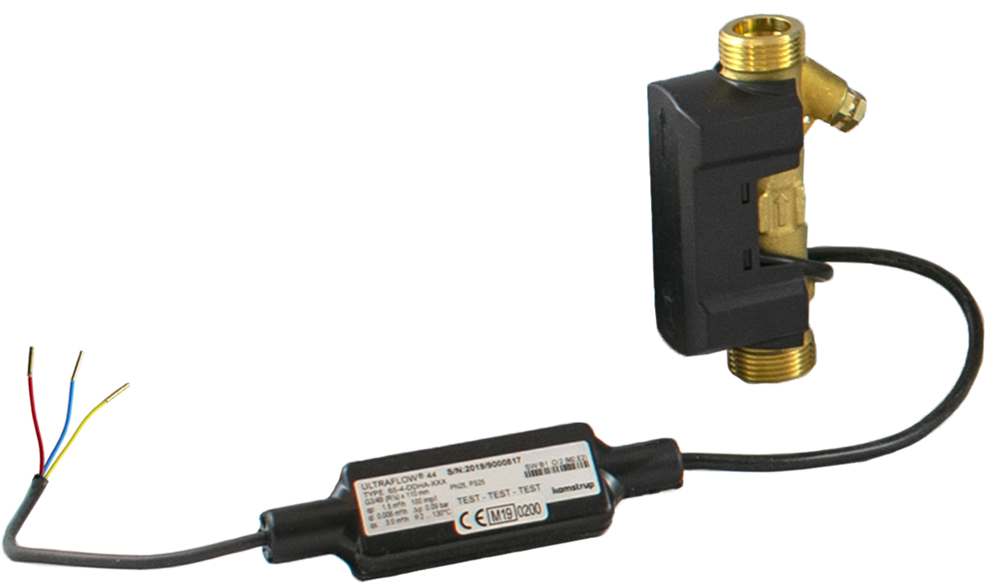
Thermal energy meters
Complete
MULTICAL® 303
Compact
Comm.
Modules
Temperature sensor sets
MULTICAL® 403
Combined
ULTRAFLOW® 44/54
MULTICAL® 603
MULTICAL® 803

Slide 6
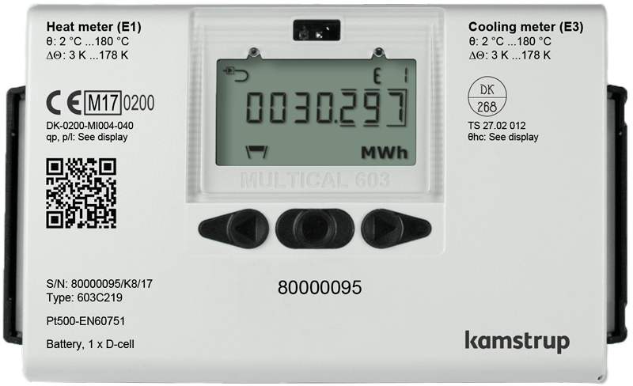
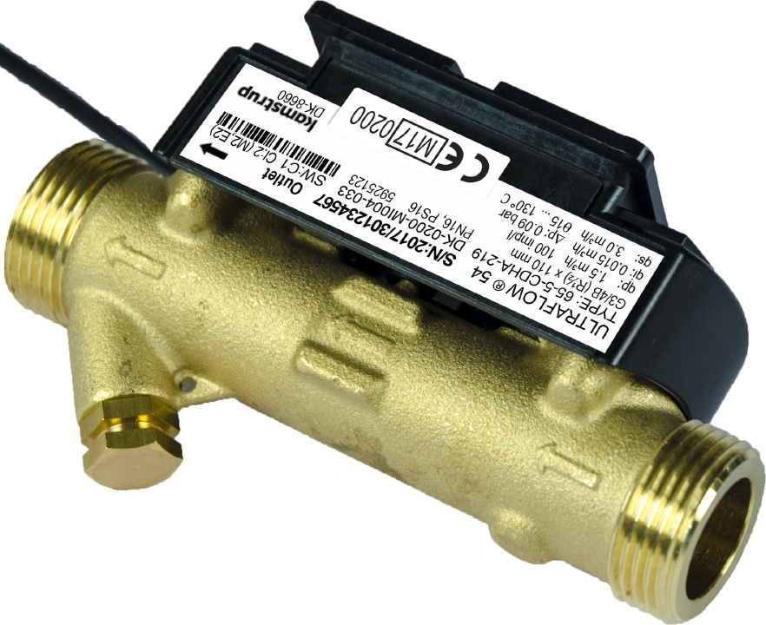
Thermal energy meter - How does it work?
An energy meter (heat or cooling) consists of 3 main parts:
V = volume of heat conveying fluid (at temperature θ_{q})
ΔΘ = change of temperature due to heat exchange
E = thermal energy
k = heat coefficient
Flow sensor (based on Ultrasound-Technology)
Temperature sensor pair (Platinum resistors)
Calculator
E = V · ΔΘ · k
Notes:
Range of sizes 15mm – 300mm
Temp sensors lengths

Slide 7
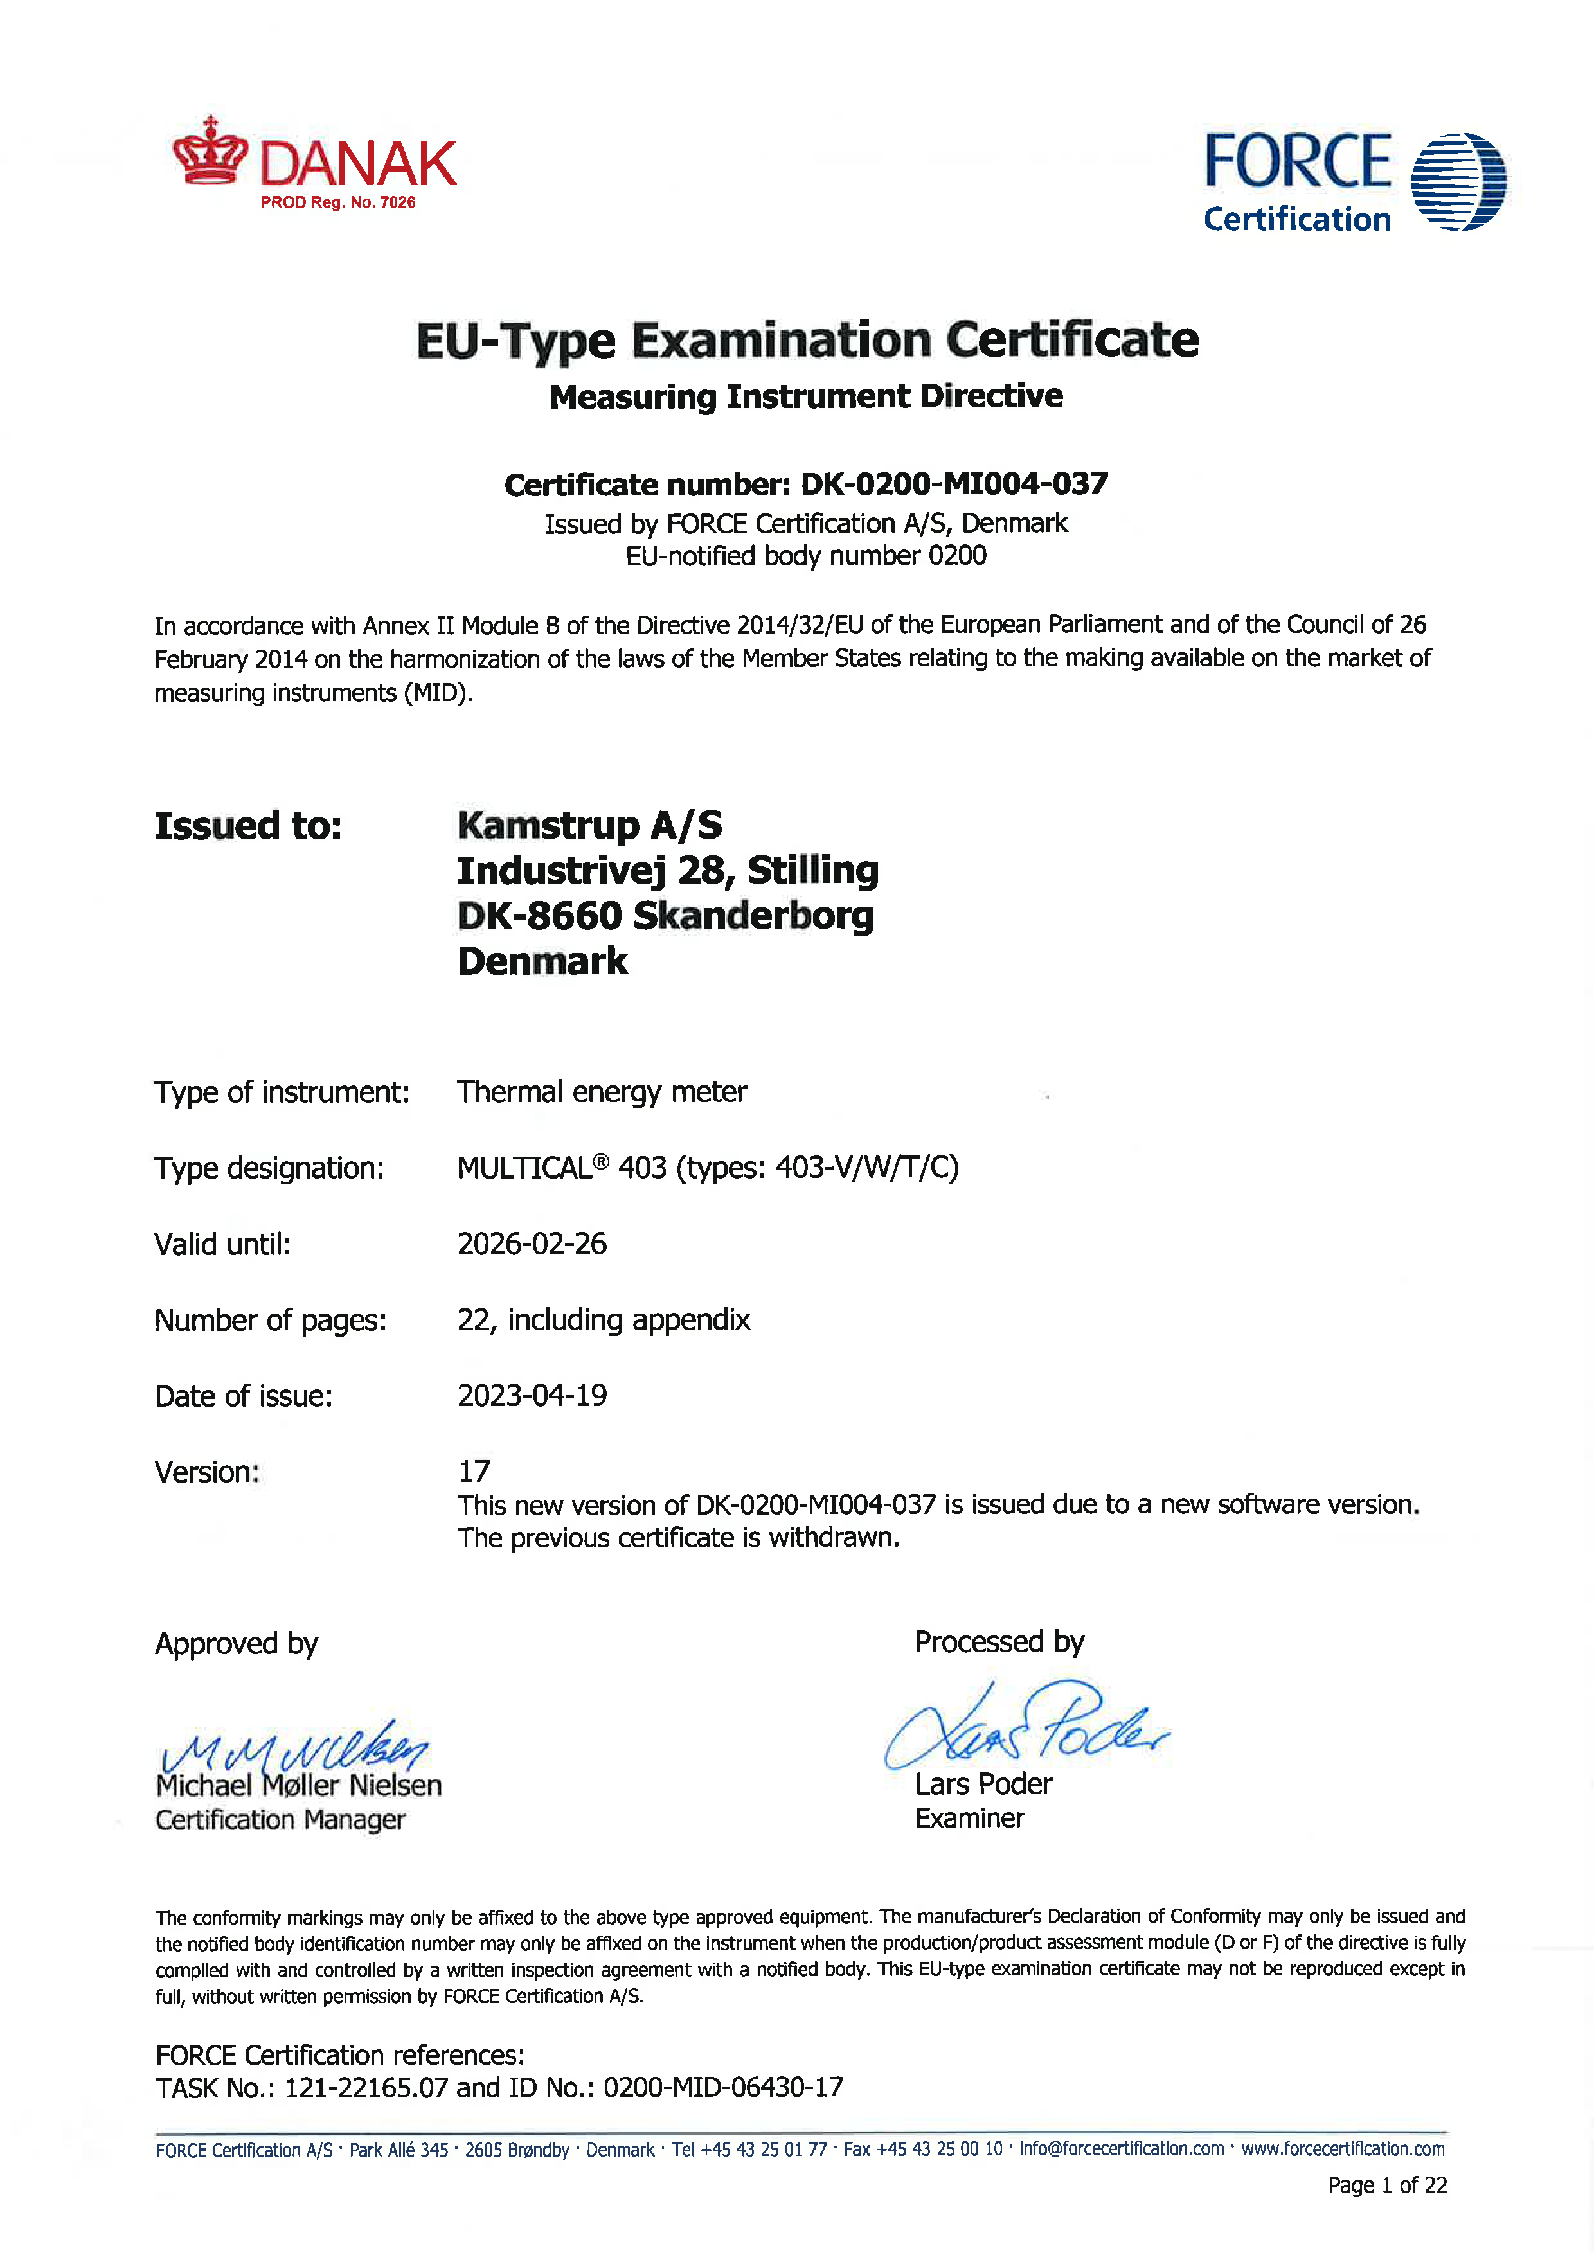
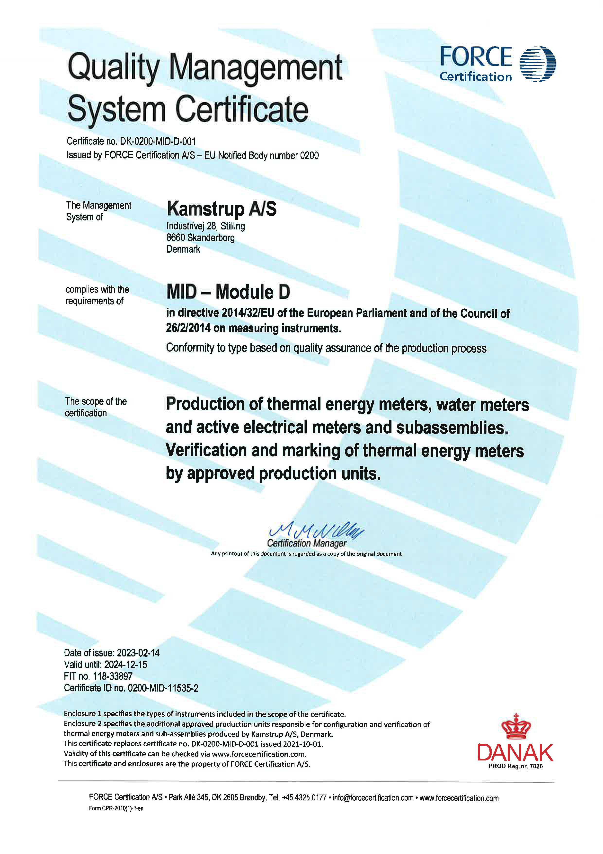
Thermal energy meter - Legal metrology, heat
Approved according to Measuring Instrument Directive 2014/32/EU (MID), Modul B and D – MID004
BS EN 1434:2022 - Heat meters to comply with revision to the EN1434 - British & European Standard
Notes:
British Standards Document - BS EN 1434-1
Thermal energy meters. General requirements

Slide 8
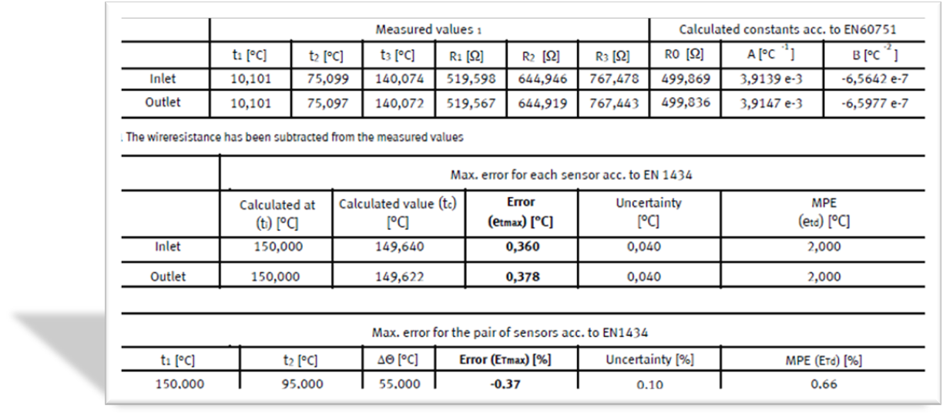
Calibration certificates

Slide 9
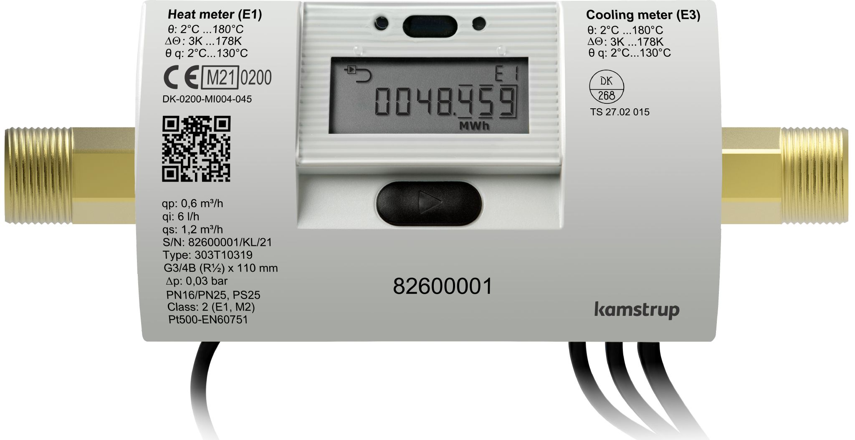
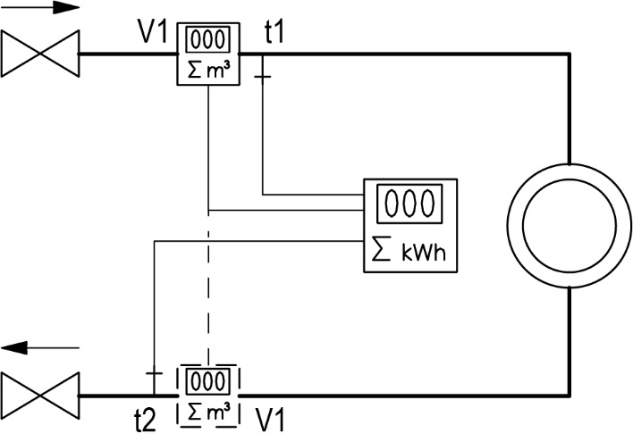
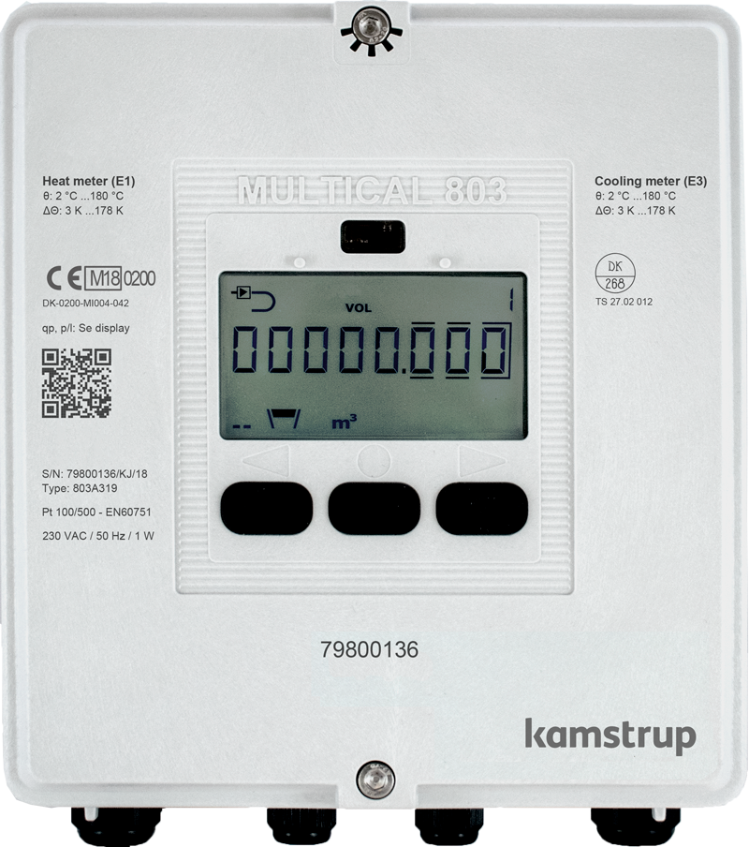
The billing application:
ü
Standard application with one flow sensor, in either inlet or outlet,
and two temperature sensors
ü
ü
ü
Notes:
Most used application = The Billing application

Slide 10
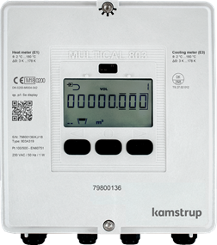
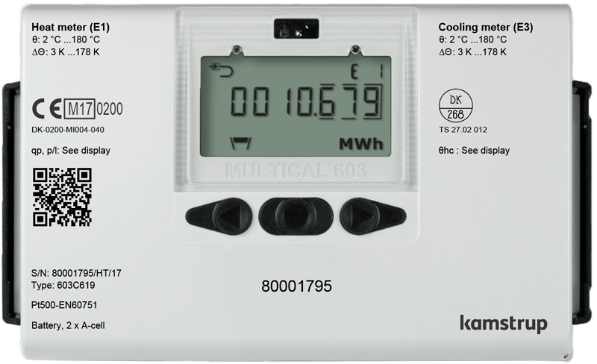
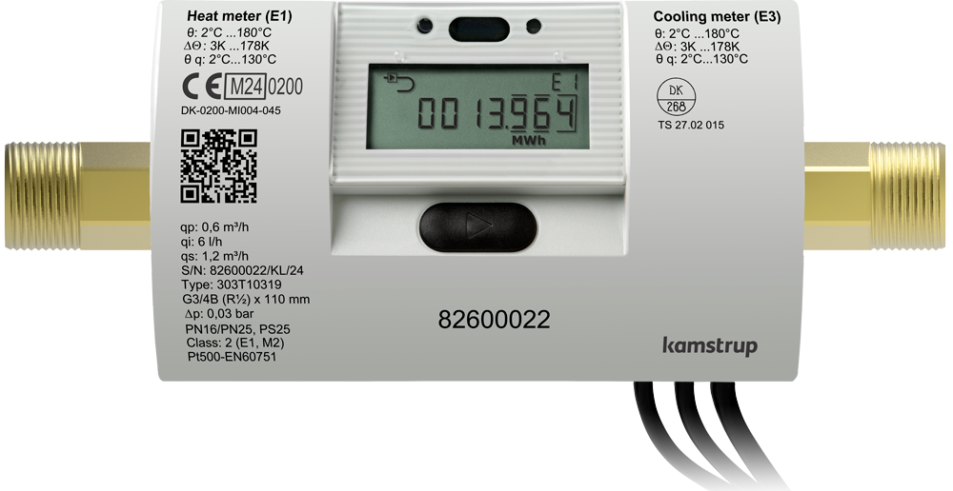
Application sectors
Industrial
MULTICAL® 803
Households
MULTICAL® 603
MULTICAL® 403
Commercial
Submetering residential
MULTICAL® 303
Notes:
Where we normally see our meters being used:
Submetering residential
Commercial (office buildings / schools / hospitals / process units)
Households
Industrial
Important to remember that there are no rules regarding what meters that can be used for what, all meters can be used in all segments.

Slide 11
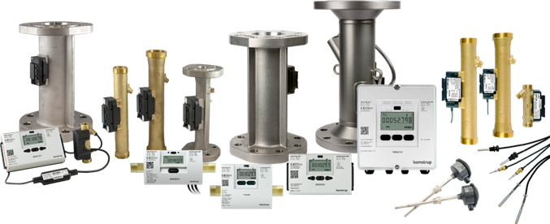
History
Ultrasonic
Mechanical Energy Meters
MID004 Ultrasonic energy meters & components
Notes:
Regulations, benefits etc.
MID, Integrator, flow part, sensors.

Slide 12
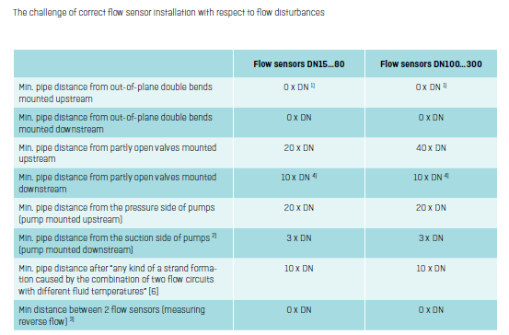
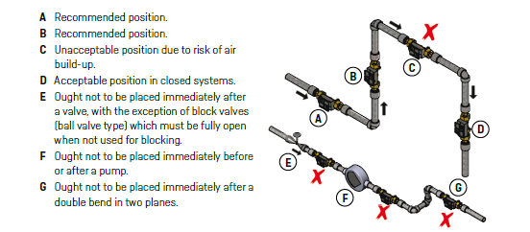
Installation, best practice and common mistakes:
Notes:
Best Practice, Being modfied, achievable norms.

Slide 13
BMS Communication:
Pulsed output
M-Bus
Modbus & BACnet
Wireless communication, M-Bus, LoRaWan

Slide 14
Thank you for your attention!
Connor Garnett
Business Development Manager
UK Metering

