Slide 1
Measuring Performance & Facilities Management
19 June 2025 | Congress Centre, London

Slide 2
Monitoring Programme at Saffron Hill (CIBSE HQ)
We have started our monitoring programme at CIBSE HQ:
Energy/carbon
Indoor environmental quality (IEQ)
Lighting
Heating, cooling, and ventilation
Occupant comfort/feedback
IES Digital Twin
The information we gather will inform “what’s next” for our rolling programme of facility upgrades 2025 - 2027.

Slide 3
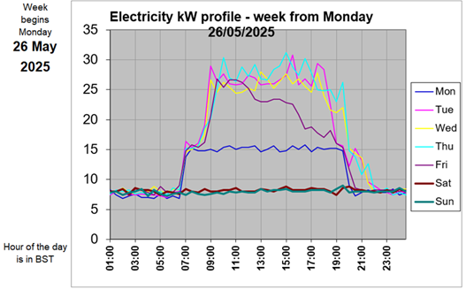
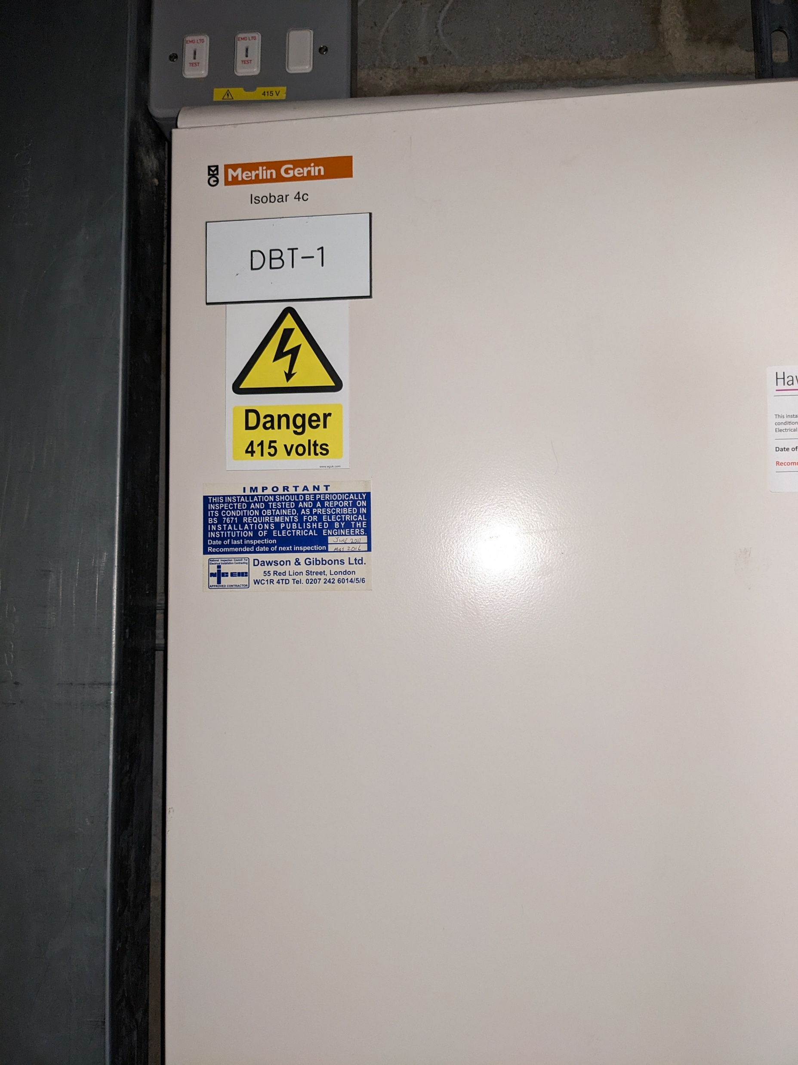
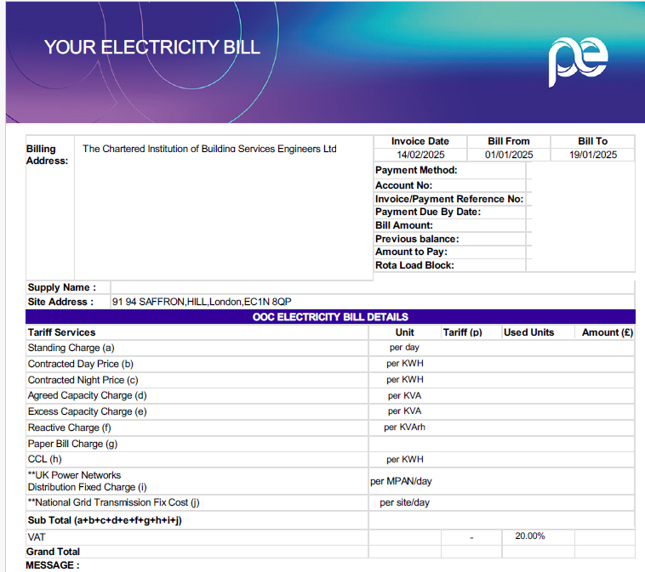
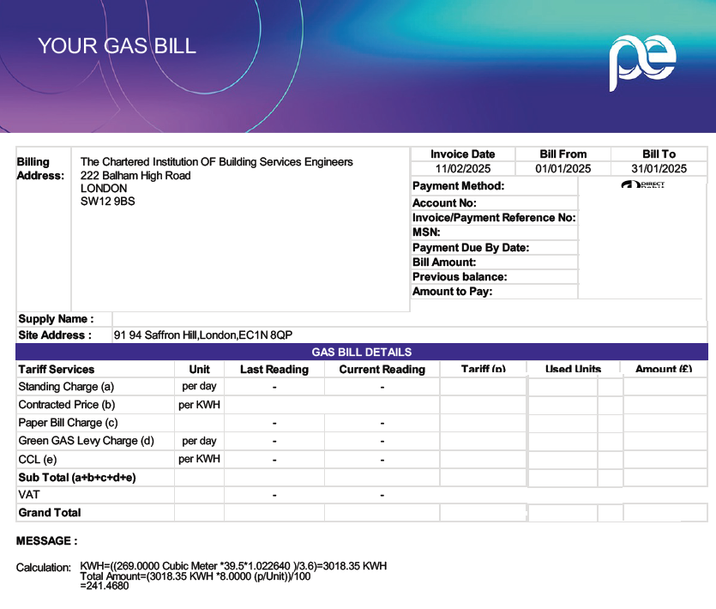
Energy and carbon
Monthly Invoices
“Top Hat” Analysis of Half-Hourly Electricity
Circuit-Level Submetering

Slide 4
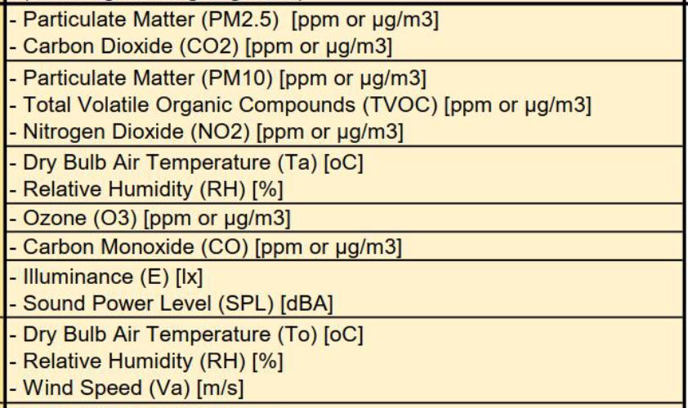
Indoor Environmental Quality (IEQ)
Doctoral student from UCL
Installing temporary IEQ logging equipment inside the building
Temp, RH and wind speed loggers on our roof

Slide 5
Lighting
Inherited our lighting from the previous building owner’s 2010 fitout.
Programme to upgrade – 2026/27.
Taking hand-held readings “lux on the working plane”.
Most areas are consistently achieving > 300 lux.
A few spots were below 300 lux during the winter - legacy LED retrofit by previous building owners is not achieving 300 lux.
Summer with high-level clerestory windows – plenty of daylight.
Before winter arrives - temporary measure - relamping with T5s to improve lux levels.

Slide 6
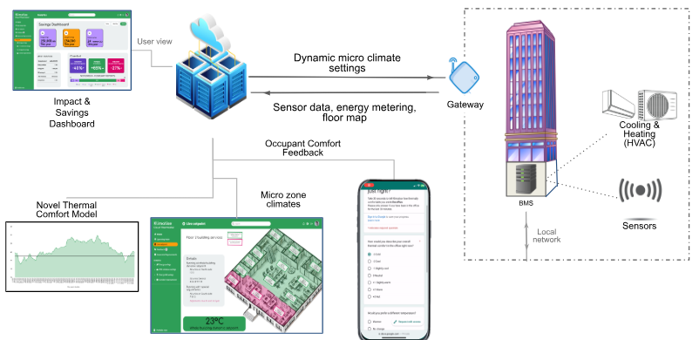
Heating, cooling, and ventilation
Inherited our HVAC equipment from the previous owners.
Programme to upgrade – 2026/27
Digital Thermostat
Interacts with building BMS
Occupant feedback app

Slide 7
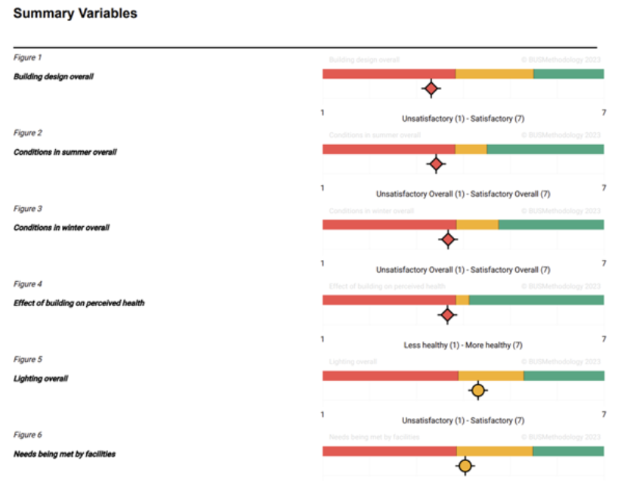
Occupant comfort/feedback
BUS Occupant Survey done in Balham, before the Xmas ’24 move to Saffron Hill in Farringdon.
One year ‘follow-up’ survey scheduled for the end of this year.
Our doctoral student will carry out a ‘mid-way’ snapshot survey using the BUS Survey student licence.
Not fully comparable with the commercial version, but still useful to get summer feedback.

Slide 8
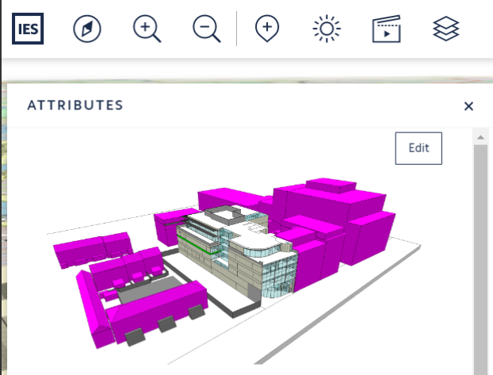
IES Digital Twin
A member of the Young Energy Performance Group (YEPG) will lead the creation of an IES Digital Twin of the CIBSE HQ building.
Start with the upper office floors.
Allow us to explore the effect of both FM and occupant behaviour, such as opening windows.

Slide 9
Measuring Performance & Facilities Management
Any questions?

