Slide 1
Importance of Considering Operation and Maintenance at Design

Slide 2
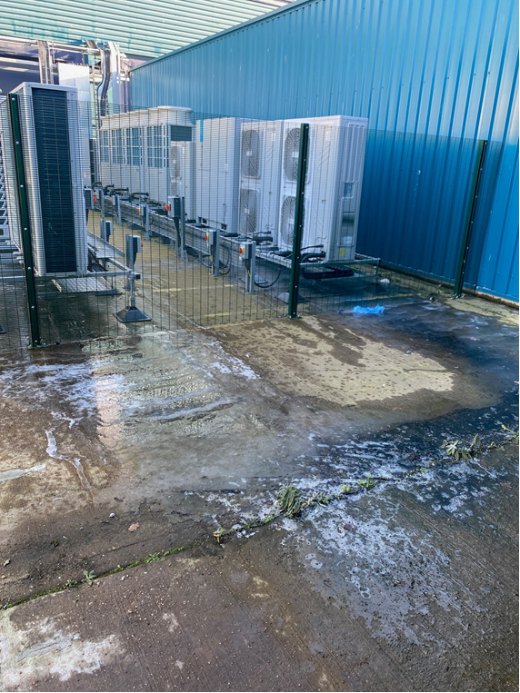
Water / Ice
External A/C condensers drainage
More cooling needed, added 2 external compounds
Problem:
Condensate would be discharged onto the ground (a concrete slab that had a camber) with drainage about 25 meters away.
Operations issue:
25 meters across walkways and disabled parking bays. Winter turned the space into an ice rink.
FM Fix:
Cordon off the area, install drains

Slide 3
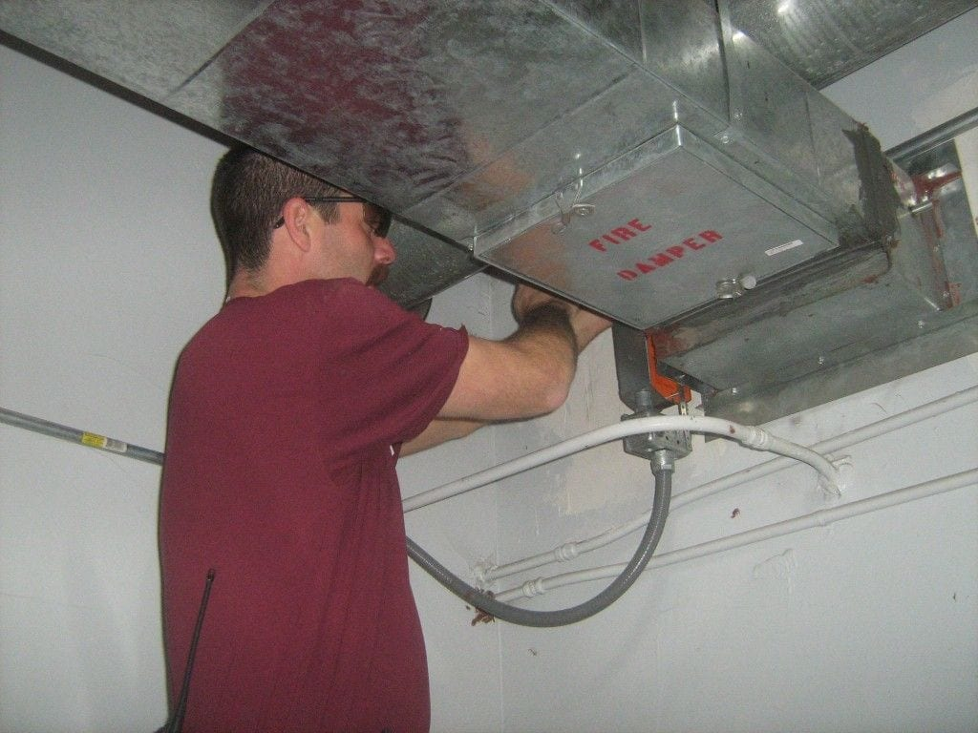
Fire Dampers in Ductwork
Problem:
Ventilation ductwork contractor not installing access panels for fire damper maintenance
Operations issue:
Fire damper maintenance is a statutory task which can’t be done without access.
Cutting access panels in operational ductwork requires out of hours working and shutdown of the plant.
In a 24x7 operational Hospital getting a shutdown adds pressure our NHS doesn’t need.
FM Fix:
Work in the early hours of the morning when the services will be least impacted.

Slide 4
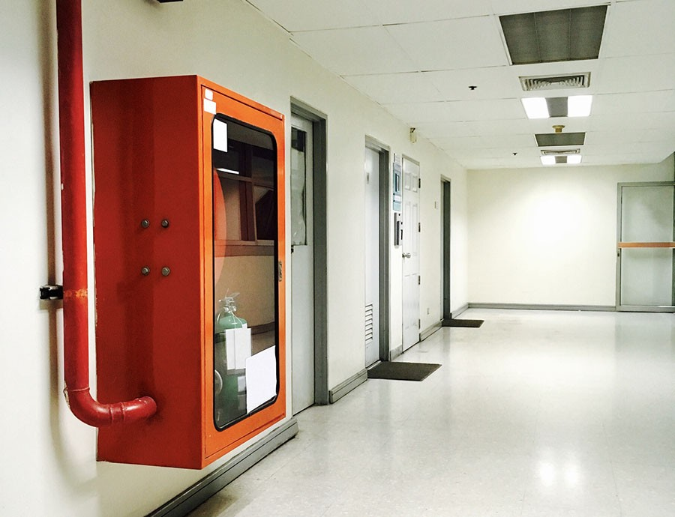
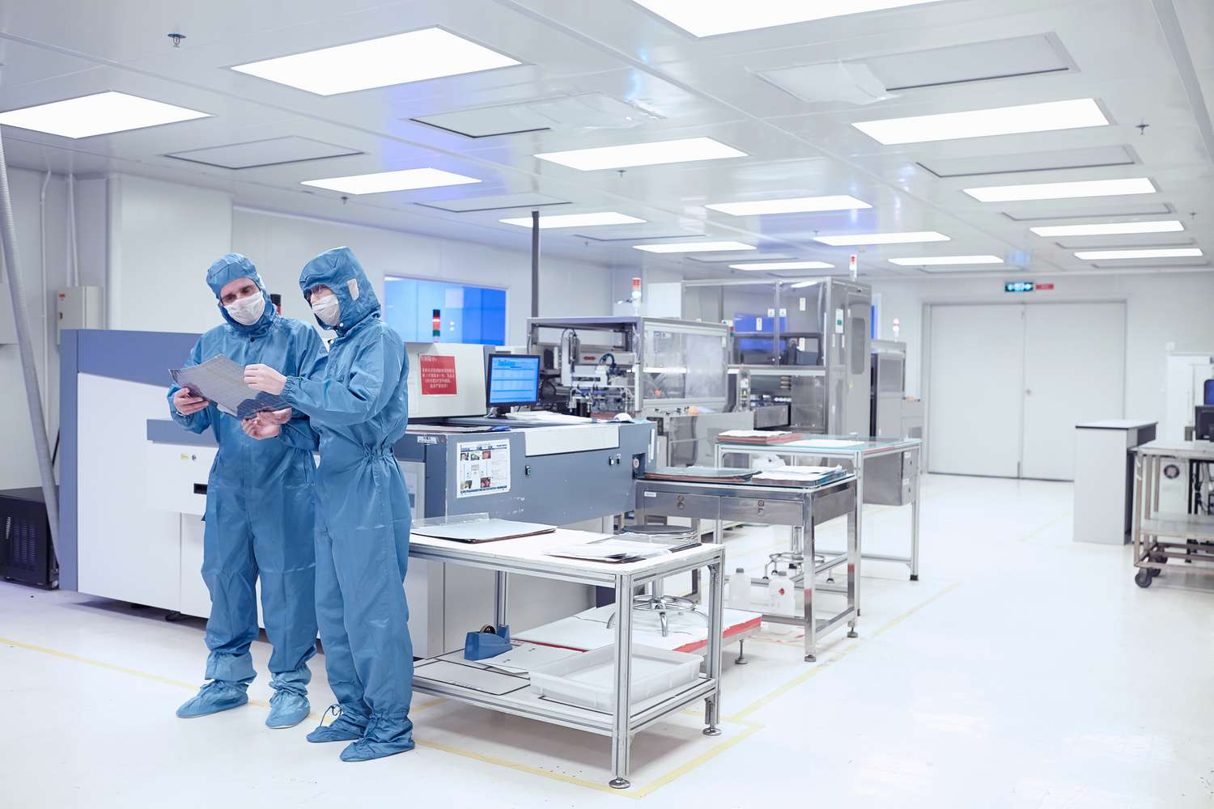
Fire Hose Reels
Problem:
5-year pressure and flow tests, in accordance with IS EN 671 standards
Operations issue:
The hose reels are a minimum of 15 meters in length, meaning they would extend across operational spaces, creating potential trip hazards, risk of water spillage which could cause damage.’
FM Fix:
Intermediate Bulk Container (IBC) for each hose flow test. The IBC wheeled to the reel, and the hose could be flow-tested without needing to be fully unspooled.
The hose would be emptied, removed, and stacked onto the IBC.
A newly manufactured and pre-tested tube would be supplied and installed, providing an additional five years before the next test.
Donate old hoses

Slide 5
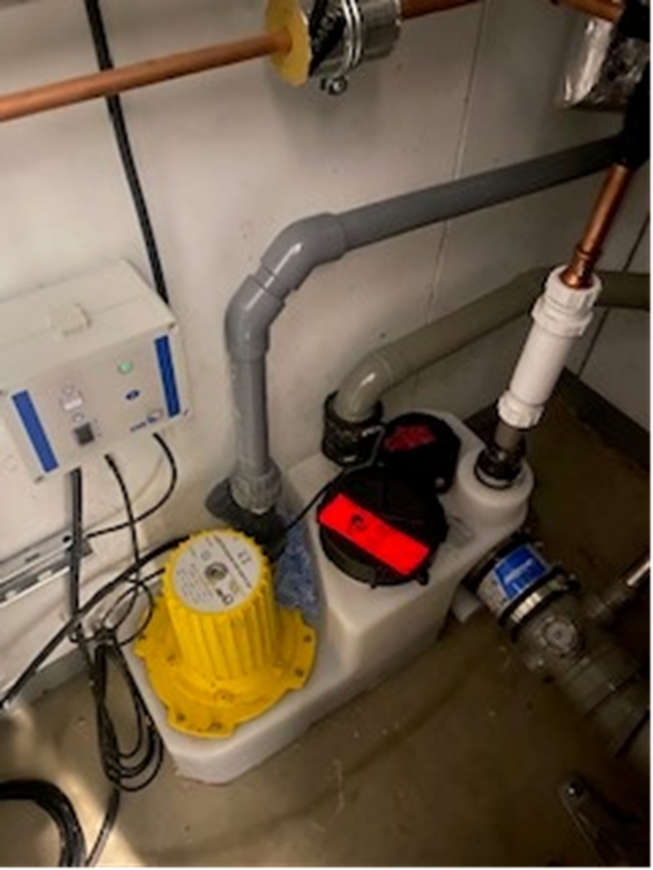
Toilet
Problem:
Building was a warehouse, instruction from the landlord was to protect the concrete slab and only break if necessary.
Operations issue:
No. of toilets required for 1,000 workers
Macerators and pump all waste upwards, then gravity feed to the edge of the building and then out into the original waste pipes.
FM Fix:
No isolation valves were installed past the macerator so if they failed, 3 meters of vertical pipe full needed to be drained (engineers needed to be trained in biological spills and conduct the maintenance in full sealed biological suits).
Construction said they built to specification, when asked for their maintenance plan they conceded and said they would retrospectively fit valves

Slide 6
Summary
1. CHECK IF DESIGN CAN BE OPERATED: (AC Compound)
- Embed maintenance thinking from inception to post-occupancy.
- Reality-check systems for usability and maintainability.
2. Access and Usability: (Macerators, Fire Dampers)
- Ensure systems are accessible for maintenance.
- Avoid future disruption and cost by strategic placement.
3. Asset Replacement Planning: (Fire hose reel)
- Consider decommissioning and replacement during design.
- Develop method statements and include in health and safety file.
5

