Slide 1
Measuring Performance & Facilities Management
19 June 2025 | Congress Centre, London

Slide 2
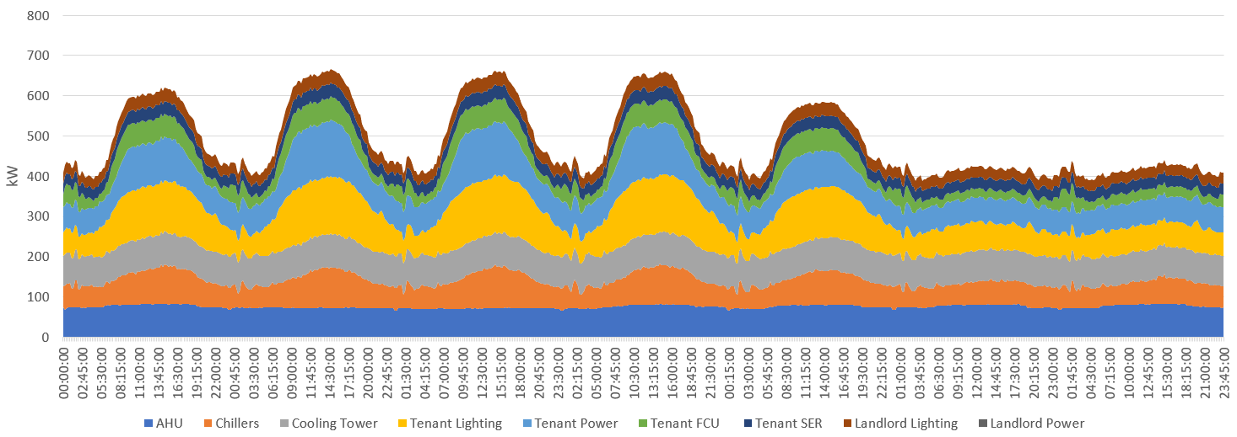
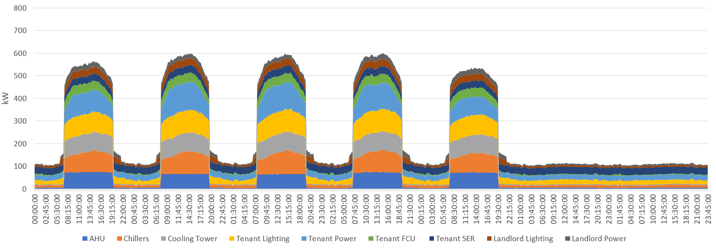
Performance & Pathways
Operational Energy Optimisation
Net Zero Roadmap
Focus on reducing energy, cost and carbon consumption in an asset through no/low CAPEX measures adjusting operation of existing systems.
Full roadmap for asset to meet net zero goals based on energy efficiency and decarbonisation measures.

Slide 3
Optimising Building Performance
5
Monitor Performance
Support Implementation of Measures
Monitor Progress
4
Develop Path Forward
Net Zero Roadmap Scenario
1
Evaluate Current Operation
Site Assessment
Data Collection and Validity
3
Assess Opportunities
Energy-Savings Measures
Onsite Renewables and District Energy
Capital Cost Estimation
Energy and Carbon Savings Calculations
2
Analyse Building Performance
Baseline Performance
Performance Against Benchmarks
Meter Data Analysis

Slide 4
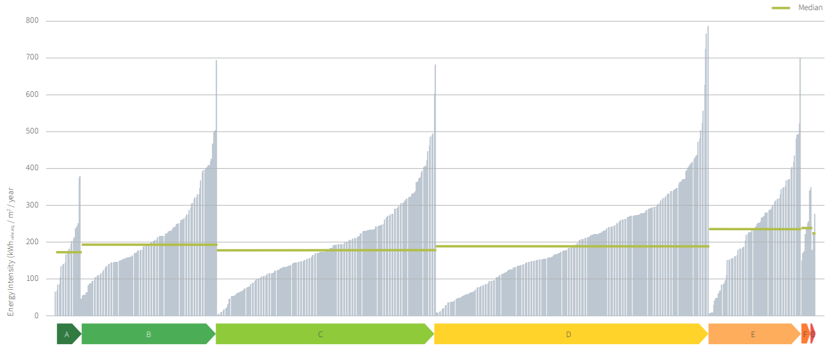
EPCs Alone Don’t Deliver
EPC only assess the specification of plant, not a true representation of performance
Better Building Partnership found no correlation between EPC Band and measured energy performance
EPC doesn’t cover all energy end uses – e.g. excludes plug loads
Simplified assessment methodology
EPC are standardised and don’t cover variance in operation

Slide 5
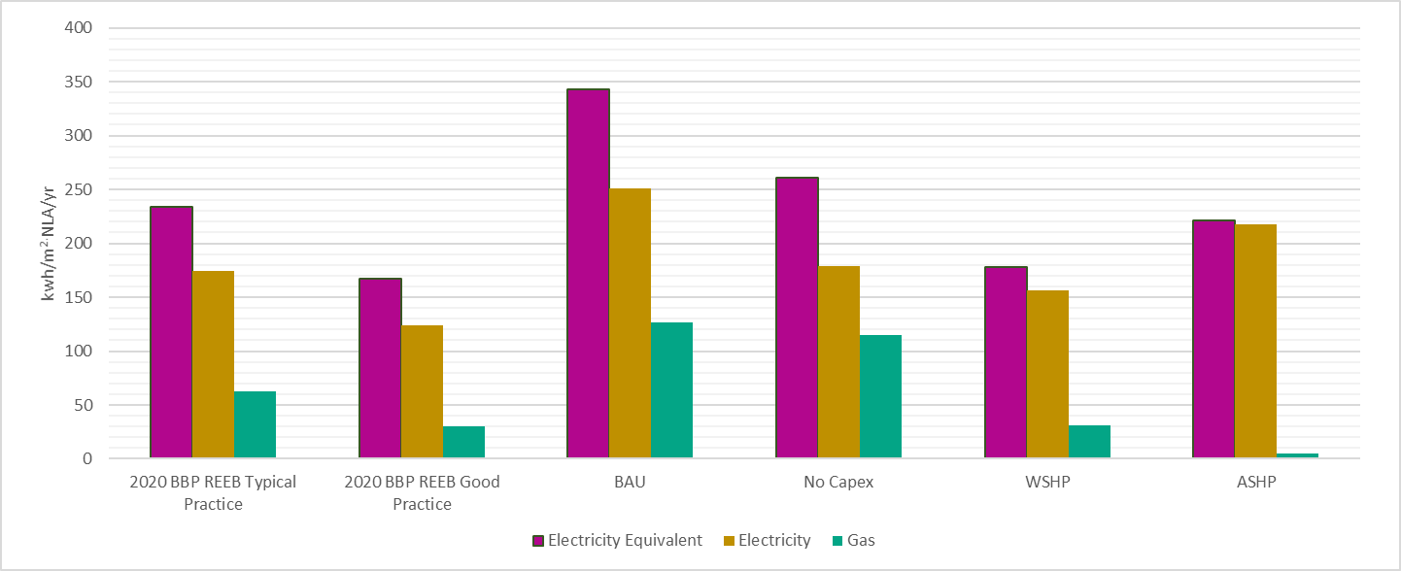
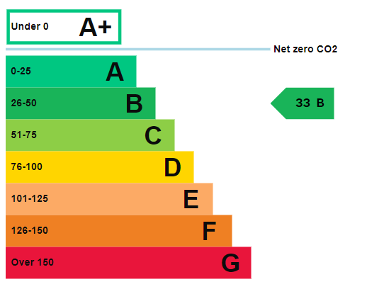
A Case Study
High EPC B
Energy consumption is about 2x industry good practice
We found ~30% savings through optimisation and management
Typical Practice
Good Practice
UKGBC2050 Target

Slide 6
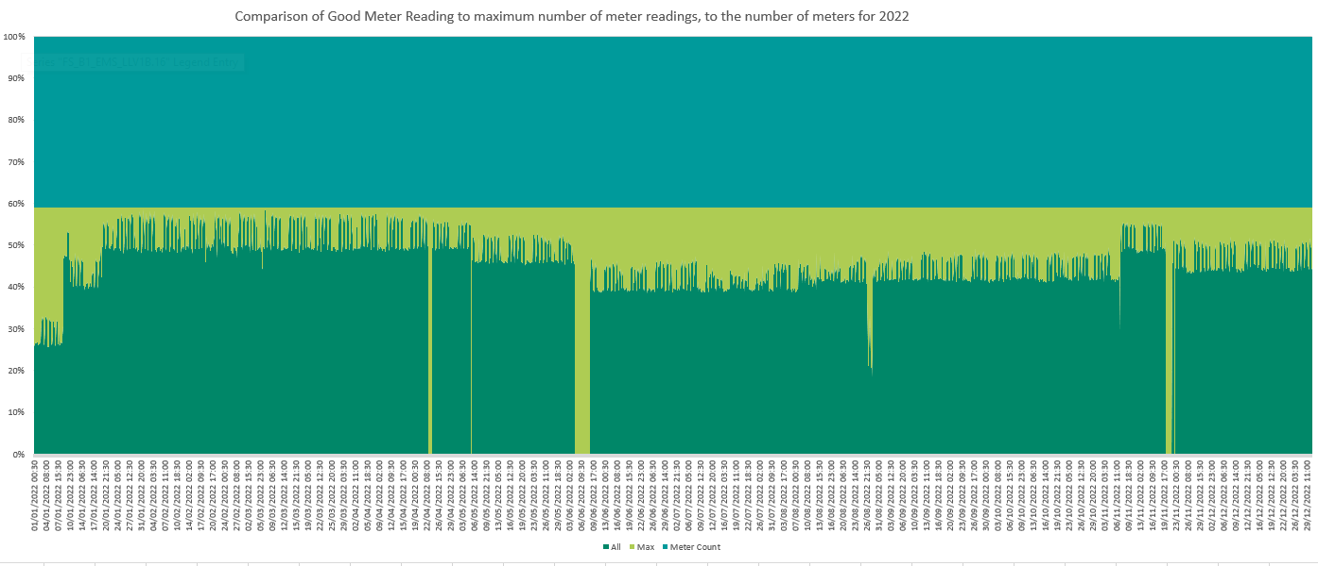
Data Validity
What data do we have?
Monthly utility bills
Manual sub meter readings
Hourly meter readings
Electrical/thermal/water metering
What format is it in?
Raw CSV/SQL formats
Cloud based or locally stored
PDF/hardcopies
Is it any good?
Can it be sum-checked
Have meters had any validation
Are there gaps in the data – the answer is most often YES
Disconnected
Data Drops
Obtained

Slide 7
Data Validity
Lessons learned
Clear meter naming and scheduling
Enhanced meter validation
EMS matches Schedule/As Built info post fitout
Separate mechanical plant on tenant floors from ‘tenant energy’
Space heating: 15.1
Gas: 29.3
Hot water: 13.9
Total Site Energy: 100.3
Space cooling: 20.6
Pumps: 10.0
Electricity: 70.7
Ventilation: 11.5
Lighting: 6.9
Small power: 5.1
Other plant: 0.5
Servers: 11.8
Catering: 3.5
Other/Remainder: 1.4

Slide 8
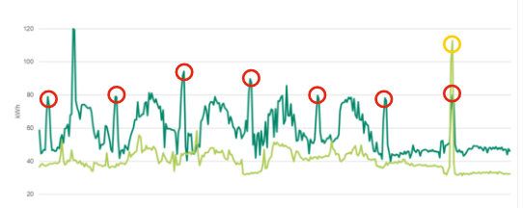
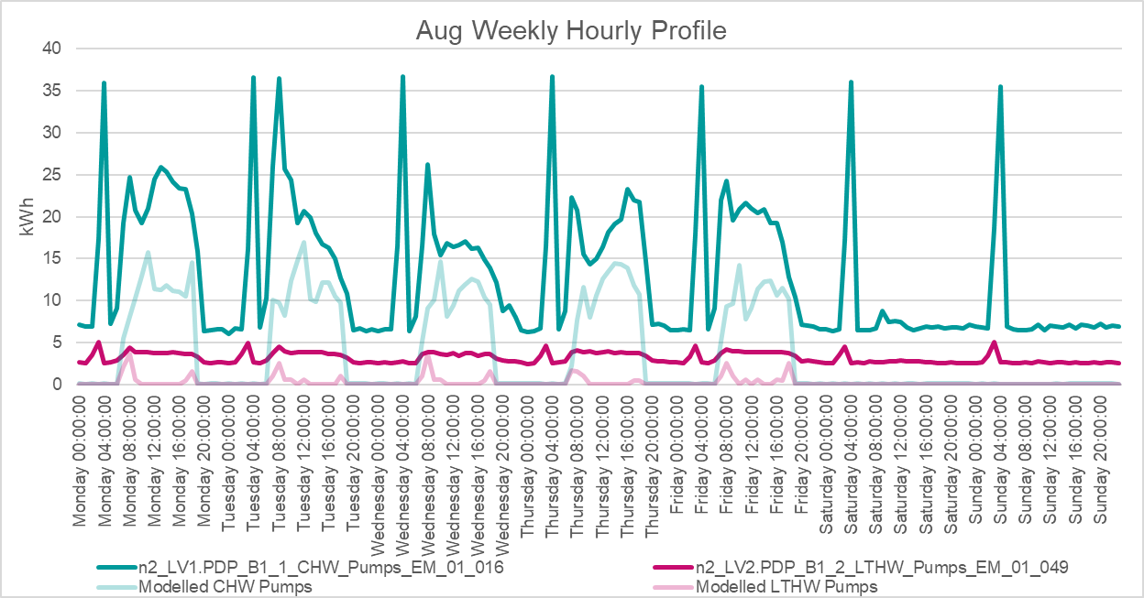
Pumps Controls
Lessons learned
Ensure pump controls include out of hours scheduling
Split 24/7 circuits from core hours
Valve Exercises regimes to 1 per week or less
Extended pump operation may indicate other control issues
Jockey/low load pump configuration
Valve Exercises regimes
Typical Pump Profiles vs Reality

Slide 9
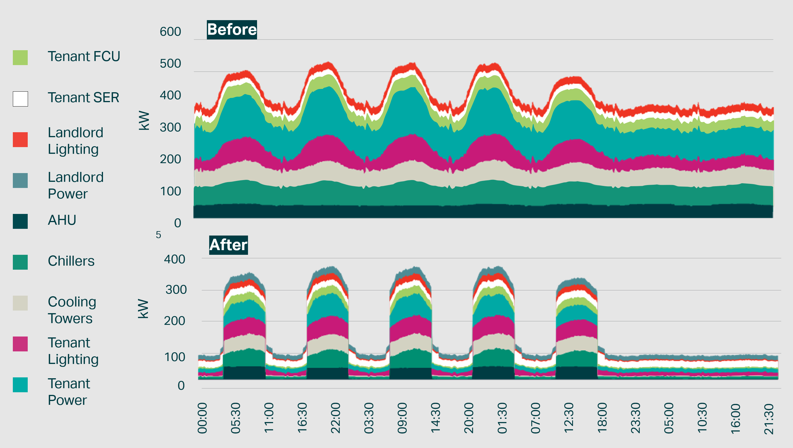
Other Optimisation Opportunities
Lessons learned
Scheduling
Cooling plant set points
Chiller water temperature optimisation
Lighting controls
Zoning/changing occupancy patterns
Design set points
Oversight of tenant overrides from BMS

Slide 10
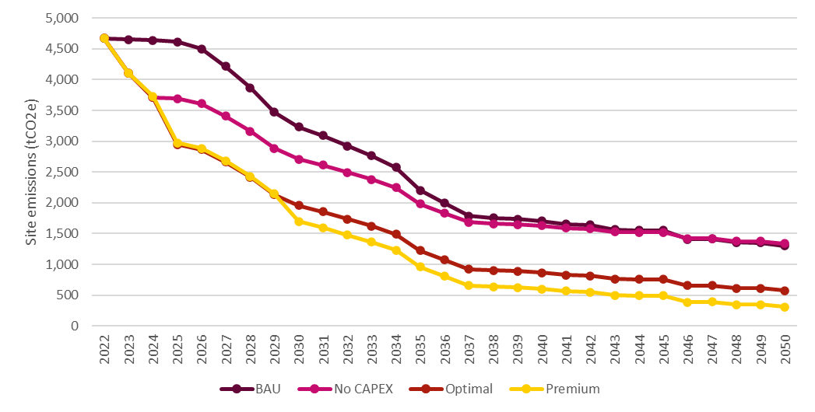
Aligning with Planned Maintenance
Strategic approach for maintaining equipment and systems
Focus on prolonging the life of equipment, ensuring safety, and maintaining operational efficiency.
Our findings aligns with or challenges the scheduled upgrades.
Interventions 01
Interventions 02
Interventions 03

Slide 11
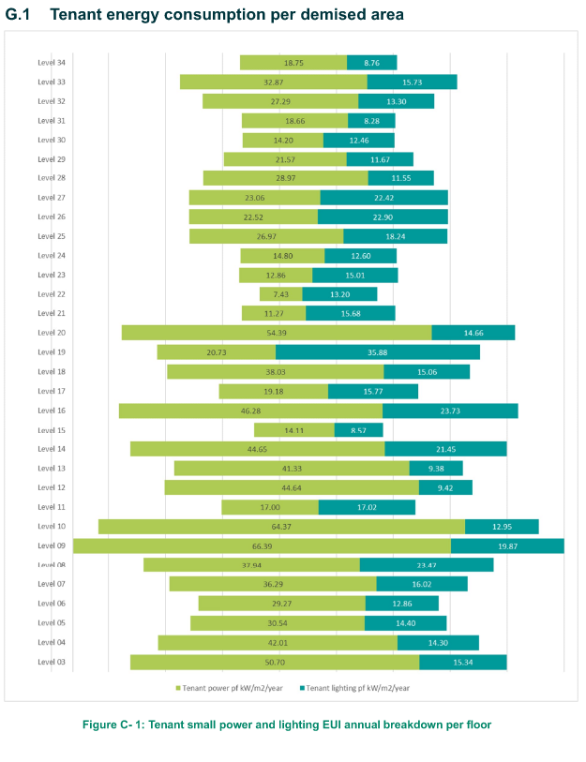
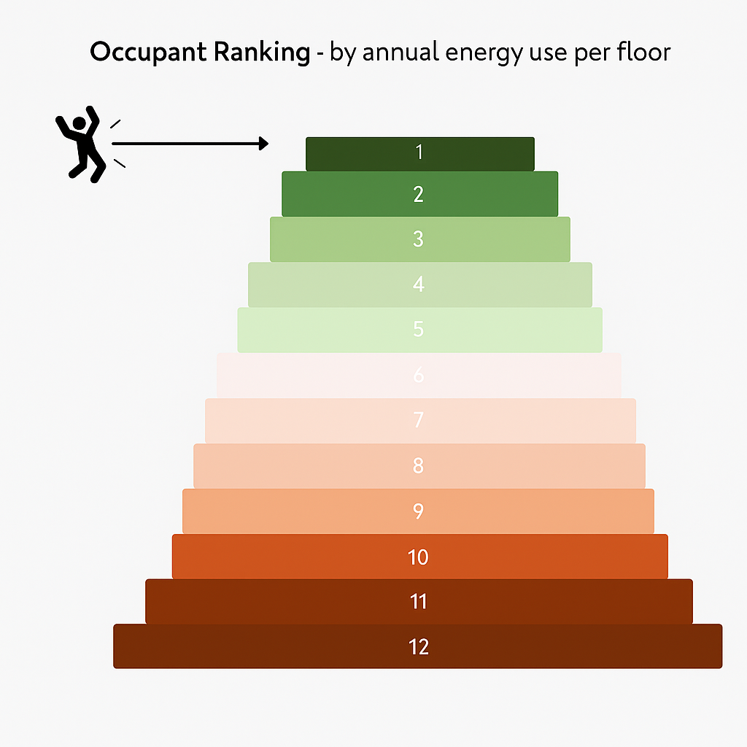
Collaboration in Achieving Building Performance
Consultant
Building Owner
FM Team
Tenants
Site engagement
Ongoing knowledge sharing
Use of tools to enhance operational understanding and data quality
Development of a net-zero strategy
Aligning ESG goals with realistic cost estimates and investment planning.
Active tenant engagement though green lease clauses and shared performance goals
Use of gamification and competition to drive energy awareness
Gamification from energy analysis

Slide 12
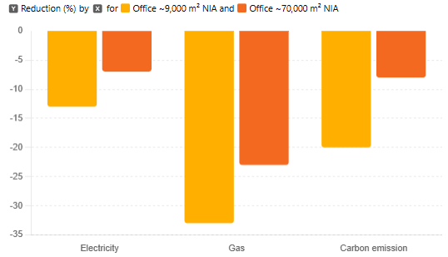
Ongoing Monitoring
Lessons learned
Ensure energy data is accessible
Allow for additional duties of energy monitoring either by client team or appointed consultant/FM provider
Identify persons responsible for actioning monitoring findings
Measured Annual Savings – from operational measures only
-7%
-8%
-13%
-20%
-23%
-33%
...and annual utility bill savings in the six figures

Slide 13
Measuring Performance & Facilities Management
Any questions?

