Slide 1
INTELLIGENT SUSTAINABLE LIVEABLE BUILDINGS FOR THE 21ST CENTURY
DEREK CLEMENTS-CROOME
UNIVERSITY OF READING
INTELLIGENT BUILDINGS INTERNATIONAL
WWW.DEREKCROOME.COM
2024

Slide 2
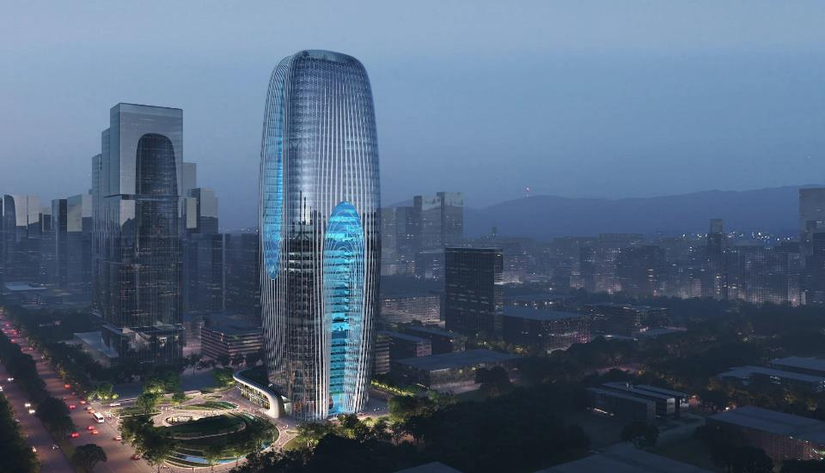
DAXIA PLANT FILLED TOWER XIAN by ZAHA HADID ARCHITECTS 210m

Slide 3
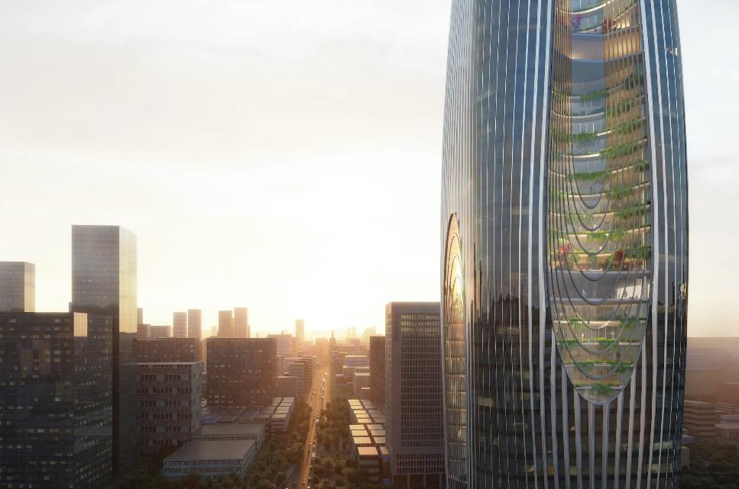

Slide 4
DAXIA TOWER XIAN
Cascades of plant terraces to clean air and promote wellbeing
Views out for all occupants
LEED Gold
Rainwater capture
Solar Panels
Advanced smart measurement systems with analytics

Slide 5
Terminology

Slide 6
ORIGINS and LESSONS for INTELLIGENT BUILDINGS
HISTORY
NATURE
TECHNOLOGY
BUILDINGS FOR HUMANITY

Slide 7
LESSONS FROM HISTORY: VERNACULAR ARCHITECTURE

Slide 8
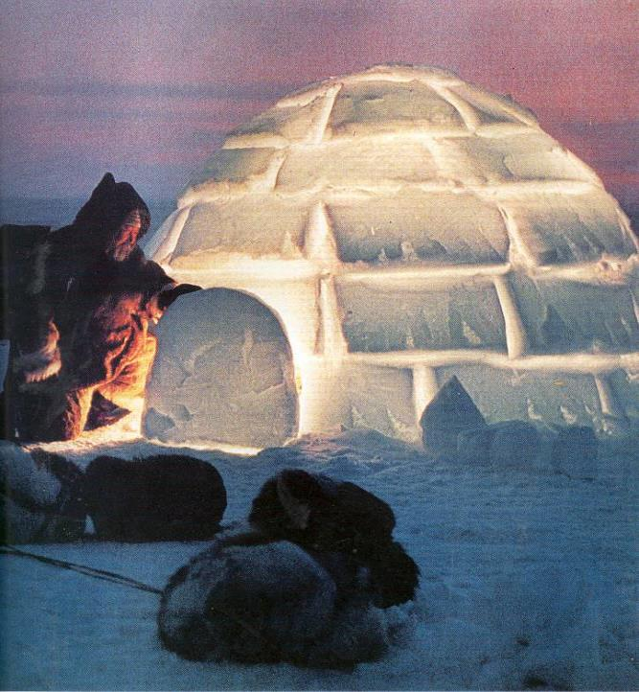
Behling 1996

Slide 9
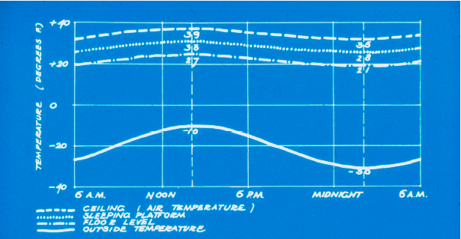
THERMAL PERFORMANCE OF THE IGLOO

Slide 10
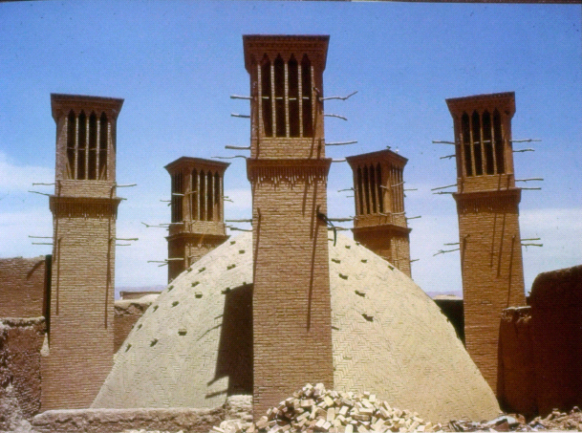
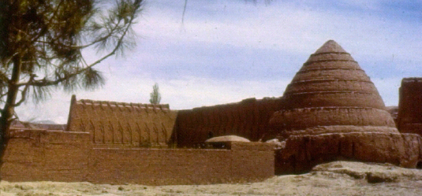
Wind towers in Yazd, Iran to ventilate houses, are also constructed to cool underground cisterns.
Michell 1978
Ice House at Kerman Iran. Ice formed during frosty winter nights in the shallow channels protected from the sun’s rays by the high wall. Its packed between layers of straw in the mud-brick dome.

Slide 11
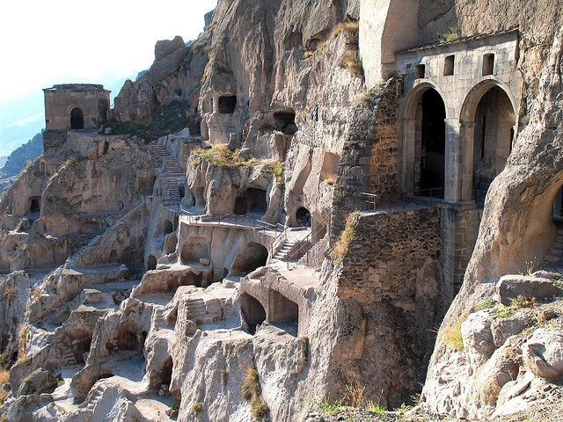

Slide 12
The J.M Tjibaou Cultural Center (Museum of Noumea)
Designed by Renzo Piano (Winner of 1998 Pritzker prize), is a harmonious alliance of modern and traditional Kanak architecture. Traditional thatch huts, native to the Kanak people, inspired the design.
Piano learnt from local culture, buildings and Nature. Tall thin curved laminated iroko wood ribbed structures supported by steel ties resist cyclones and earthquakes. The ribs have horizontal slats which allow passive environmental control to occur. The slats open and close according to wind strength and direction and admit air to a cavity which is linked to the glazed façade of the museum.

Slide 13
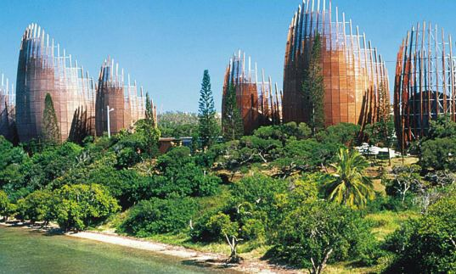

Slide 14
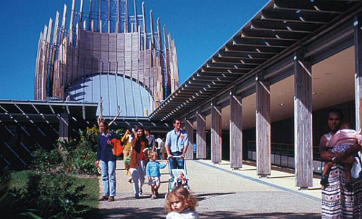

Slide 15
Buildings, Environment & People
Occupant
Internal environment
Building
External environment
Observer / passer by

Slide 16
Integration
People
Product
(Systems)
Process

Slide 17
INTEGRATING ?
WHAT?
IDEAS
VISIONS
STRATEGY
TACTICS
HOW?
HISTORY/ NATURE/TECHNOLOGY
PROCESSES
DISCIPLINES WTHIN and WITHOUT

Slide 18
Sustainable Design
Adds Value

Slide 19
LEED Rated Buildings
cost 6% more to build; but with integrated design maybe 0%
have occupancy rates over 4% higher;
command 2-6% higher rents;
save 10-50% in energy consumption;
decreased operating costs;
increased building value 10% in 2008
Hirigoyen (2009) ;Bernstein and Russo (2010)

Slide 20
PEOPLE

Slide 21
DESIGN
Humanity
Utility and
Sensory Beauty

Slide 22
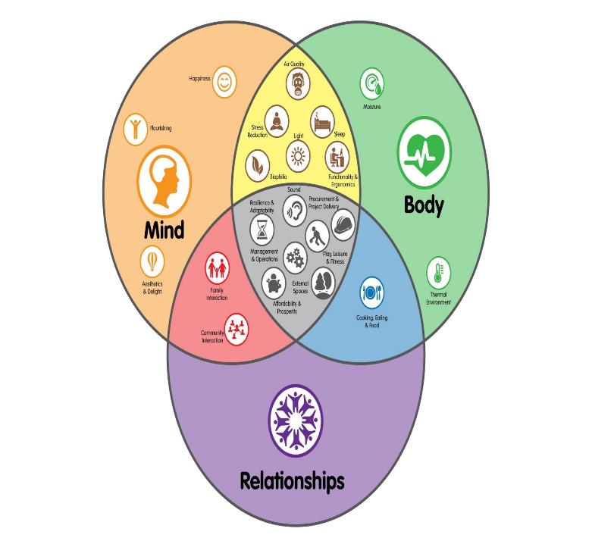
MIND and BODY

Slide 23
WELL STANDARD v2 2018
BASED ON US INPUTS FROM STAKEHOLDERS AND MEDICS
AIR
WATER
LIGHT
COMFORT
MIND
SOUND
MATERIALS
COMMUNITY
NOURISHMENT
FITNESS

Slide 24
Impact of WELL Certified Buildings
See paper by Nasim Ildiri et al., in Journal Building and Environment vol 224, 2022, 109539, doi: 10.1016
Improves health and wellbeing
1300 POE responses

Slide 25
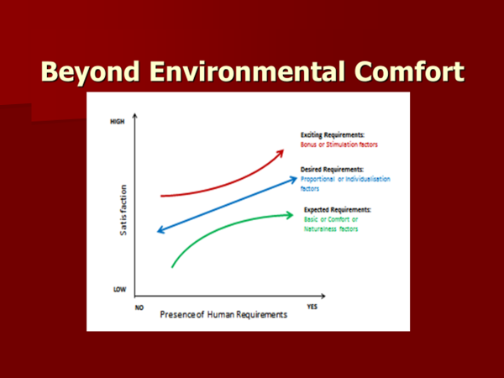
Beyond Environmental Comfort
Clements-Croome 2020 Designing Buildings for People

Slide 27
Care
of People
Leaner and Fresher
Environments
Saves Energy
Greener

Slide 28
LESSONS FROM NATURE

Slide 29
Characteristics of Nature
Benyus (2002)
runs on sunlight;
uses only the energy it needs;
fits form to function;
recycles;
rewards cooperation;
banks on diversity;
demands local expertise;
realises the power of limits.

Slide 30
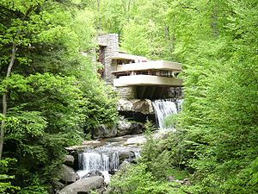
Organic Architecture
Organic architecture promotes harmony between human habitation and the natural world through design. Sympathetic and integrated into its site so that buildings, furnishings, and surroundings become part of a unified, interrelated composition.
Fallingwater by Frank Lloyd Wright

Slide 31
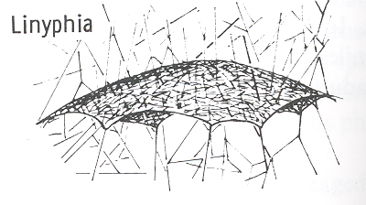
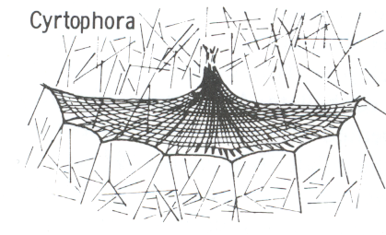
SPIDERS WEBS

Slide 32
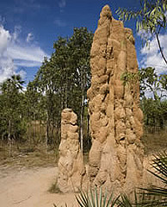
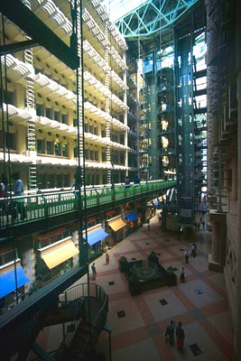
Eastgate Office Building in Harare Zimbabwe inspired by termites nest

Slide 33
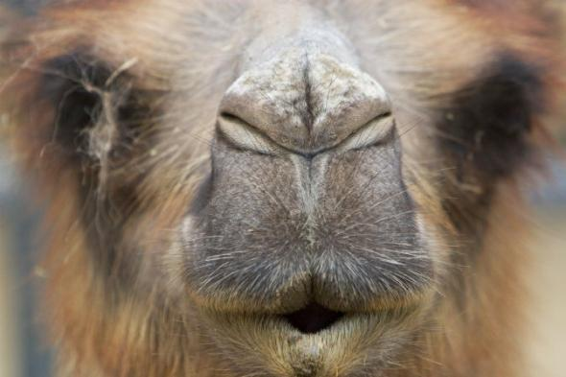
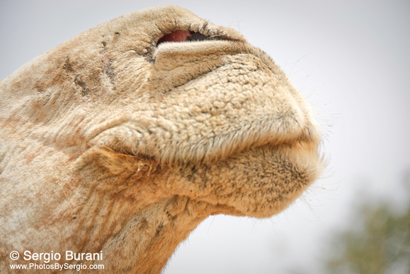

Slide 34
The camel's nose acts as both a humidifier and a dehumidifier with every breathing cycle.
The hot, dry air that is inhaled passes over the large area of moist membrane. This air is immediately humidified by picking up moisture from the nose and cooled in the process,. This cooler air passes to the lungs and remains at approximately body temperature.
When it is exhaled, it is cooled even further by passing over the same nasal membranes, this time by a process of dehumidifying instead of humidifying. The nasal membranes are coated with a special water-absorbing substance that extracts the moisture from the air like the cooling coils of a dehumidifier.
A net savings of 68 percent in the water usually lost through respiration occurs just between the cooling and drying phases of the breathing cycle.

Slide 35
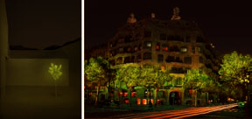
Alberto Estévez’s Bioluminescent Tree
Experiments in bio-illumination with implications for architecture, industrial and environmental design.
Dollens, 2005,Design Biomimetics: An Inquiry and Proposal for Architecture and Industrial Design

Slide 36
Benefits of Biophilia
Increased physical activity
Reducing harmful exposures,
Increases social engagement
Improves mental health
Off-sets Heat Island Effect
Green landscaping may help climate change in regards CO2, temperature……
Green vegetation associated with decreased mortality (Harris et al Harvard 2016)
Nature enhances health and wellbeing

Slide 37
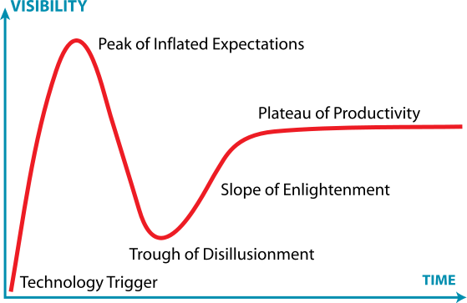
Technology Hype Cycle
New technologies are over hyped by the media and businesses.
A hype cycle is a graphic representation of the maturity, adoption and business application of specific technologies.

Slide 38
Significant Technologies
AI
Robotics (manufacturing and maintenance)
New materials
3D, 4D printing
Virtual and Augmented reality
Internet of Things (eg Wearable technologies)
Biophilic Design

Slide 39
Airconditioning without Electricity
Photonics uses coatings which reflect solar radiation but also emits the infra- red from the inside of the room and thus effects cooling without airconditioning.
Multi-layered films of hafnium oxide and silicon dioxide reflect 97% of sunlight at wavelengths of 8—13 micro metres. This results in the temperatures of such film coated surfaces being about 5 deg C below other surfaces. Cooling power is about 40W/m2
(Nature 27 November 27 2014 volume 515 page 541 by A P Raman et al.,Stanford University).

Slide 40
GRAPHENE
Carbon atomic scale honeycomb lattice
Lightest strongest and stiffest substance known
Can self-repair
Many applications
Look our for Phospherine

Slide 41

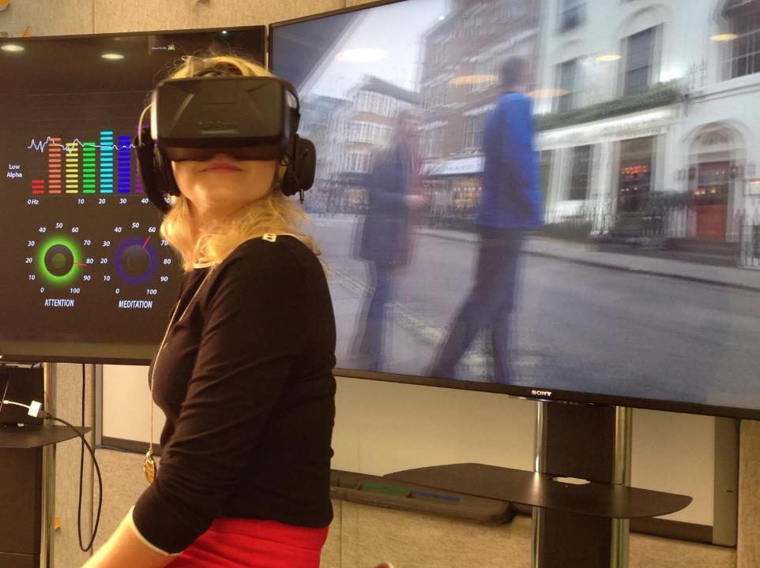
Oculus Rift & Mindwave
Notes:
Image: Arup Associate © So Hyun
Reference:
http://raconteur.net/business/robots-virtual-reality-and-wearable-tech-set-to-enter-the-workplace
http://www.information-age.com/technology/applications-and-development/123460817/augmented-reality-and-wearable-tech-marriage-made-enterprise

Slide 42
SENSORY WORLD
Embedded Sensors in Buildings, Equipment, Clothing and the Body

Slide 43
CARBON POSITIVE BUILDINGS
Artificial Leaf can generate hydrogen

Slide 44
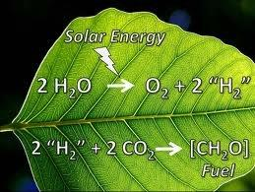
Hydrogen Production in Leaves

Slide 45
Hydrogen Producing Façade
A Water Wall with Artificial Leaves Immersed Within
Sunlight Radiates Causing Reaction
Hydrogen Produced

Slide 46
Case Studies

Slide 47
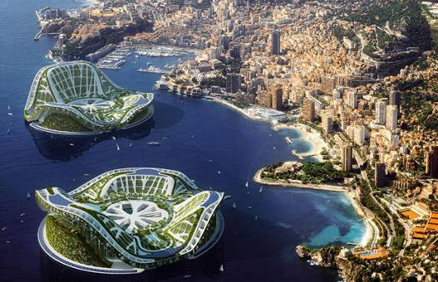
Green Mega City: Lilypads by Vincent Callebaut
http://www.popsci.com/futurecity/plan.html

Slide 48
Green Mega City: Lilypads by Vincent Callebaut
Titanium Dioxide skin to absorb CO2
2 seater electric pod cars
Biodiesel/electric buses guided by embedded road magnets
Footstep energy
Wind turbines using air movement
Hydrogen from an Algae Park
Tidal power from wind from passing car
Solar energy from paint containing solar nanoparticles
http://www.popsci.com/futurecity/plan.html

Slide 49
Green Mega City: Lilypads by Vincent Callebaut
Solar energy from paint containing solar nanoparticles
Clear water from desalination
Robotic maintenance
Bubble Houses
Phase change materials give temperature regulation
Hydroponic farms
Plant water from sewage filtered via zebra mussels
10 storey concrete tower with embedded photovoltaics
Geothermal wells for heating/cooling
http://www.popsci.com/futurecity/plan.html

Slide 50
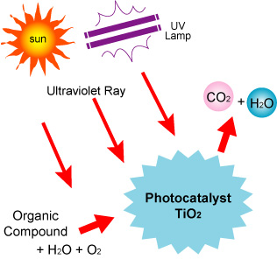
UV PCO
Photocatalytic Oxidation (PCO) or Photocatylisis is the opposite
of photosynthesis.
PCO is a natural process whereby Ultra Violet light energy reacts with the mineral Titanium Dioxide (TiO2), triggering a chemical process that safely and instantly oxidizes or breaks up organic matter at a molecular level.
As a catalyst, TiO2 continues to work and is not consumed in the process.
www.pureti.co.uk

Slide 51
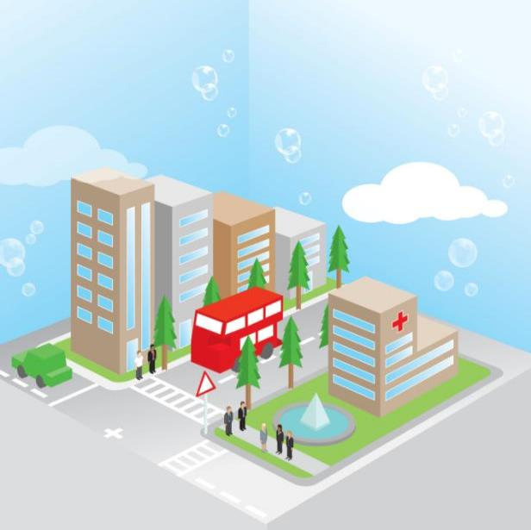
Improving Air Quality
Indoors on windows and lighting
Outdoors on building exteriors,
hardscapes, asphalt and concrete.
PURETi treated surfaces work with nature to purify air quality including:
Volatile Organic Compounds (VOCs)
Smog incorporating NOx and organic Particulate Matter.
Odours from methane – such as tobacco smoke, human and agricultural waste.
Methane / Formaldehyde
www.pureti.co.uk

Slide 52
Phase Change Materials
The RACUS® ceiling tile incorporates a bio-based phase change material which captures and stores excess heat gains from within the building which reduces the need for air conditioning.
The phase change material is a composition of vegetable oils and fatty acids which are microencapsulated within an acrylic polymer shell that are embedded within the ceiling tile.“
"RACUS® stands for Reducing Air Conditioning Units and Systems.

Slide 53
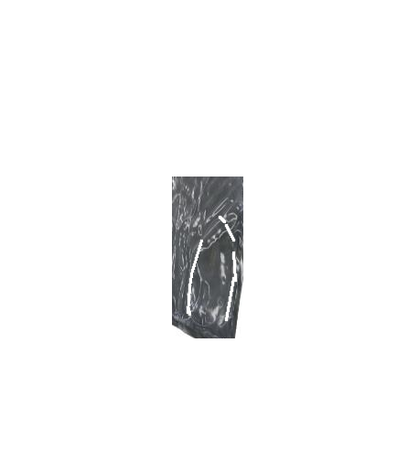
Microencapsulated Bio-based PCM
ACRYLIC POLYMER SHELL
VEGETABLE OIL & FATTY ACID PCM CORE

Slide 54



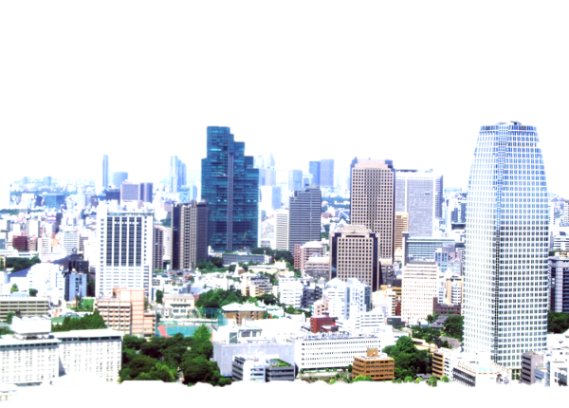
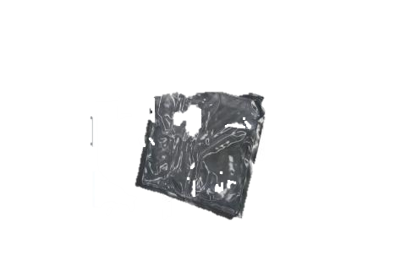

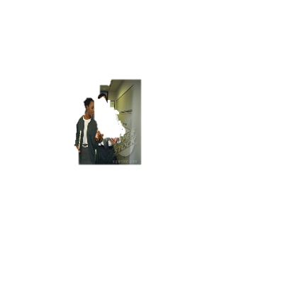
Infra-red Thermal Imaging
Room Temp.
without RACUS®
28
26
24
20
18
24°C
22°C
22°C
20°C
19°C
20°C
24°C
Room Temp.
with RACUS®

Slide 55
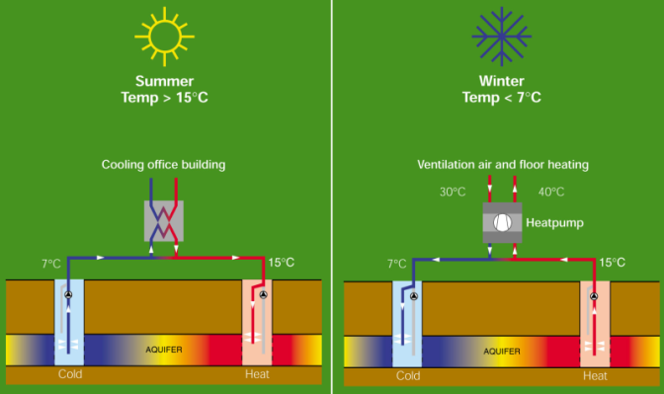
ATES - Aquifer Thermal Energy Storage

Slide 56
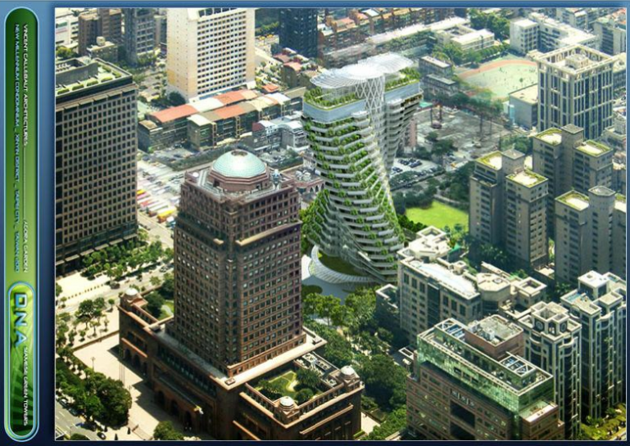

Slide 57
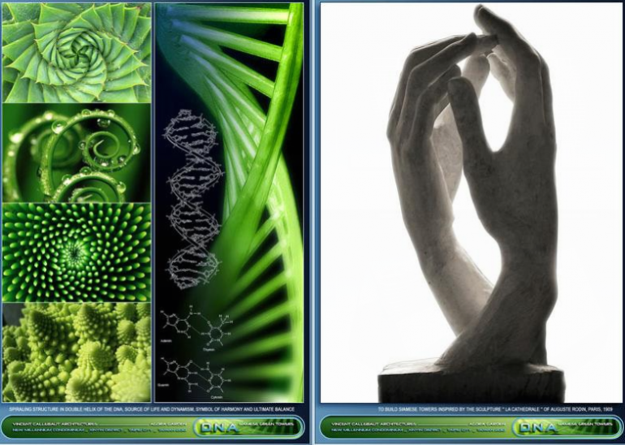

Slide 58
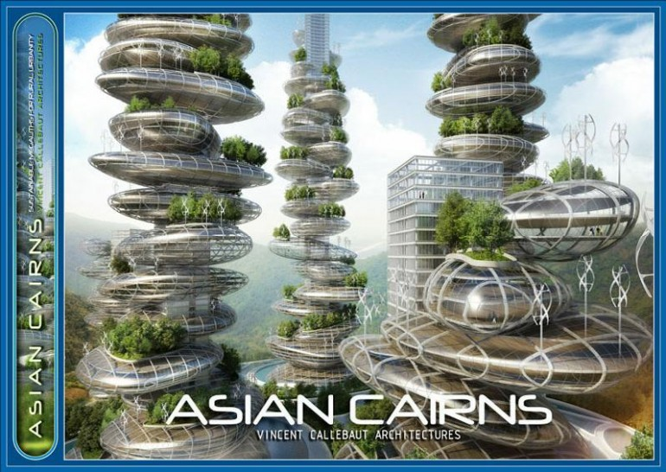

Slide 59
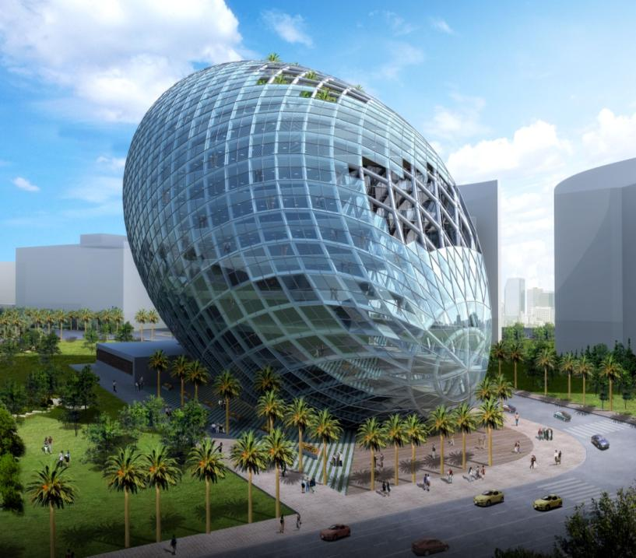

Slide 60
BIQ Algae Powered Building Hamburg 2013
Bio Intelligent Quotient building by Arup/Splitterwerk £4.8m 3 years
129 Algae louvred tanks SE/SW facades
Algae +nutrients+CO2+sunlight
Algae harvested and processed for biogas
Also shades building
Solar heat used too

Slide 61
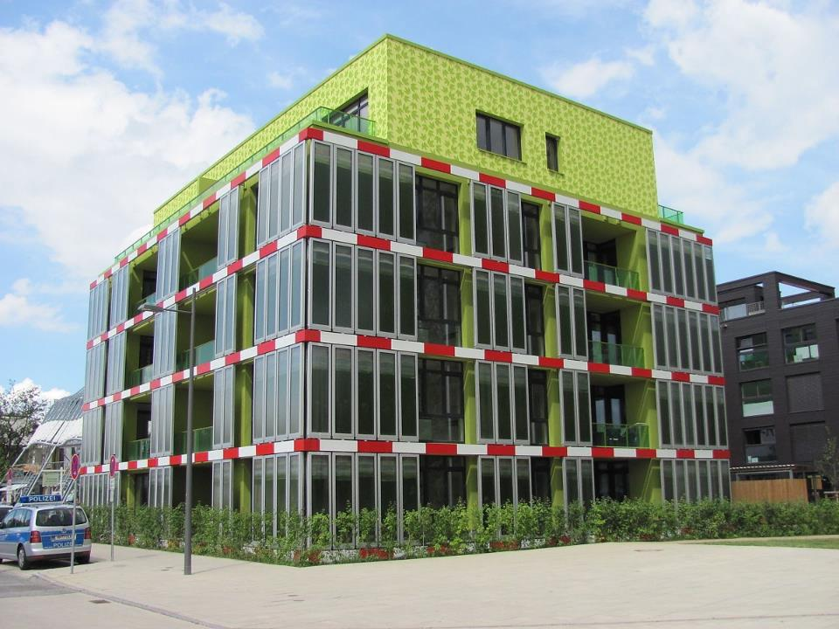

Slide 62
Masdar City
Abu Dhabi
2005--2025

Slide 63
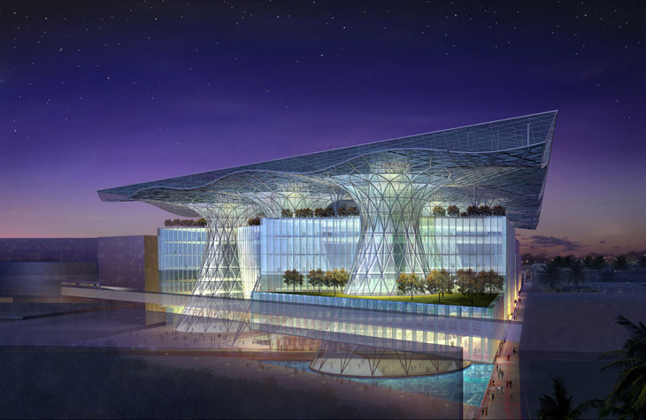

Slide 64
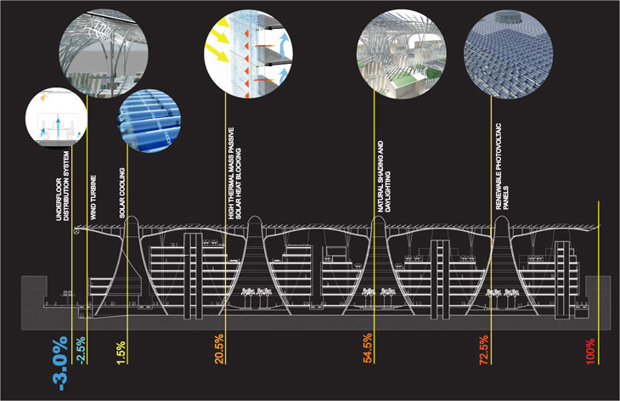

Slide 65
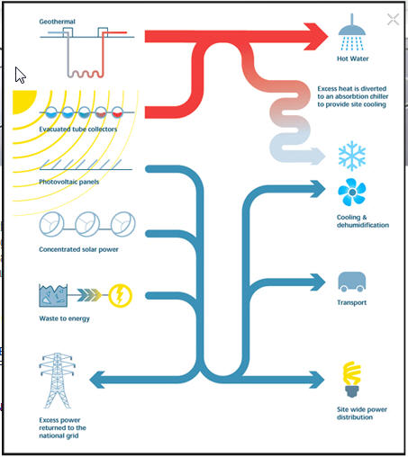

Slide 66
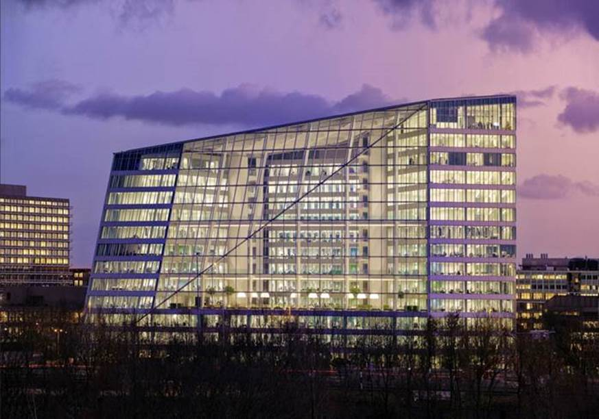

Slide 67
Edge Building by Deloitte 2015
28,000 sensors
Edge mobile App
Finds desk
Sitting, standing, meeting, concentration spaces
BREEAM 98.4%
LED digital ceiling with 8.3 years payback
Workspaces < 7 m from window

Slide 68
EDGE BUILDING
Natural ventilation via atrium
1000 hot desks for 2500 workers
Breakout spaces available+ Gym
Interactive walls
Personal data not shared
Electric parking
Aquifer water storage for radiant heating-cooling
Solar panels on South face

Slide 69
FUTURES
Carbon positive buildings like artificial leaf hydrogen generating facades also
Algae biofuel facades
Green living facades
Applications of biomimetics
Smart materials for reactive facades; embedded sensors, nanotubes , graphene
Application of nanotechnologies

Slide 70
FUTURES
Robotics for prefabrication, cleaning, maintenance and site assembly
Fully integrated interoperable systems
Buildings into smart grid system
Wireless Sensor Technology IoT linking climate, building, systems and occupants
Innovation with respect for passive low technology and smart materials
New culture of value, systems and holistic thinking and vision

Slide 71
THANK YOU

Slide 72
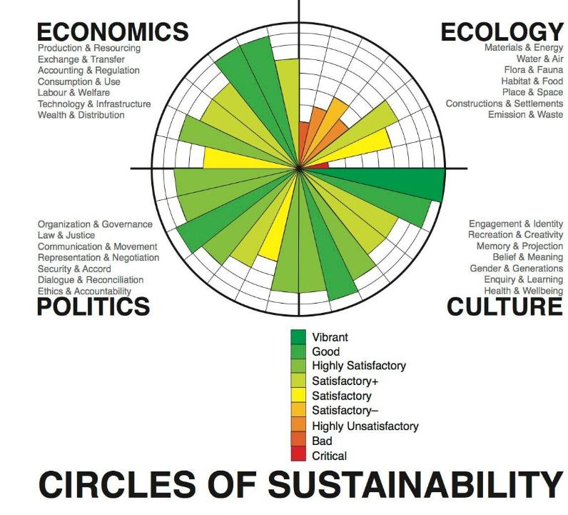

Slide 73
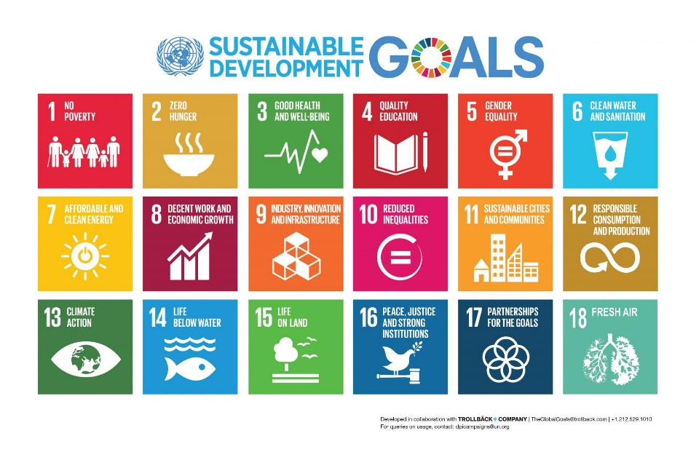

Slide 74
WHAT WE CALL THE BEGINNING IS OFTEN THE END
AND TO MAKE AN END IS TO MAKE A BEGINNING
THE END IS WHERE WE START FROM
T.S.ELIOT-- FOUR QUARTETS-- LITTLE GIDDING

