Slide 1
The Water Treatment / Hygiene Industry & Their Adoption of Technology
Rob Nicoll B.Sc. (Hons), MoID Fellow of WMS
Notes:
Rob will be focusing on the water treatment and hygiene industry, which is responsible for conditioning manufacturing process water, cooling water, steam and heating water, whilst also overseeing water safety management. Worth c$89bn worldwide, he will review how suppliers and clients are collaborating to bring innovation to a demanding market but is the development of people in the sector and their training keeping pace?
The FM sector is increasingly coming under pressure to deliver high quality services, whilst newly deployed technology is shining a bright light on poor quality work, tardy delivery and inaccurate reporting. Compliance is key. Mashing together different IT systems, such as CAFM, LIMS, IOT and Asset Management is gaining pace but will the water treatment and hygiene industry keep up? And where can AI be used to improve water management and predict system failures but the regulators need to key up.

Slide 2
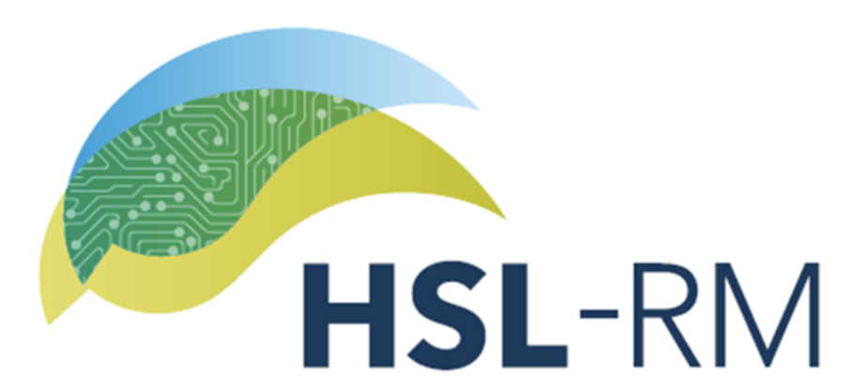
About Rob
Fellow of the Water Management Society – who have asked me to talk here today
Founder of Zeta Compliance Services and ZetaSafe
Currently the Technology Director at HSL Compliance, Commercial Director at Virtual Helpdesk, founder of Pocket Data and Innovation Director at Oxford Innovation Spaces

Slide 3
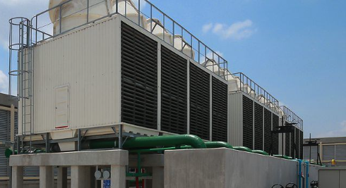
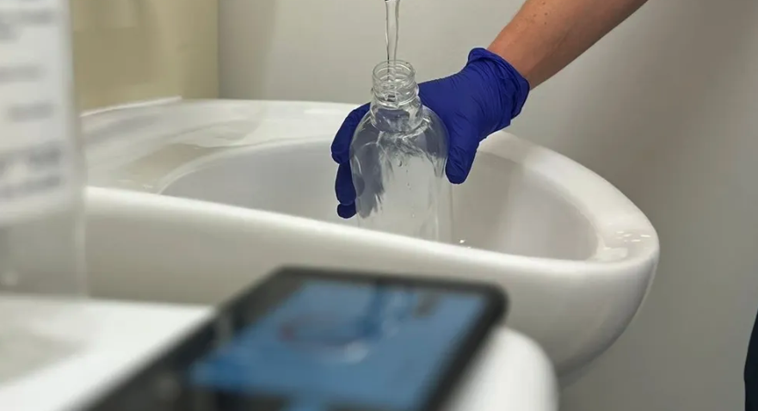
What is water treatment and water hygiene?
Water treatment
Conditioning water so that it is suitable for the manufacturing process
Evaporative cooling water
Steam production
Chilled water
Heating water i.e. LTHW
Water hygiene industry oversees water safety, typically:
Legionella management - everywhere
Pseudomonas management – specifically healthcare
Potable water quality – private water supplies
Combined it tis estimated to be worth c$89bn worldwide

Slide 4
What I will cover today
The FM sector is increasingly coming under pressure to deliver high quality services, whilst newly deployed technology is shining a bright light on poor quality work, tardy delivery and inaccurate reporting.
Compliance is key. Mashing together different IT systems, such as CAFM, LIMS, IOT and Asset Management is gaining pace, but will the water treatment and hygiene industry keep up? And can AI be used to improve water management and predict system failures, possibly, but the regulators need to keep up.

Slide 5
What are the issues around delivering high quality work?
Timeliness – completing daily, weekly and monthly tasks as specified is a major problem for the water treatment and hygiene industry.
Issues include:
Recruitment
Retention
Geography
Service delivery – a thorough understanding of the subject matter is not as ‘inherent’ as it once was.
Issues include:
Limited and poor training
A lack of skills
Tolerance – clients equally do not have the time to support contractors, and they work within increasingly tight timescales and budgets.
Issues include:
Time
Draconian contracts
Budgets

Slide 6
Trends - shining the light
FM providers are under pressure to ensure that all the work that they are contractually responsible for is completed, on time and to the right standard.
Speciality contractors, water companies, are struggling with these totally virtuous standards.
CAFM – water technicians increasingly being challenged to complete their work using these systems
Asset Management Software – the clients of FM companies may not have ‘full’ access to the CAFM service, but they often have access to these systems
LIMS – these laboratory run services also shed further light on the ‘compliance process’

Slide 7
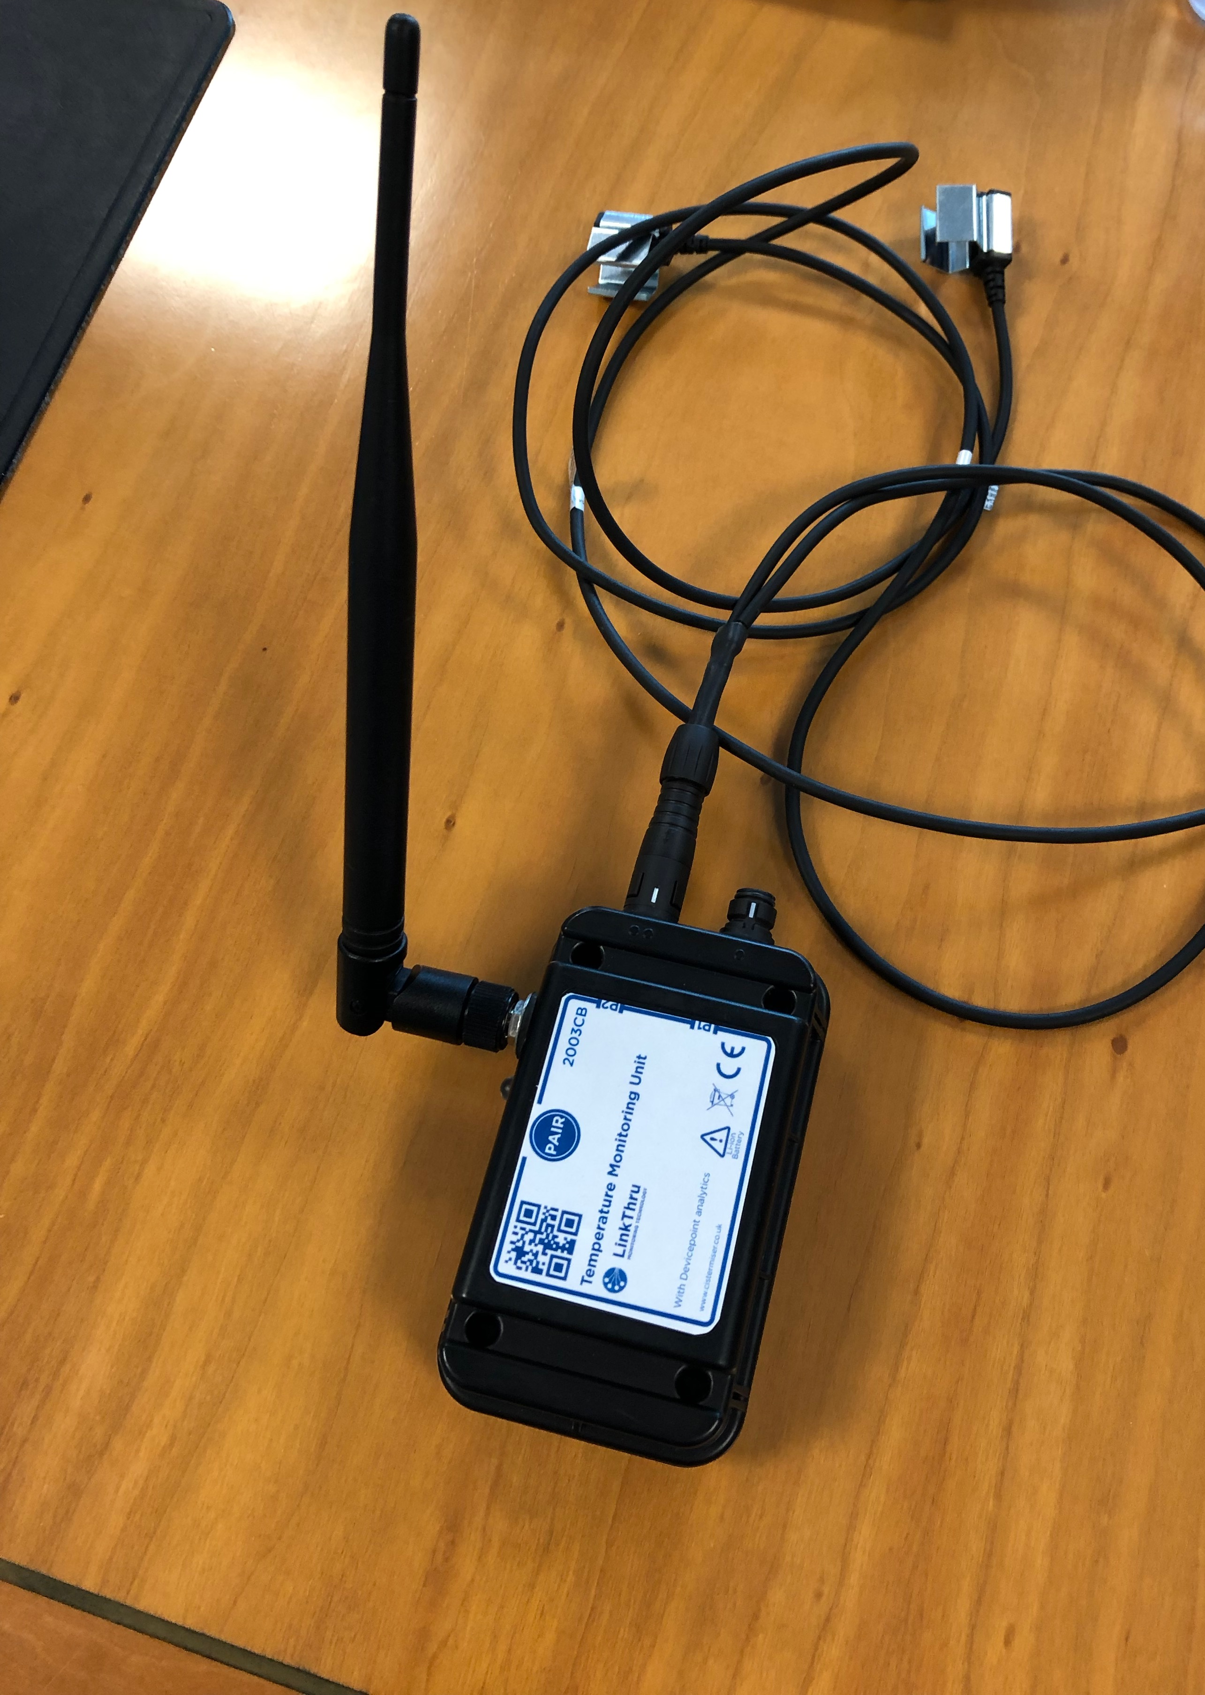
Are there any green shots / collaboration?
Remote Monitoring – temperatures, meters, corrosion rates
Asset Management / CAFM Integration
Sample Management
Corrosion Rates
This is not new technology…

Slide 8
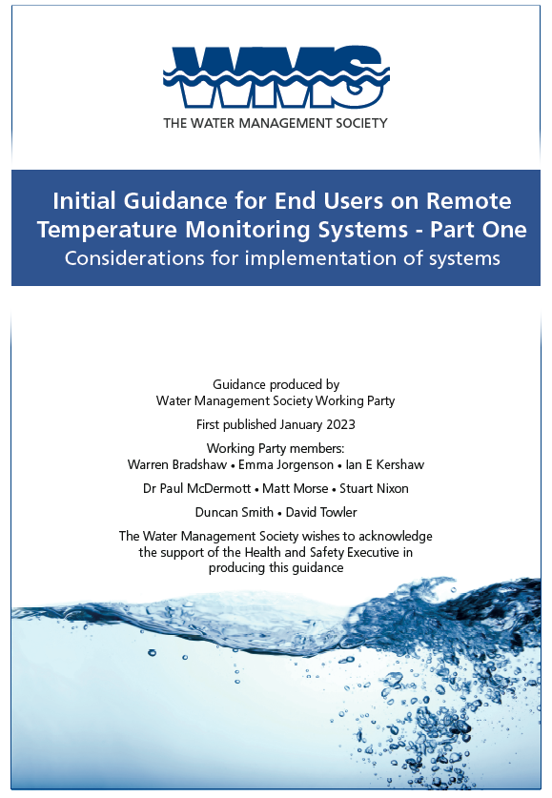
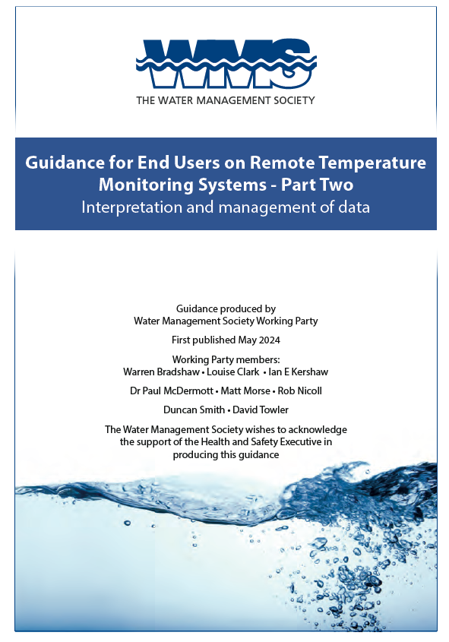
Remote Monitoring (IOT)

Slide 9
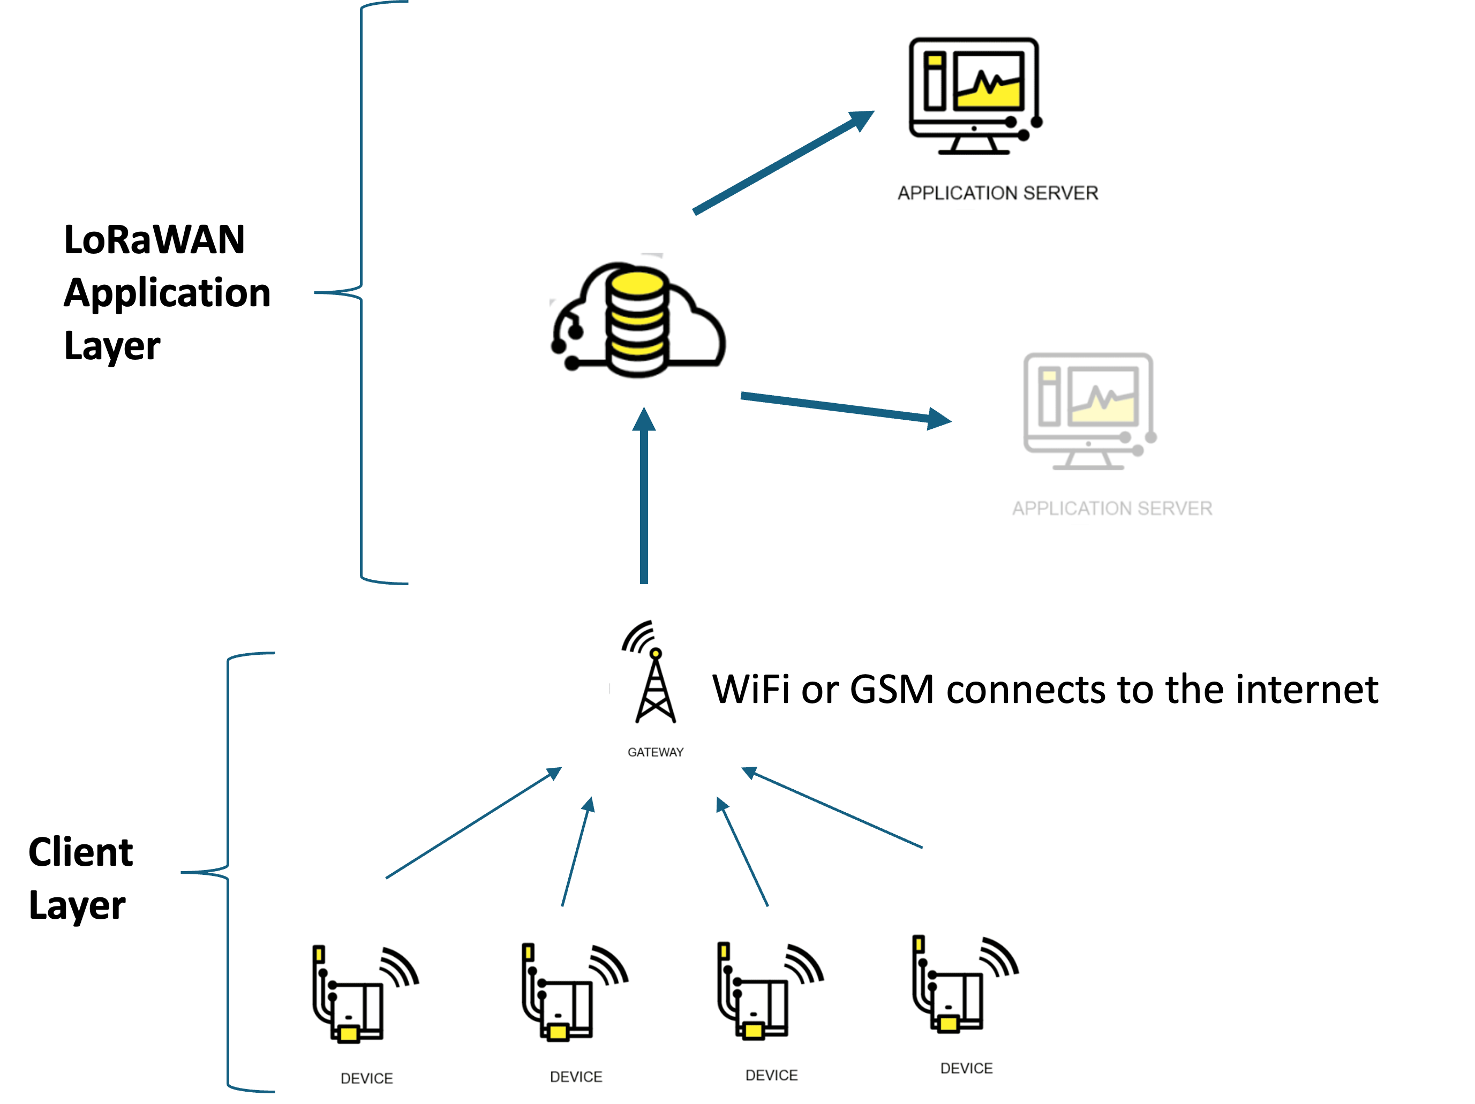
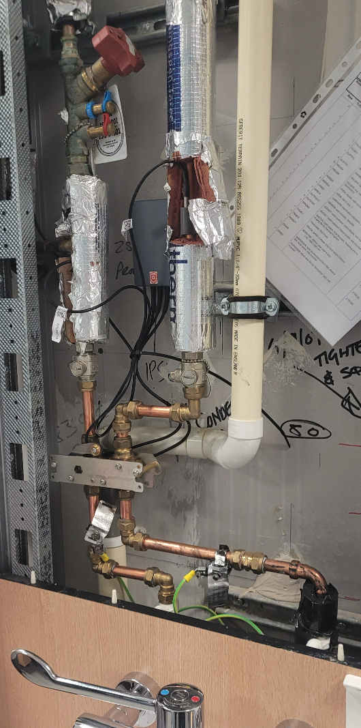
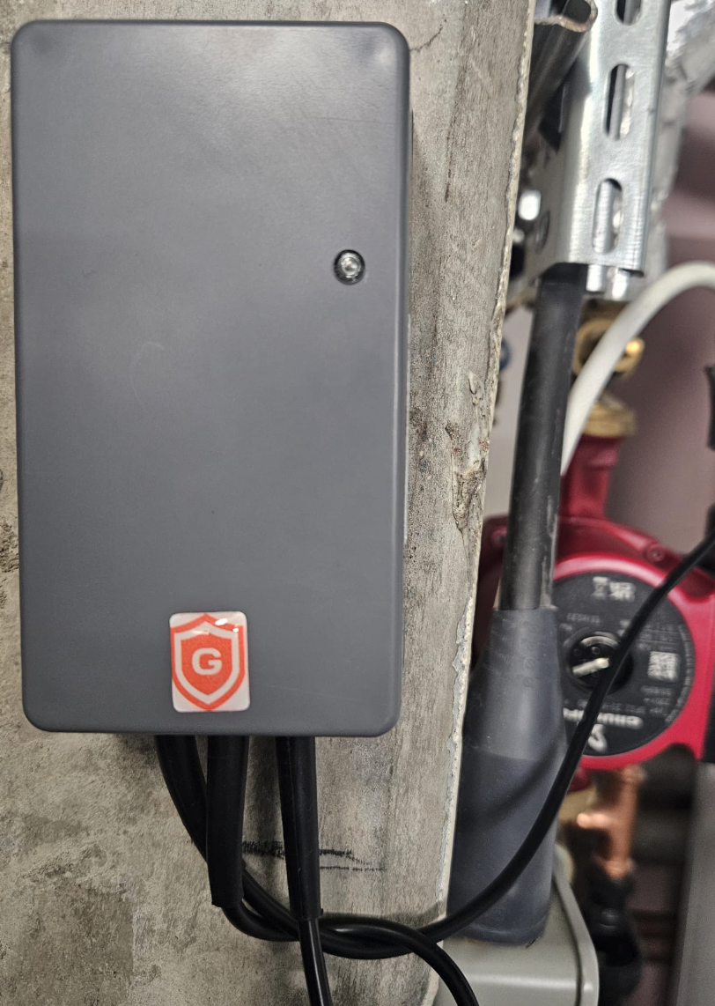
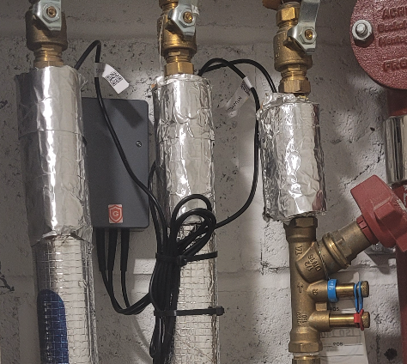
Remote Monitoring (IOT)
Typical Remote Monitoring System Architecture
Sensors on Pipes
Node collecting data
What does this all allow you to do? Essentially replace 2 in 3 visits to site per annum with IT and reduce your field staff requirements.

Slide 10
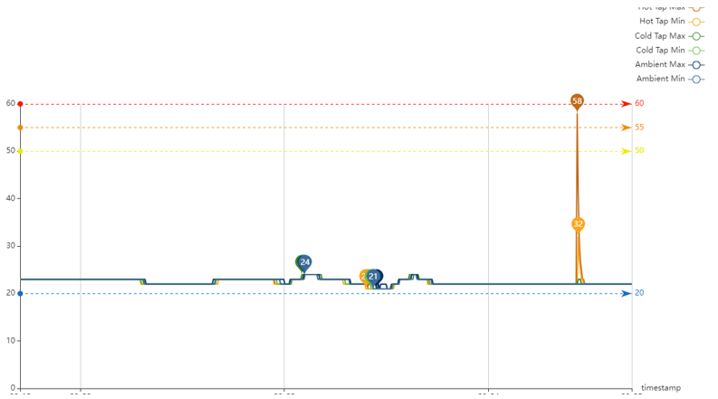
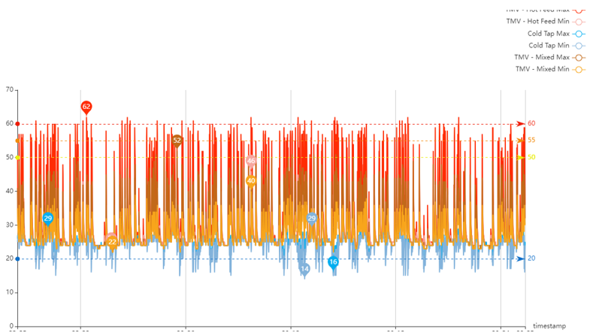
Remote Monitoring (IOT)
Well Used Asset
Underused Asset

Slide 11
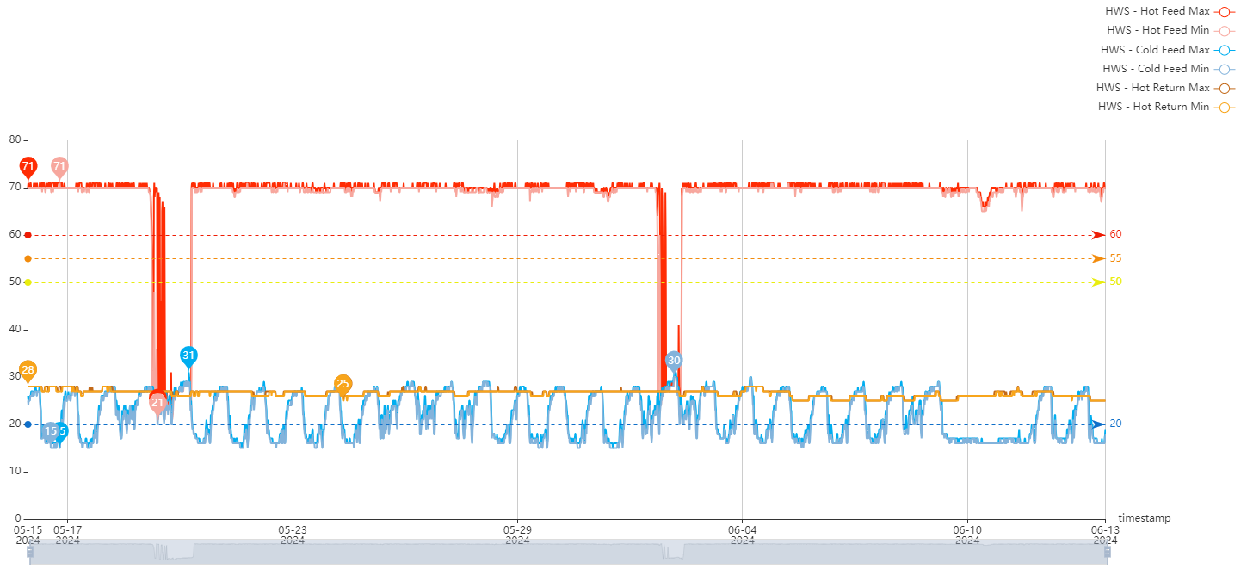
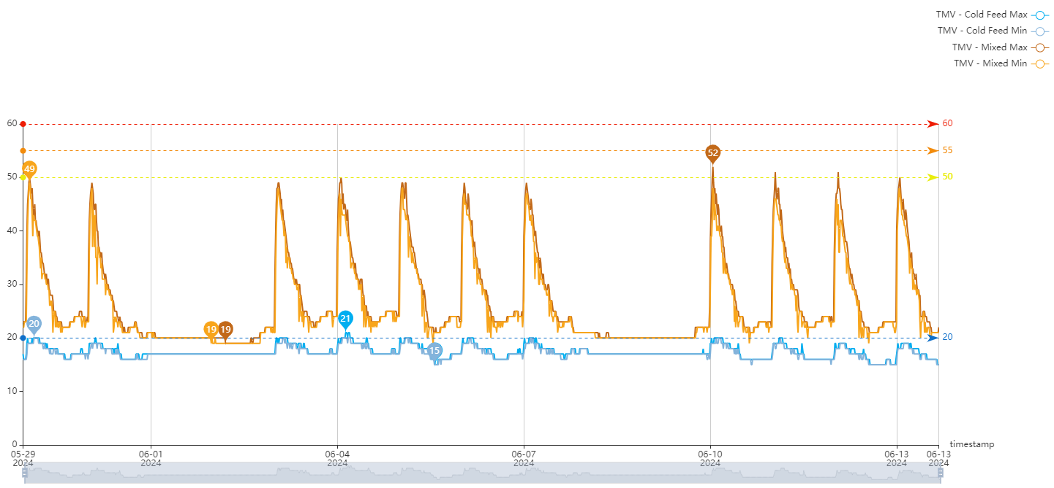
Remote Monitoring (IOT)
Hot Water Outages
TMV Failure

Slide 12
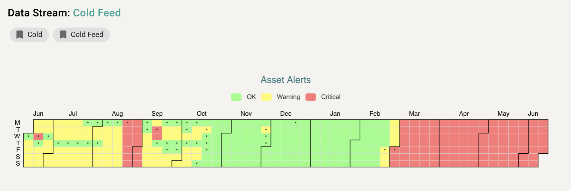
Remote Monitoring (IOT)
Asset History
Sharing and Acting on Data

Slide 13
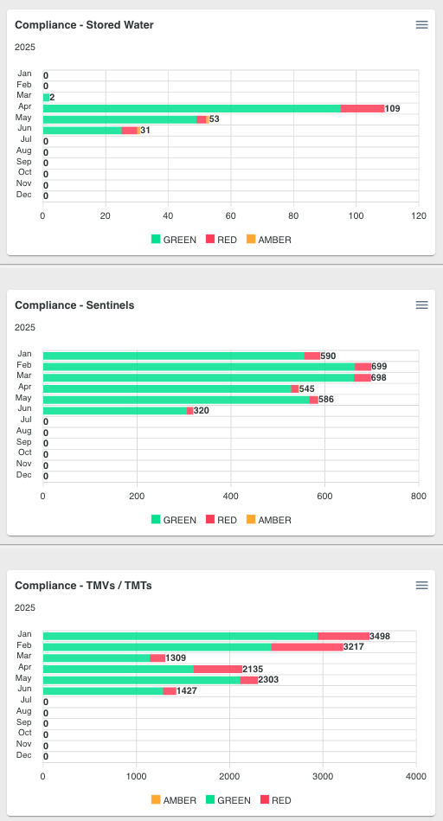
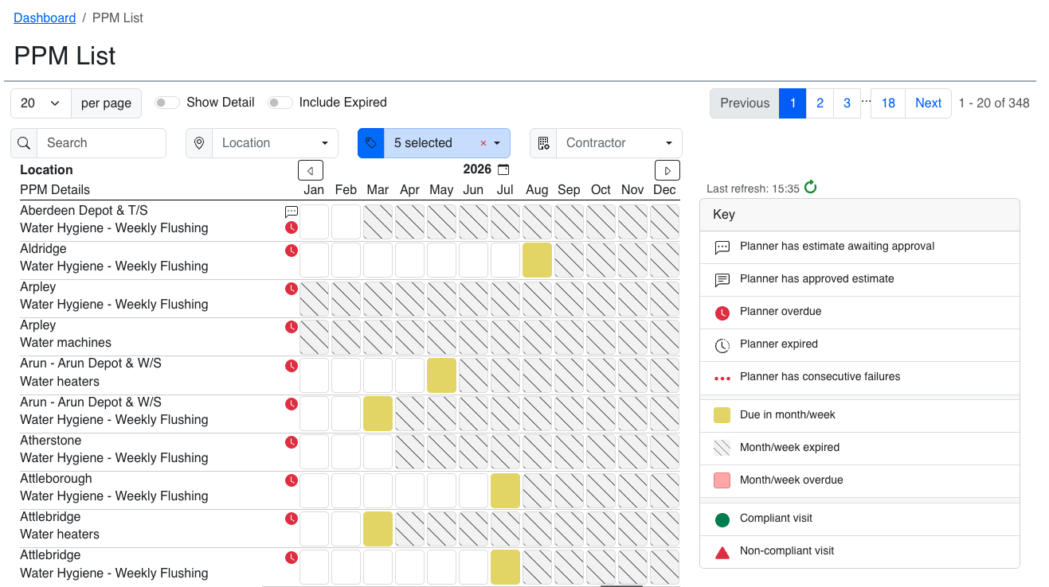
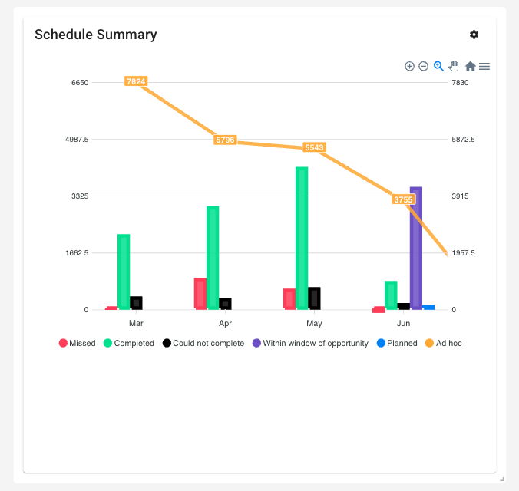
Asset Management
CAFM
Non-compliance results need to be resolved by send to a helpdesk
Completed work needs to update the Asset Compliance software
CAFM and Asset Management are two sides of the same coin, one deals with jobs to people, while the other deals with the compliance on an asset.

Slide 14
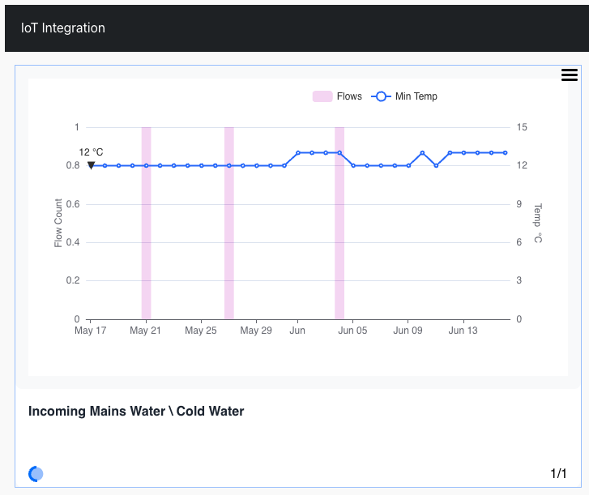
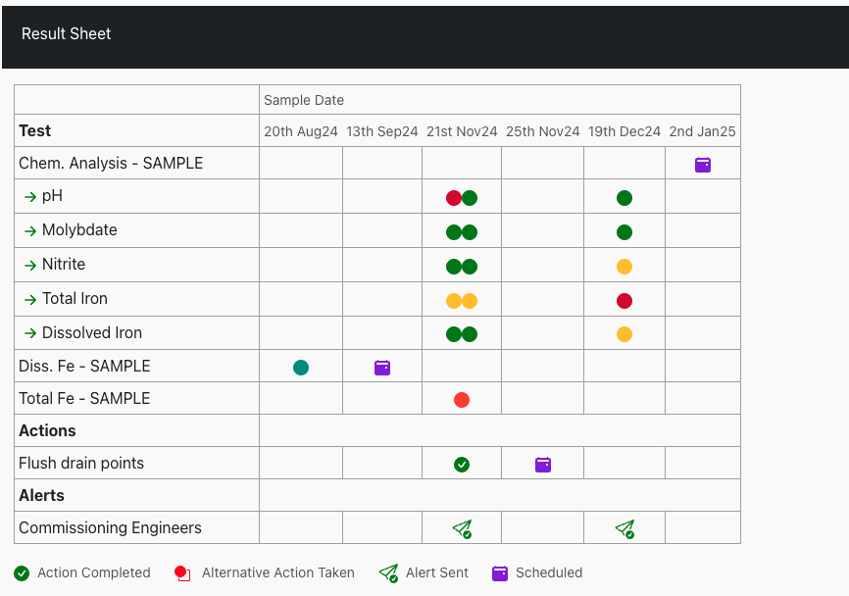
Sample Management
IOT and Sample Data ‘Mashed Up’
Flushing events and current temperature trends available within the same platform
Future actions planned
Clear record of results, actions, and alerts
Better and quicker decisions are being made…

Slide 15
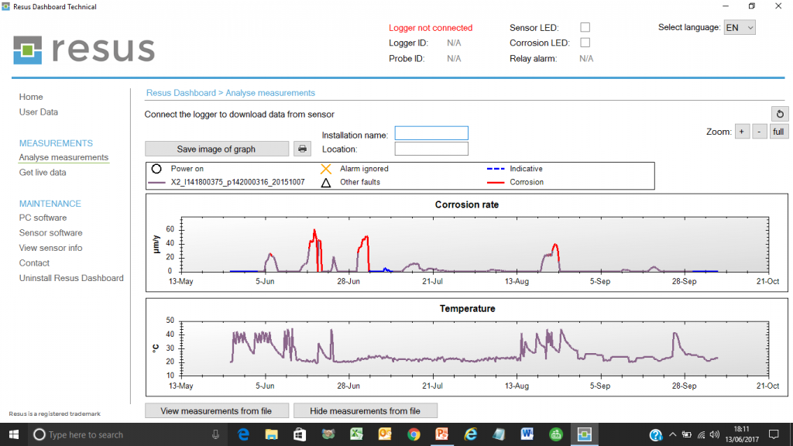
Corrosion Management
Closed Systems
Closed systems have been the poor relation of steam production and cooling systems but now at PFI projects start to look their contracts there is a new sense purpose about their management.
Corrosion rates monitored in real time
Technology is playing its part and providing real-time data to support the local teams and central compliance managers an eye on what is going on.
Better and quicker decisions are being made…

Slide 16
Will it change?
Technology is now getting more widely used in the water safety industry and pushed by the Facilities Industry in healthcare.
Elsewhere, take up is slow and achieved when driven necessity, i.e. the prison service.
The price of kit needs to come down, that is assured as much as the cost of employment if technicians will go up.
More collaboration is welcome and indeed essential if carbon targets are to be met…
Source Compare Banks (www.comparebanks.co.uk)

Slide 17
Thank you for listening
Acknowledgements:
Water Management Society
HSL Compliance
HSL – RM (Plexus)
Sample Hub ™
REACT
Virtual Helpdesk

