Slide 1
Boost your CV with CIBSE membership
Globally recognised credential
Access to knowledge and CPD resources
Grow your professional network
Shows commitment to professional development
Indicates a professional mindset to employers

Slide 2
Growing your industry knowledge through CIBSE
CIBSE Journal
Knowledge Portal
Networks
Events
Training

Slide 3
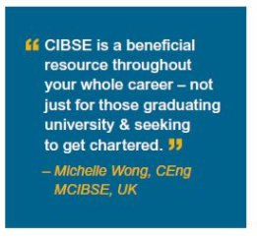
Summary of benefits for CIBSE Members
Knowledge Portal
CIBSE Journal
20% off CIBSE Training
CPD Events and Webinars
Awards and Bursaries
Networking

Slide 4
Application support & guidance
CLOSING DATE SURGERIES
PHONE SURGERIES
MEMBERSHIP WEBINARS
membership@cibse.org
Notes:
We run virtual surgeries – free one on one 30 minute slots every Thursday with one of our Membership team where you can discuss your membership options – please get in touch by replying to this email if you would like to book a session.
If you are considering ACIBSE/MCIBSE/FCIBSE membership our November Application Workshop provides technical guidance in the form of a workshop and step by step support from two experienced CIBSE reviewers.The workshop will consist of four online midday sessions each lasting 90 minutes, taking place throughout November. You can find out more information and register here.
We run free webinars twice a month on the application process for Associate (ACIBSE) and Member (MCIBSE) grades that can help you understand the process and requirements. you can find out more information and register here.
We also hold closing date surgeries before each closing date and phone surgery slots where you can book an appointment with a CIBSE interviewer to review your draft EPR for £25.00 – see here for more details.
Finally you can always contact us by emailing your query into membership@cibse.org or phoning the membership team on +44 (0)20 8772 3650.

