Slide 1
Transforming Government through Estates
Balancing Performance and Prosperity
Saurabh Bhandari

Slide 2
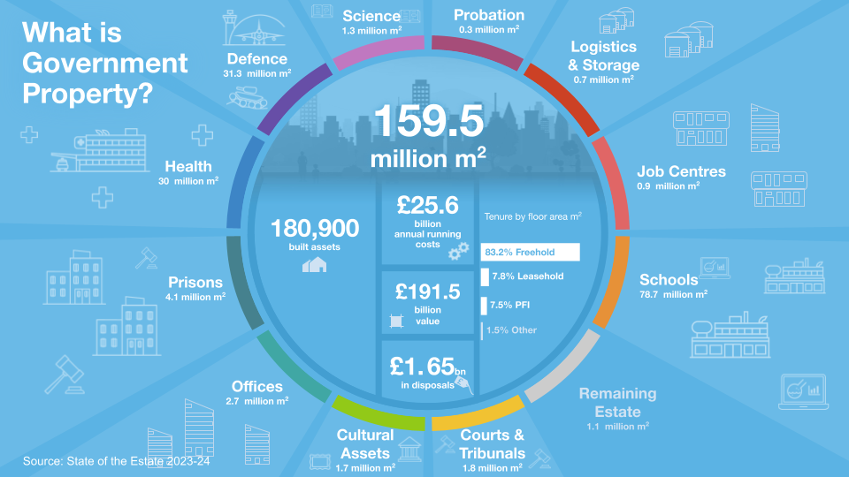
The Government Estate

Slide 3
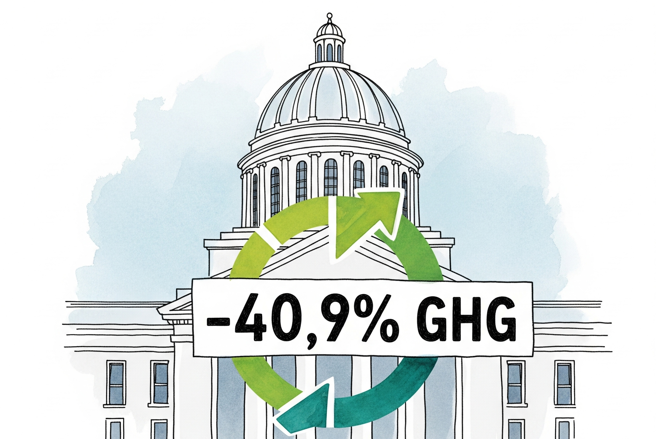
State of Government Estates - Dichotomy
Maintenance of Public Buildings, NAO, Jan 2025
State of the Estate Report, May 2025
2025 report to parliament, CCC, Apr 25
Improving resilience and coordination

Slide 4
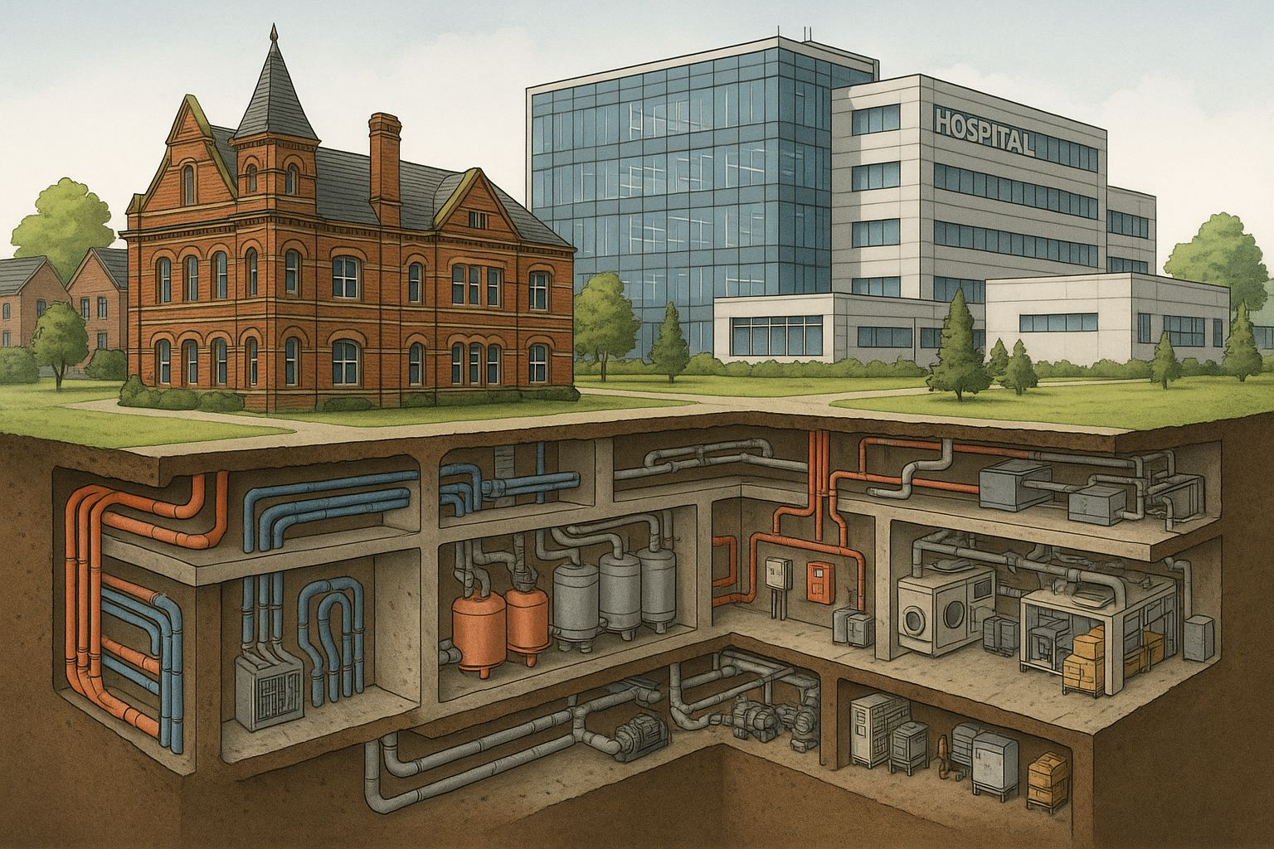
The stories behind the numbers

Slide 5
The stories behind the numbers
When an underground water leak flooded key energy infrastructure at a South East hospital, 1/3 of the facility suffered from a complete power failure.
A combination of maintenance issues and outdated infrastructure were to blame, compounded by the leak detection system not being operational.
DIRECT IMPACT
SYSTEMIC DOMINO EFFECT
Maintaining the pipe before the flood occurred would have cost:
£40k
A&E closed for
Services disrupted for
Other providers forced to cover extra clinical workloads, straining the system
Repairs and temporary emergency measures pulled resources from other critical priorities
36 hours
12 months
with stroke and cardiac patients displaced for up to 72 hrs
during repairs
Inc. repair bills & clinical losses, the incident cost a total of:
£7m
This is not an isolated incident. Property failures disrupt NHS treatments 5,400 times a year on average.
By investing in proactive maintenance, we can turn things around.

Slide 6
The stories behind the numbers
The UK’s largest Magistrate’s court was forced to close unexpectedly and indefinitely after a small fire exposed a critical failure in the alarm system.
At 130 years old, prolonged underinvestment in the building’s maintenance made it impossible to keep up with modern operational standards.
DIRECT IMPACT
SYSTEMIC DOMINO EFFECT
The full repair bill has now ballooned to approximately:
£58 million
5,700
courtroom
days lost
50,000
outstanding cases in the jurisdiction alone
Sensitive cases were displaced or delayed, increasing trauma for victims and exploding costs.
Delays fuelled public distrust, economic uncertainty, prison overcrowding and weakened community fairness.
Across the country, poorly maintained courts cause around 100 unplanned closures weekly.
Investing in these spaces is the key to getting justice moving.

Slide 7
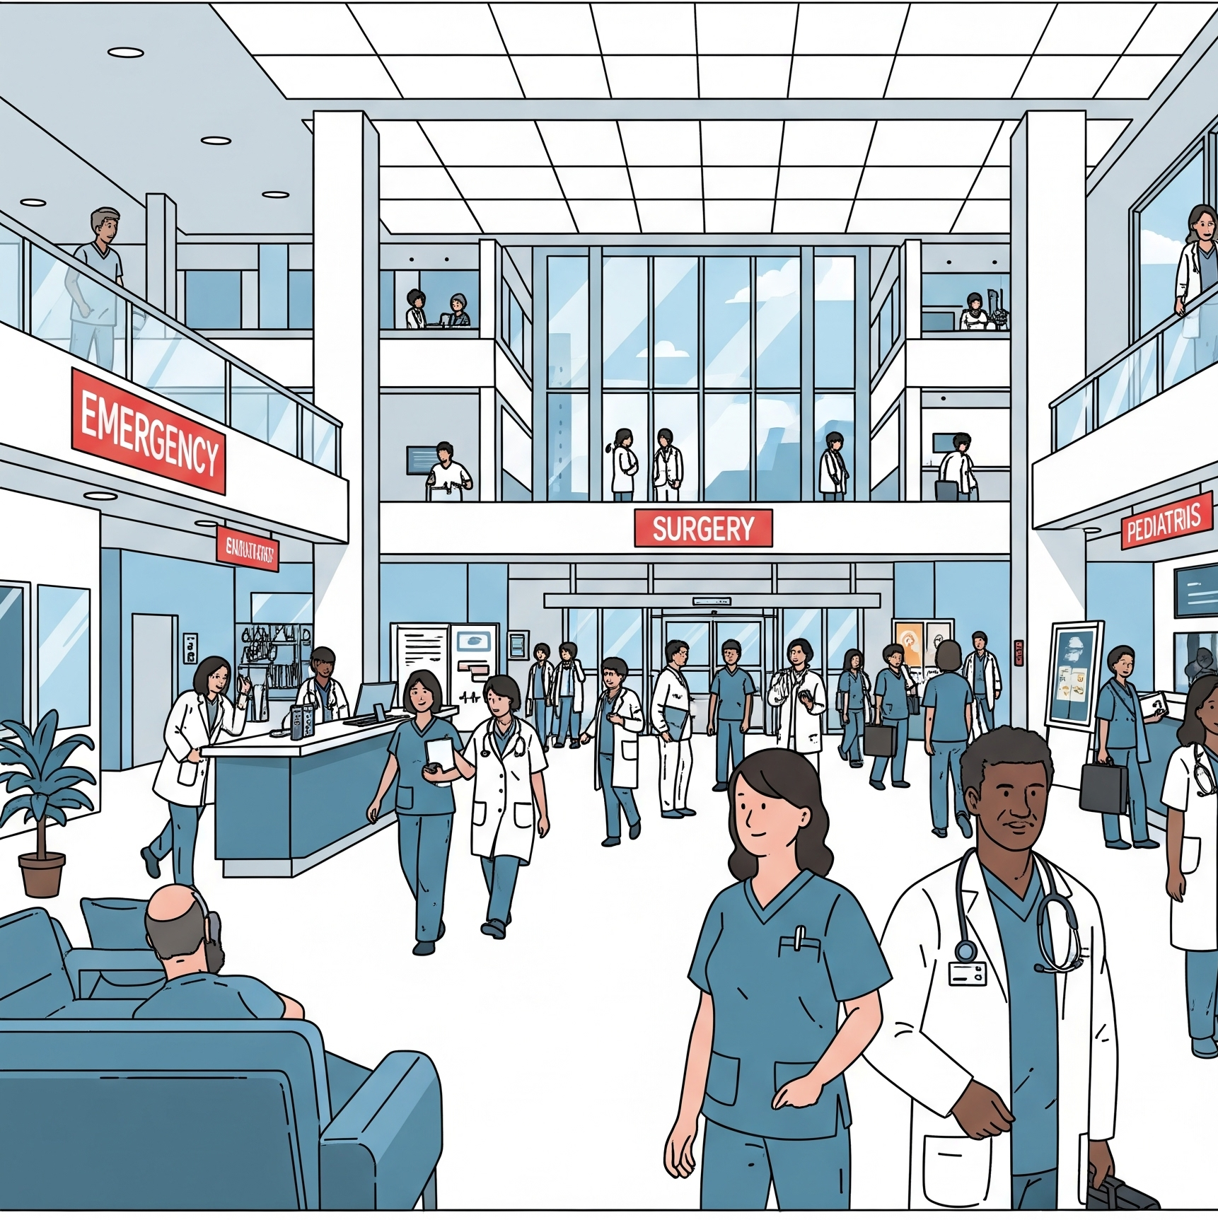
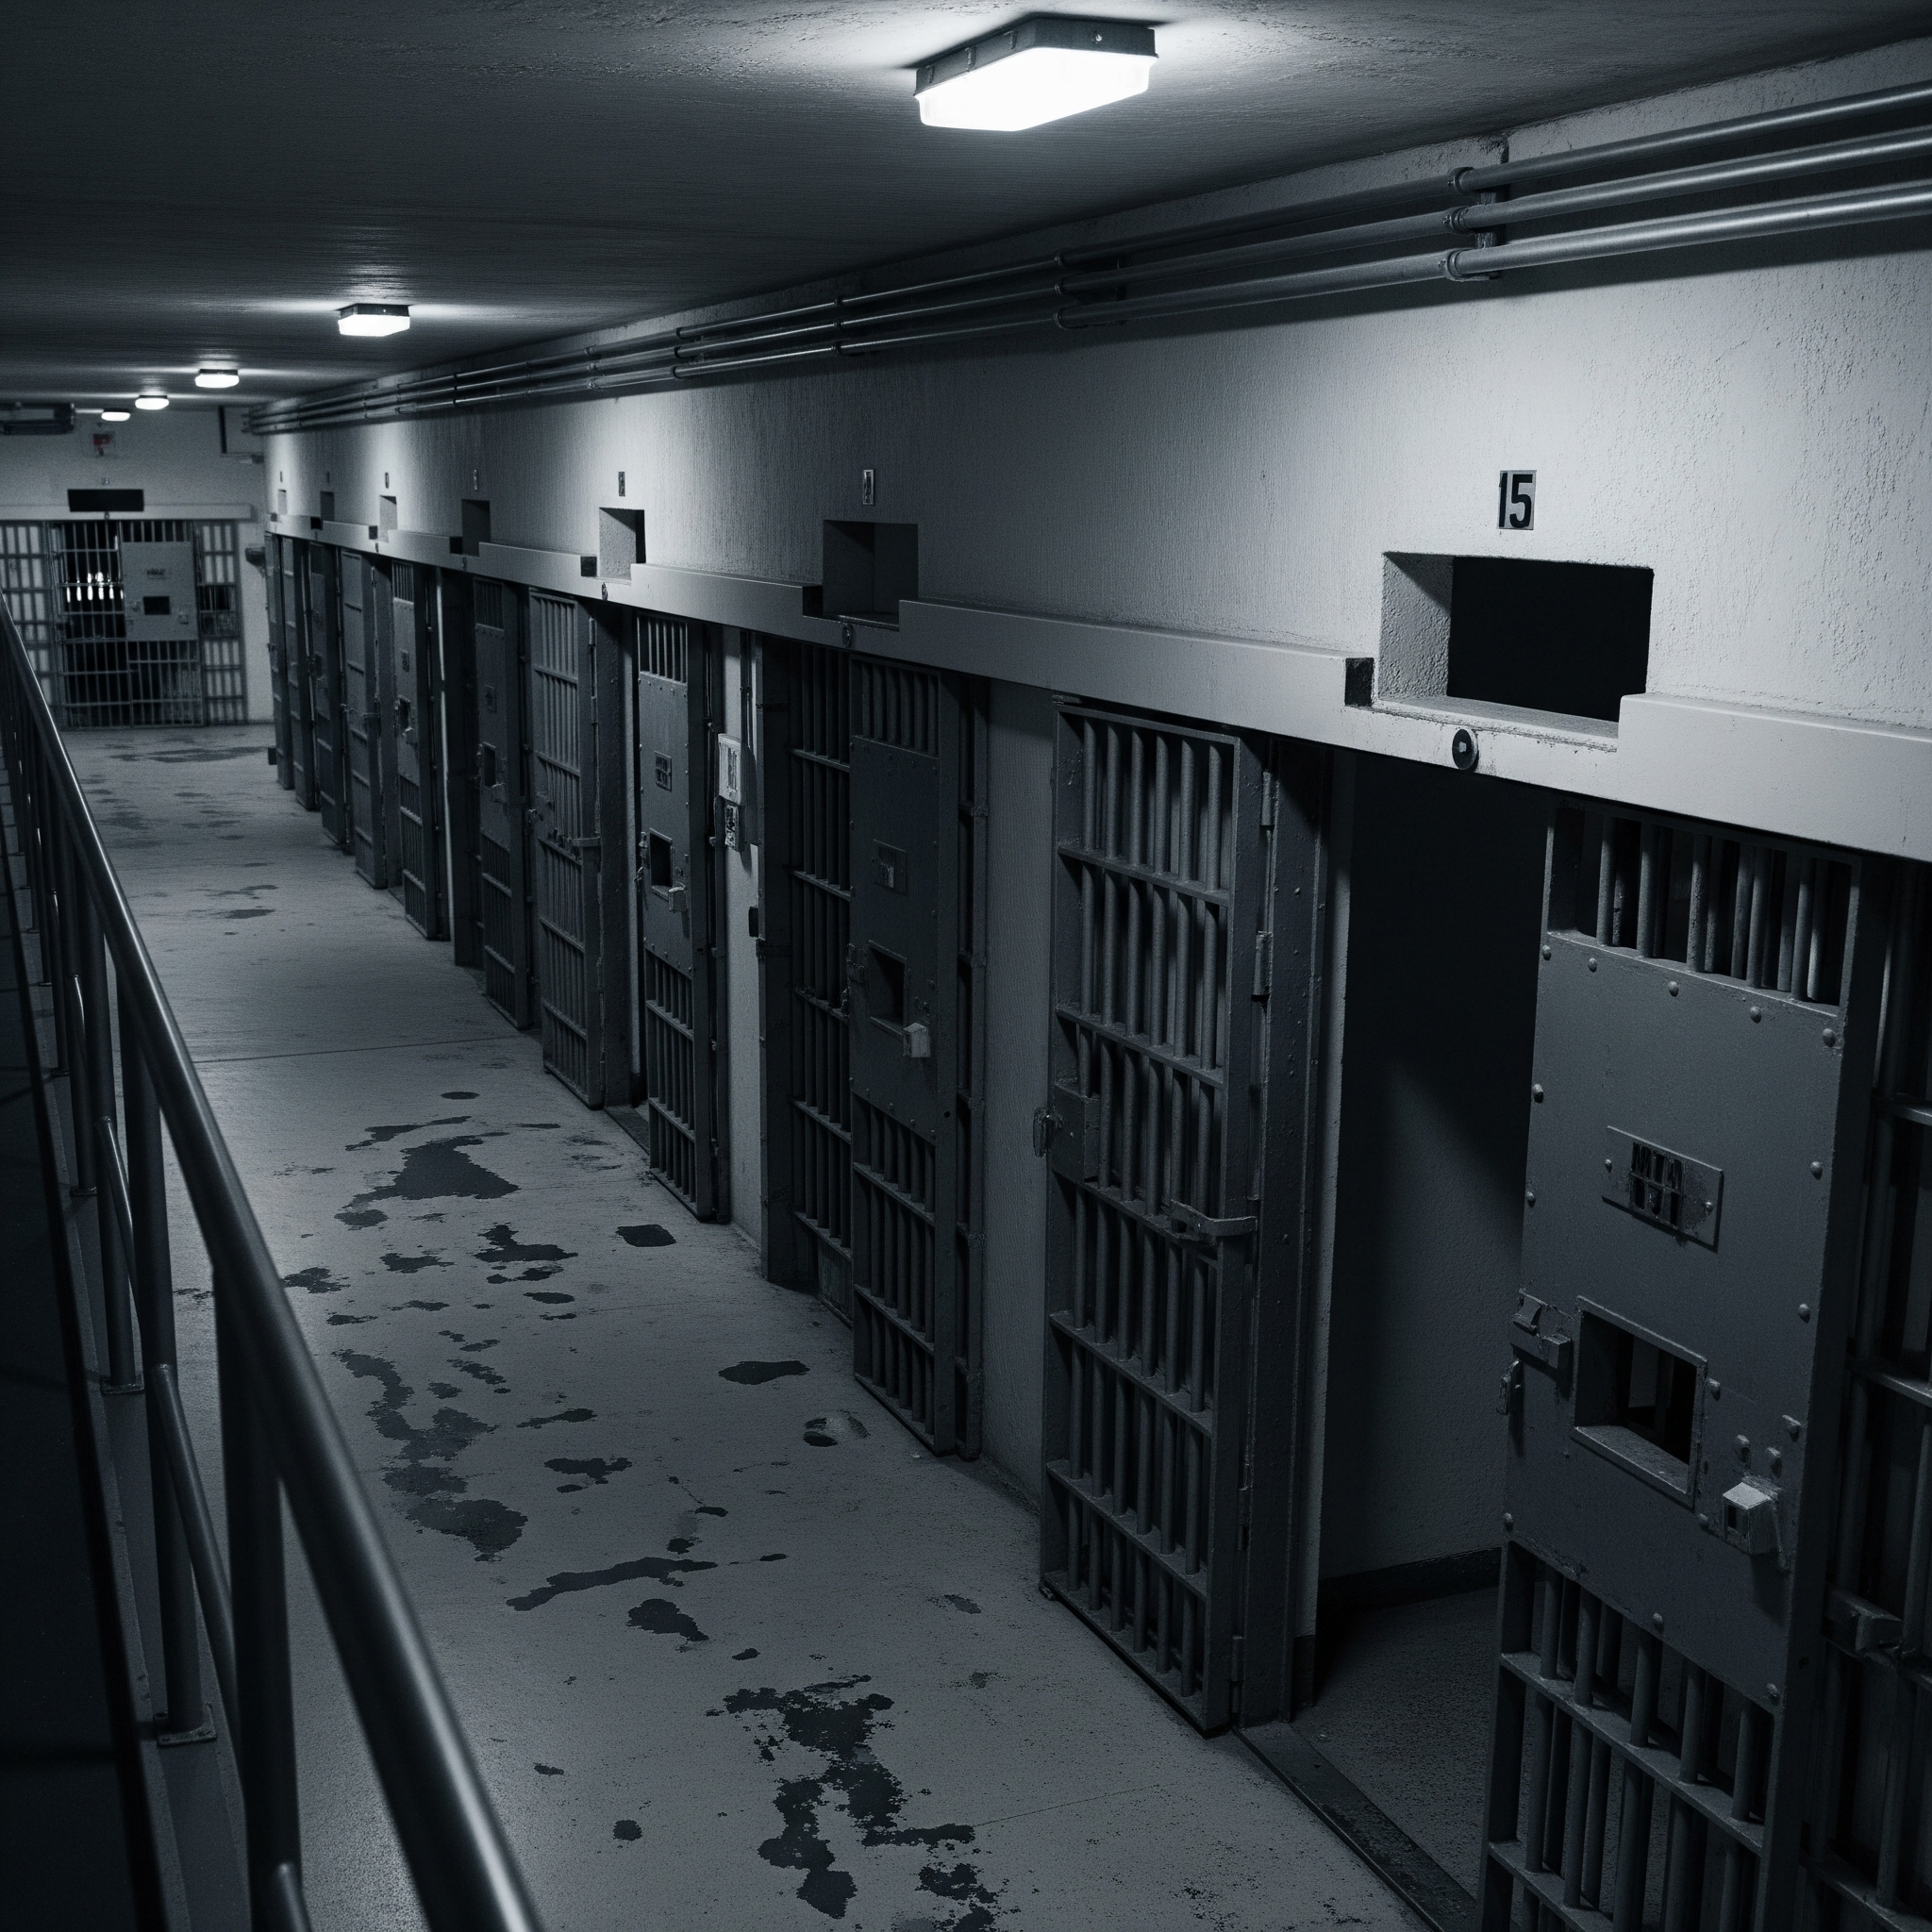
The Impacts we see are system wide and intertwined
Clinical activities disrupted
Increasing Welfare costs
Education Disrupted
Prison System burdened
However, the response is often siloed

Slide 8
Surfacing the voices - Estates Management perspectives
Chronic Underfunding
Deferred maintenance, suboptimal short term solutions, inefficiencies due to start stop method of estates investment, pay gap to retain talent
05
Disconnected Policies
Conflicting policy agendas & horizons, disconnect in space and time for allocation of resources actively frustrate progress and completion
01
04
Lack of Professionalisation
Institutionalised practices built on acquired methods, fail to harness evidence based good practice prevalent in a result focussed industry , brain drain with ageing workforce and lack of skills transfer
Emergence
Operational requirements, consumer demand, technology, security, climate change, statutes and market condition create new requirements faster than estate planning can react
02
03
Burden of Legacy
Misinformed decisions, short termism, innovations gone wrong and low appetite towards failure frustrates transformational change/ innovation required to leverage asset base.
Are these really the reasons or just a manifestation of larger issues?

Slide 9
Estates are platforms for Resilience - not cost centres
Yet, estate reports rarely evidence the measurable impact on operational productivity!

Slide 10
Measure the true value of continuity, breaking invisibility
Start measuring the impact on operational delivery
Measure consistently
[across social infrastructure]
Share broadly
[your evidence is translatable]
Measure success too
[you have already got some great examples of intervention]

Slide 11
Emerging and Existing WoW, technology
The underlying system is fragmented and Invisible !!
CAFM
Business Processes
BMS
ERP
Integrating across domains,portfolio and correlation has never been easier.

Slide 12
Questions, Comments, Observations?
Thank you

