Slide 1
CIBSE

Slide 2
Glasgow School of Art. Charles Rennie Mackintosh

Slide 3
Glasgow School of Art Charles Rennie Mackintosh

Slide 4
Glasgow School of Art Charles Rennie Mackintosh

Slide 5
Charles Rennie Mackintosh Design Integrity?

Slide 6
University Building

Slide 7
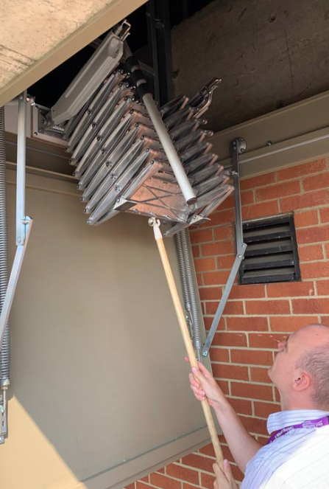
How do we get to the plantroom? Where are the Cleaning cupboards?

Slide 8
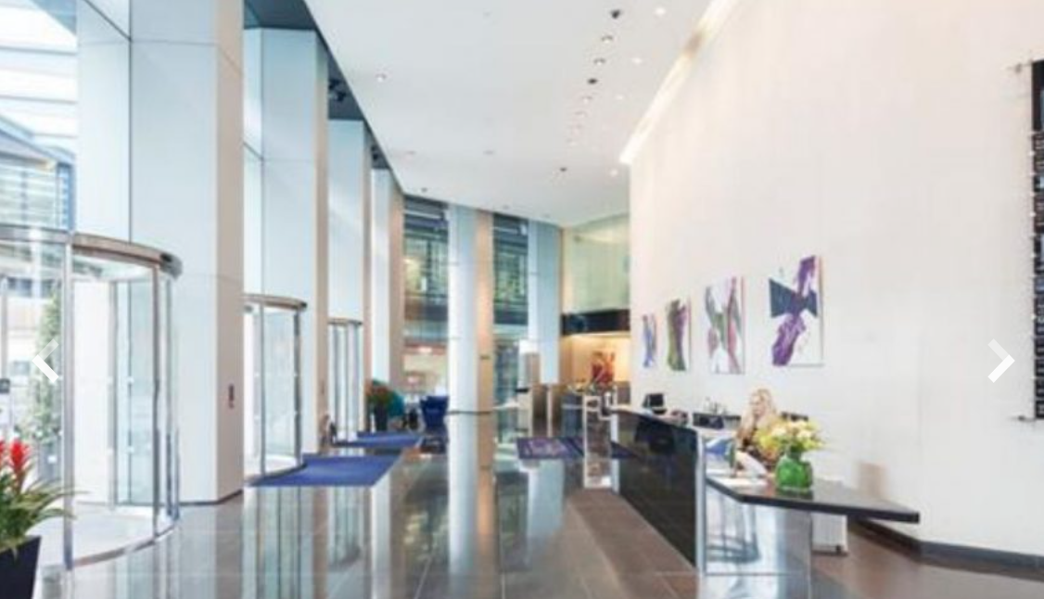
Is it a little cold in here today? (14c)

Slide 9
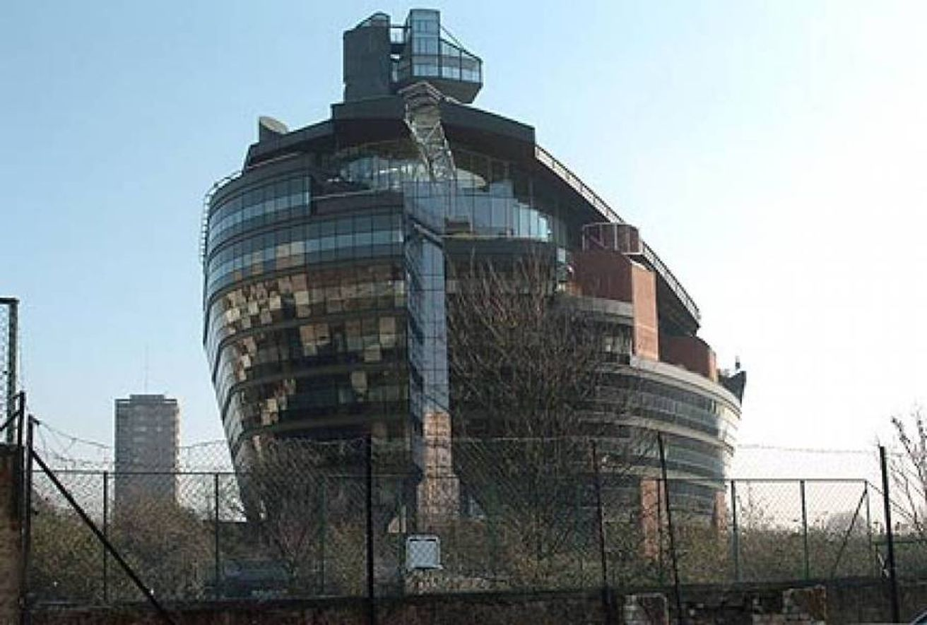
Any comments or questions?
Bernard Crouch CIWFM AMSFE CIBSE FM Group

