Slide 1
Tackling Indoor Air Quality Continuous Monitoring & Unforeseen Consequences
Graeme Fox
Head of Technical
Notes:
Many existing buildings’ ventilation systems are inadequate.
Building standards are changing.
How do we know the retrofitting we’ve carried out is doing what we expect it to do…?

Slide 2
Beginners Guide to IAQ
“We spend a lot of time thinking about what we eat and drink, but very little on the quality of air that we breath….”
Nathan Wood, Chair of the BESA Health & Wellbeing in Buildings Group
Notes:
Poor air quality affects our oxygen levels.
Most people aren’t grasping that good ventilation is a covid mitigation measure is because good ventilation is an IAQ improvement measure.

Slide 3
Beginners Guide to IAQ
“This guide is an invaluable non-technical introduction to the issue of IAQ and explains how we can make our own indoor environments safer and healthier for us and our children….”
Rosamund Adoo-Kissi-Debrah, Honorary President of the BESA Health & Wellbeing in Buildings Group
Notes:
It is estimated that in the UK we spend around 90% of our time indoors

Slide 4
Beginners Guide to IAQ
Practical measures for building services operation with regard to Covid-19
Recommending opening of windows where possible – but this only goes so far even when it is possible.
https://www.thebesa.com/media/1409321/besa-guidance-vg002-2-february-2021-v6.pdf
Notes:
It’s important to remember this because it’s crucial to demonstrate how we’ve learned so much about the covid transmission routes and other issues with IAQ in such a short period of time…..

Slide 5
Guangdong Restaurant outbreak

Slide 6
Guangdong Restaurant outbreak
The 5 tables in the original sketch were in fact at one end of a larger zone;
The AC unit was one of 5 in the restaurant;
The extract fans were switched off, as were the fresh air supply fans on the day in question;
No other patrons were infected from other tables;
None of the waiting or kitchen staff became infected;
The only fresh air supply was via infiltration with the limited negative pressure only being created by the toilet extract fans at the far end of the restaurant!

Slide 7
Guangdong Restaurant outbreak
A stagnant recirculating zone at one end of the restaurant was created.
The lack of air movement and, crucially, dilution of infected air allowed the exhaled droplets of infected particles to be transmitted over a further range than the normal expected short-range transmission.
This concurs with previous studies of the WHO and others in previous pandemic outbreaks of airborne viruses.
The study concluded that over crowding and poor ventilation increases risks of transmission:
which concurs with the guidance already issued by ASHRAE, REHVA and The BESA
Maximise fresh air volumes to dilute any contaminated air.
Notes:
A catalogue of errors…. It was an accident waiting to happen and any airborne illness would have probably been propagated in this situation – including common flu or colds.

Slide 8
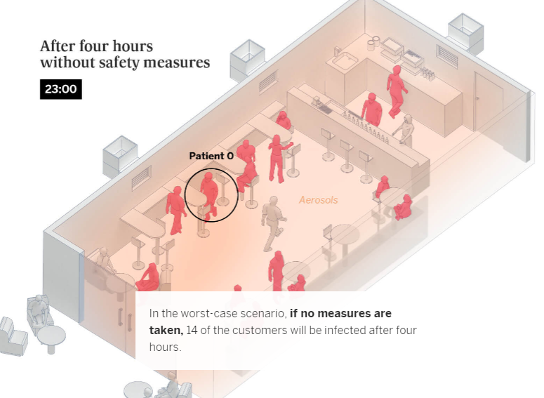
Risk of viral spread – transmission mitigation
A typical public space such as a bar can be shown to expose a high number of fellow patrons if an infected asymptomatic person is present
If no mitigating measures are taken…..
Pictures from El Pais 28th October 2020

Slide 9
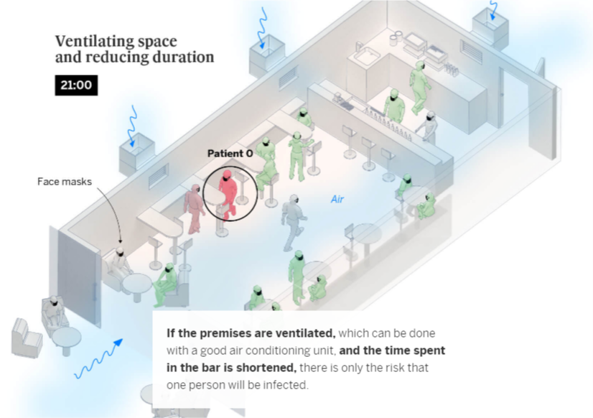
Risk of viral spread – transmission mitigation
That same bar with good ventilation being introduced that will dilute the viral load and massively reduce the exposure of the patrons will see a huge reduction on passive infection rates.
Humidity level concerns:
www.40to60RH.com
Pictures from El Pais 28th October 2020
Notes:
www.40to60rh.com
All aware of rapid spread of colds in offices over the years – now we have a better understanding of why that happens, and what we can do to avoid it.
So how are we applying this knowledge at the BESA longer term…?

Slide 10
Indoor Air Quality – the hidden dangers
Notes:
CO2 levels
HEPA
UV

Slide 11
Indoor Air Quality – the hidden dangers
Notes:
PM off static traffic
No mechanical ventilation

Slide 12
Indoor Air Quality – the hidden dangers exposed

Slide 13
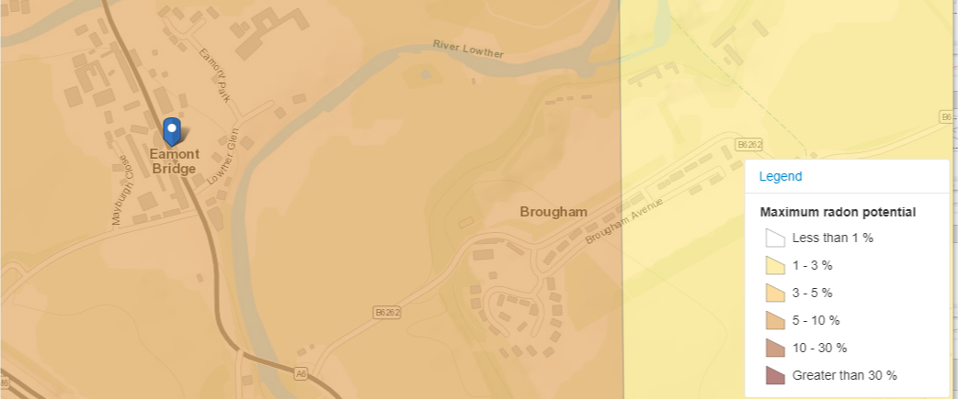
Indoor Air Quality – the hidden dangers exposed

Slide 14
Indoor Air Quality – ventilation is the key

Slide 15
Indoor Air Quality – ventilation is the key
Ventilating by opening doors and windows daily has helped reduce levels from 1449 Bq/m² to 853 during the day – proving that ventilation does work
And a drop to a safe level after a weekend of opened windows!
Notes:
Demonstrated the ventilation brings the radon under control.
Energy efficiency & net zero ambitions - what is the trade off and how do we articulate that message?

Slide 16
Thank you. Questions? https://www.thebesa.com/iaq
?
Graeme Fox
Head of Technical

