Slide 1
Measuring Performance & Facilities Management
19 June 2025 | Congress Centre, London

Slide 2
Going for Gold!
LEED accreditation
Process driven
Significant investment
Early FM engagement
Systems set up to support operations
Seasonal commissioning
Post occupancy evaluations
Demonstrable evidence

Slide 3
Optimisation
Savings achieved through optimisation of existing systems
Collaboration with PM’s, FM’s and Customers
Training to FM’s
Upskilling of engineers
Understanding control and operation strategies
Reset systems to design intent
Description of Operations

Slide 4
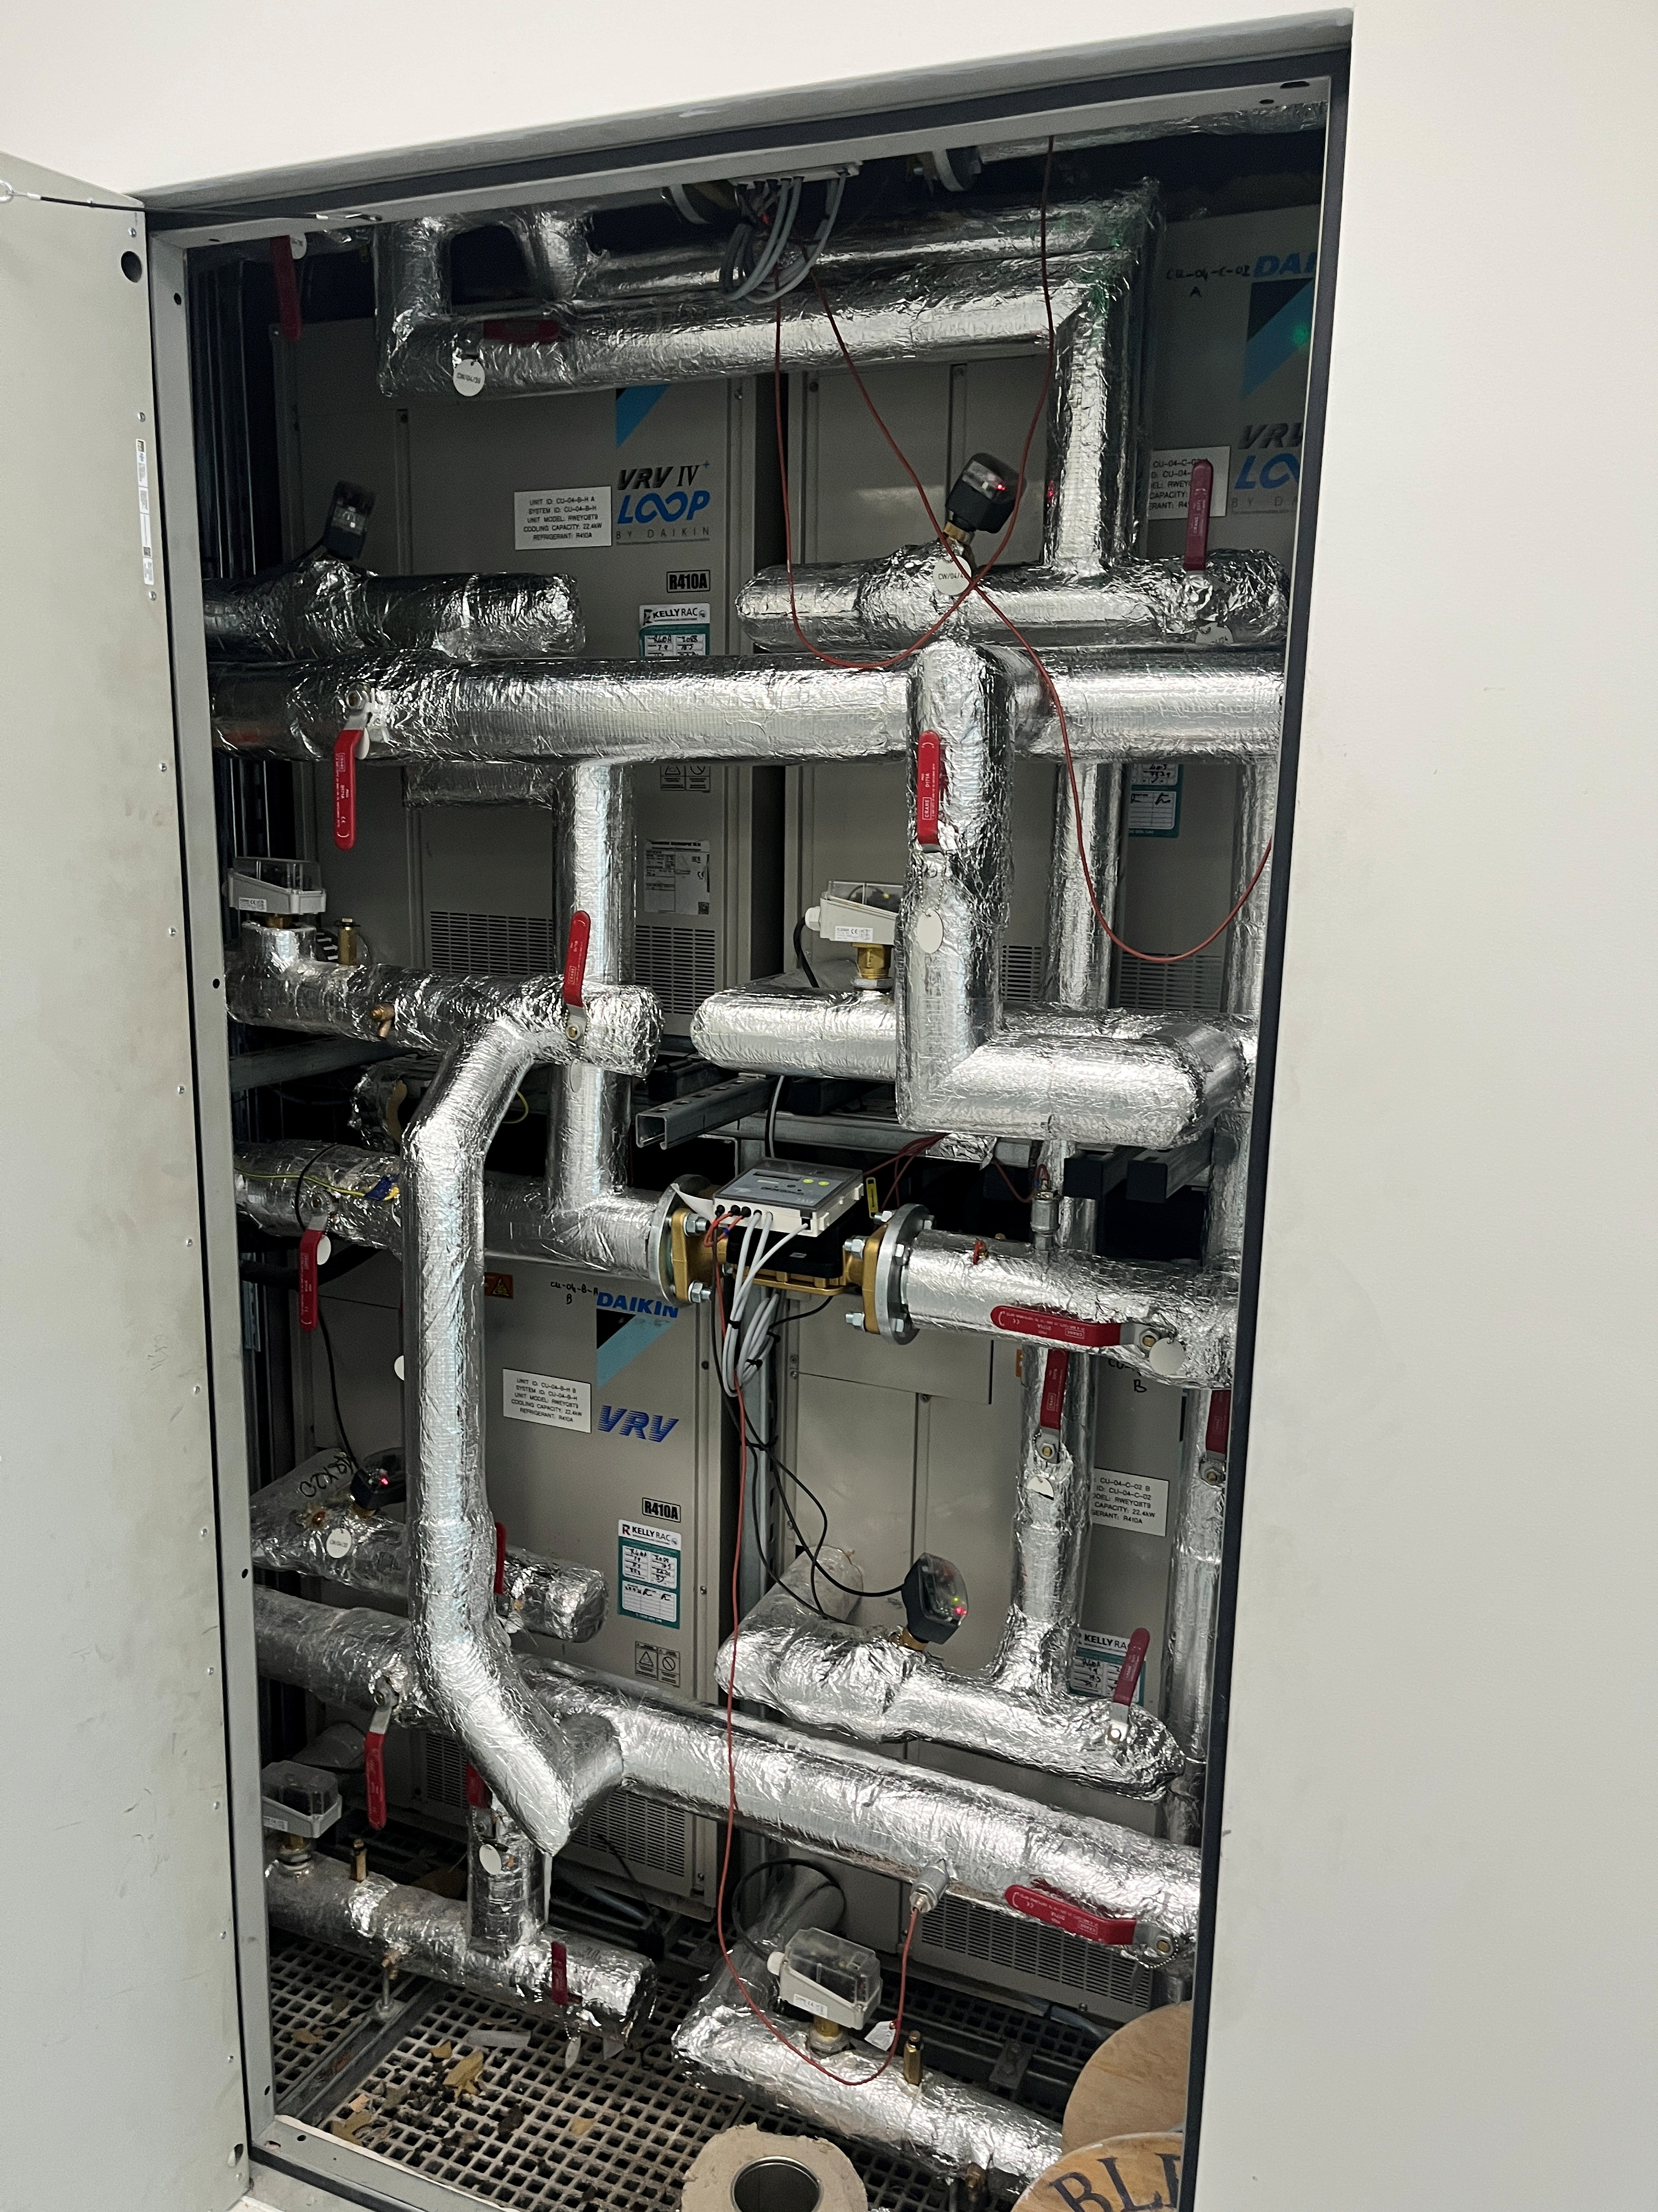
Think forward
Access
Impact
Warranty
Are systems going to be operating to 100% design duty on day one?
What is the risk if they are not?
Domestic water installations modified
Ventilation adjustments

Slide 5
License to alter
Control of process
Being prepared – validations
Access to maintainable assets
Dedicated tenant plant space
Joint witnessing and demonstration
Training
O+M updates – not separate packs

Slide 6
Thank you to our sponsors

Slide 7
Measuring Performance & Facilities Management
Any questions?

