Slide 1
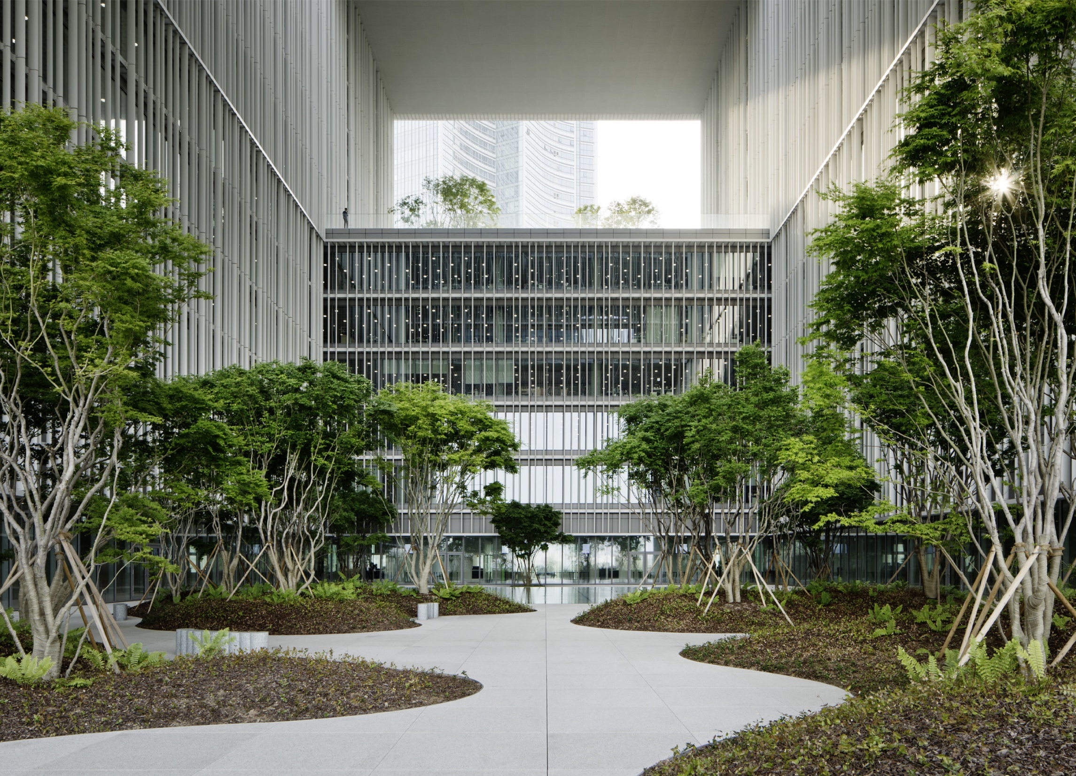
Presentation title runs here
Subtitle runs here.
Click on the image to change it

Slide 2



















Slide 3
Before we get started…
Housekeeping & FAQs

Slide 4
About our Group
Our group is…
We focus on…
Our aim is to…
We are accepting co-opted members if you wish to join the committee. Just ask at the end or email groups@cibse.org.

Slide 5
Subscribe to our emails
If you have not done so already, you can subscribe to our emails.
Visit www.CIBSE.org/login to log into your profile or create a free account
Update your preferences to receive Groups and Networks emails.
Make sure you have our Group ticked.

Slide 6
Code of Conduct
We expect everyone to behave in a professional manner.
If you are made to feel uncomfortable at any CIBSE event, report it to inclusivity@cibse.org

Slide 7

FAQs
Today’s event is scheduled to last 1 hour inclusive of Q&A
Please ask questions throughout/at the end.
This event is/is not being recorded.
The slides will be made available on the CIBSE website.
We have a global network of members and followers. Say hello and tell us your name.
You can join our committee by co-option throughout the year. Come and talk to one of us if you’re interested in joining!

Slide 8



Become a STEM Ambassador
CIBSE STEM Ambassadors visit schools, colleges, universities and youth group organisations. They give an insight into the life of a building services engineer and promote careers in the profession, inspiring the next generation of engineers. Meeting industry experts can have a real impact on students and can inspire their career choices.
www.cibse.org/stem
Notes:
You must be a member of CIBSE to be a CIBSE STEM Ambassador. You can be any grade. Anyone above the age of 17 can join.
You can choose from various listings – there is no minimum required hours. Training and resources are provided via our partner STEM Learning.
You must pass a DBS check as you will be working with children. This can take a couple of months to prepare but it is worth it to promote the profession!

Slide 9

Become a CIBSE Mentor
CIBSE Mentors volunteer their time to help those in their early careers.
You can choose your preference to mentor face-to-face, over phone call, via email or video chat.
Most mentorships last between one to three months and are invaluable to the mentees who will learn from your expertise!
www.cibse.org/mentoring
Notes:
This is separate from sponsoring an application for Chartered status – CIBSE Mentoring focuses on the personal and professional development of a person who is already a member of CIBSE.
Mentors can turn off/on their availability at any point throughout the year.
Any questions can be sent to groups@cibse.org or refer them to the website.

Slide 10
Past Events
Notes:
Why not promote your past events in case you have new members in the audience? Remember to say they can find the slides and recordings on the CIBSE website.

Slide 11
Upcoming Events
Notes:
If you have upcoming events, promote them here!

Slide 12
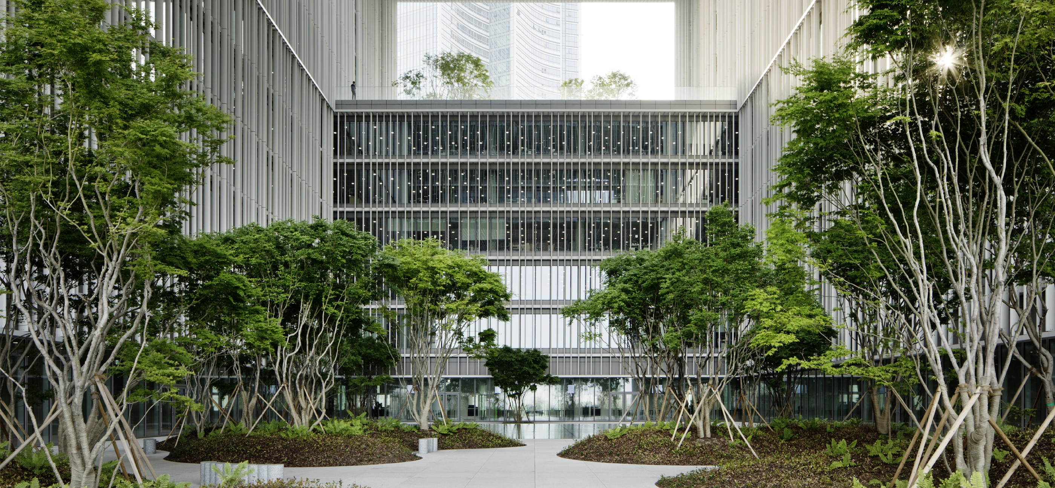
Heading here
  Subheading here

Slide 13
Slide with one column
This is display text it is not here to be read it is here to show how this document will look when populated with real text. This is display text it is not here to be read it is here to show how this document will look when populated with real text. This is display text it is not here to be read it is here to show how this document will look when populated with real text. This is display text it is not here to be read it is here to show how this document will look when populated with real text.
This is display text it is not here to be read it is here to show how this document will look when populated with real text. This is display text it is not here to be read it is here to show how this document will look when populated with real text. This is display text it is not here to be read it is here to show how this document will look when populated with real text. This is display text it is not here to be read it is here to show how this document will look when populated with real text.

Slide 14
Slide with two columns
This is display text it is not here to be read it is here to show how this document will look when populated with real text it is not here to be read. This is display text it is not here to be read it is here to show how this document will look when populated with real text. This is display text it is not here to be read it is here to show how this document will look when populated with real text.
  This is bulleted text
  This is bulleted text
  This is bulleted text
This is display text it is not here to be read it is here to show how this document will look when populated with real text it is not here to be read. This is display text it is not here to be read it is here to show how this document will look.
  This is bulleted text
  This is bulleted text
  This is bulleted text
This is display text it is not here to be read it is here to show how this document will look when populated with real text.

Slide 15
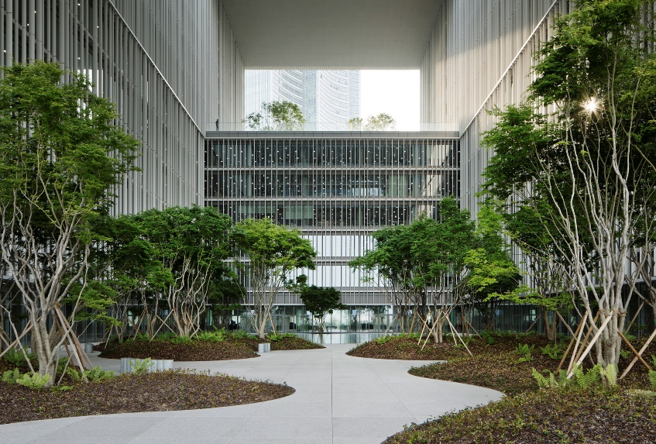
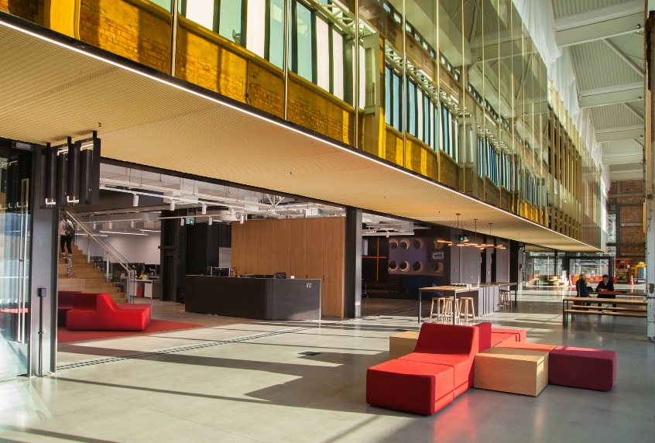
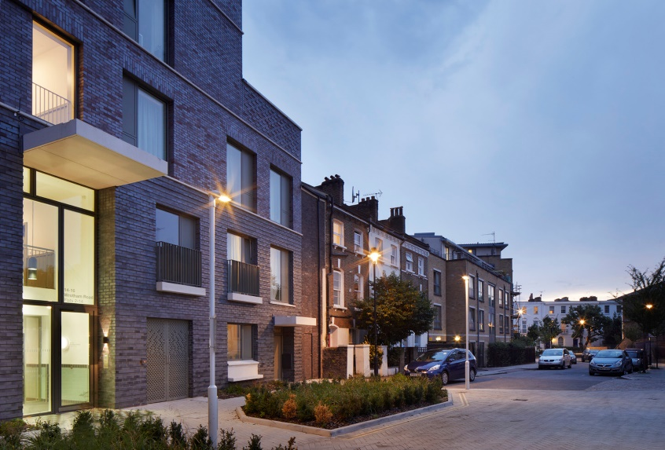
Three images with captions
Caption text here
Caption text here
Caption text here

Slide 16

Slide with one column
This is display text it is not here to be read it is here to show how this document will look when populated with real text it is not here to be read. This is display text it is not here to be read it is here to show how this document will look when populated with real text. This is display text it is not here to be read it is here to show how this document will look when populated with real text.
  This is bulleted text
  This is bulleted text
  This is bulleted text

Slide 17
Three text boxes
Heading here
  This is display text it is not here to be read it is here to show how this document will look when populated.
    Bullet here
    Bullet here
Heading here
  This is display text it is not here to be read it is here to show how this document will look when populated.
    Bullet here
    Bullet here
Heading here
  This is display text it is not here to be read it is here to show how this document will look when populated.
    Bullet here
    Bullet here

Slide 18
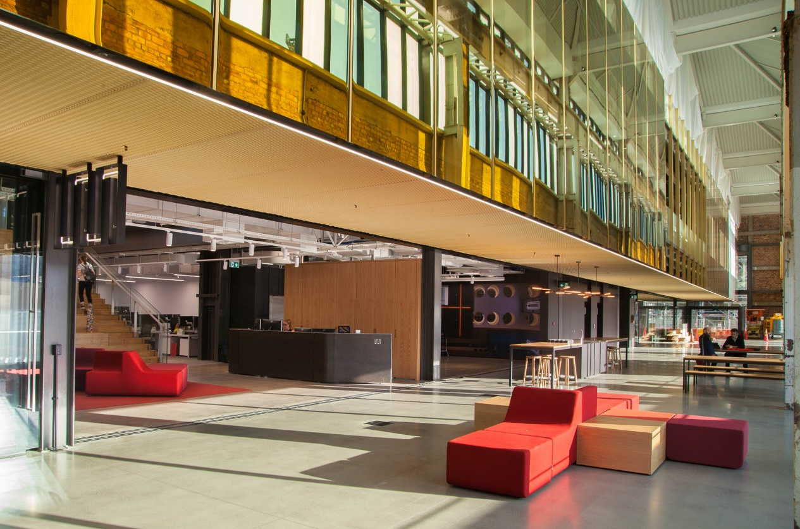
Heading runs here
This is display text it is not here to be read it is here to show how this document will look when populated with real text it is not here to be read. This is display text it is not here to be read it is here to show how this document will look when populated with real text. This is display text it is not here to be read it is here to show how this document will look when populated with real text.
  This is bulleted text
  This is bulleted text
  This is bulleted text

Slide 19

Heading runs here
This is display text it is not here to be read it is here to show how this document will look when populated with real text it is not here to be read. This is display text it is not here to be read it is here to show how this document will look when populated with real text. This is display text it is not here to be read it is here to show how this document will look when populated with real text.
  This is bulleted text
  This is bulleted text
  This is bulleted text

Slide 20
Thank you for attending!
To learn about CIBSE Special Interest Groups, visit cibse.org/sigs
To get involved with CIBSE, visit cibse.org/get-involved
To learn about CIBSE membership, visit cibse.org/join-cibse

