Slide 1
Automation²
Using engineering software tools and augmented intelligence to drive productivity, efficiency and standardisation in the built environment sector.
Notes:
Introduction
Why Automation squared? We are going to talk about applying automation to the automation industry
In other terms I would like to talk about the use of eng software tools in our industry and the benefits of these

Slide 2
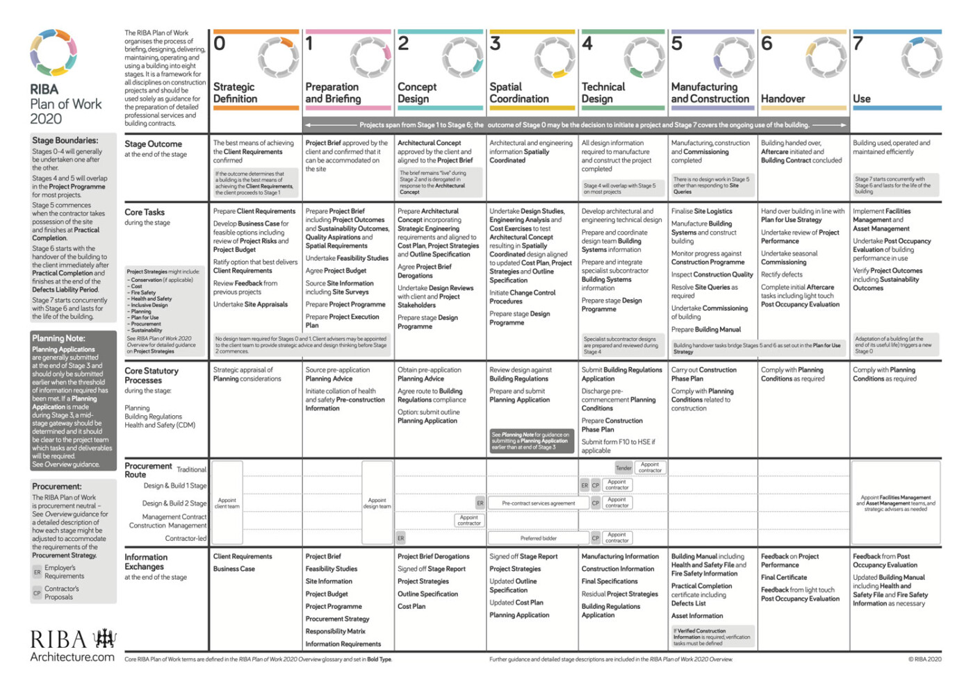
The project lifecycle
Notes:
BMS involvement in projects traditionally starts too late in the project cycle, this needs to change as projects become even more data heavy and are built to be connected to the cloud
Network design
Nomenclature / naming conventions/building keys/symantic tagging for MQTT and other IOT protocols
Design overlap – Presence sensing in lighting, bms and intruder systems for example – one data set, one time

Slide 3
The project lifecycle
Notes:
Explain why we believe we should be earlier in the process

Slide 4
Augmented Intelligence
Augmented as opposed to Artificial (trigger warning)
Best practice rule sets
Task automation
Still requires input from a technical human
Context is everything
Artificial common sense
Notes:
We are going to talk about AI… Not Artificial intelligence, trigger warning, I have seen people apoplectic over claims of Artificial I used in our industry
Why augmented not Art
What is augmented – rules – automation of tasks, still needs humans
Context is needed– anecdote about the AI platform installed on data centre to optimise energy – kept wanting to shut down the chillers to save energy
Context is needed – AI platforms exist that can create an image from text – what happens if you ask it to create salmon swimming in a river ?? Next slide

Slide 5
Augmented Intelligence
Augmented as opposed to Artificial (trigger warning)
Best practice rule sets
Task automation
Still requires input from a technical human
Context is everything
Artificial common sense

Slide 6
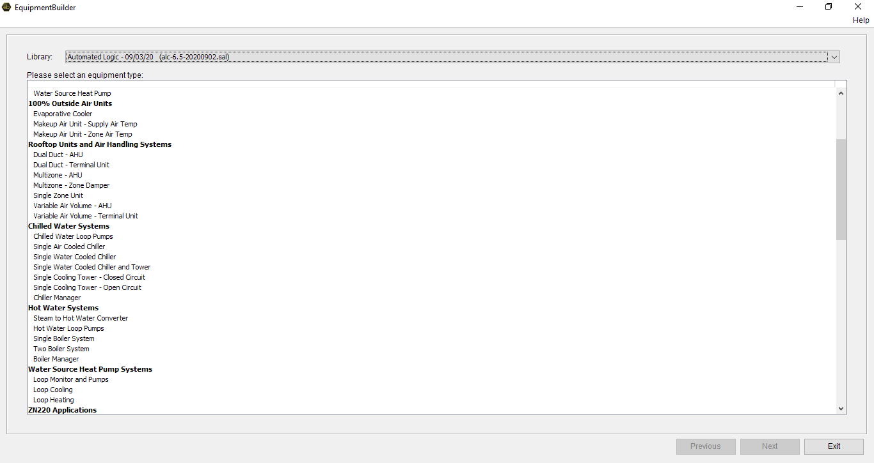
Using AI in the real world
Notes:
Run through of the current augmented intelligence systems
Benefits from a design consultancy point of view:
Rapid development (drastically increases speed) from performance spec to detailed spec/points-list/des-of-ops
Allows HVAC knowledge of consultants to translate into accurate BMS schematics/points-lists/des-of-ops
We are a truly native BACnet system – BACnet is manufacturer agnostic – the ‘Esperanto’ of the HVAC world

Slide 7
Using AI in the real world
Notes:
Run through of the current augmented intelligence systems

Slide 8
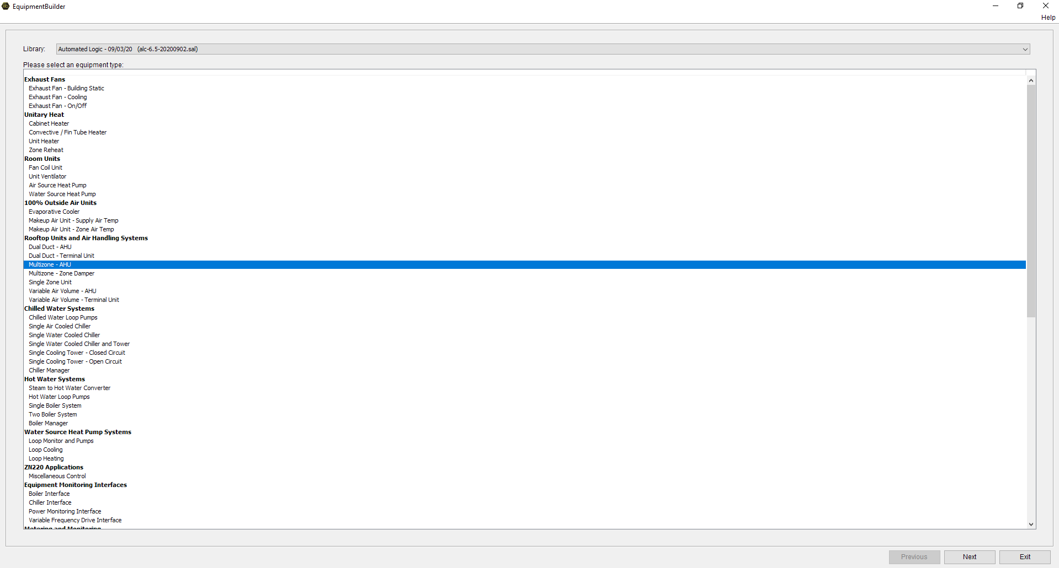
Using AI in the real world
We have selected a single duct – multizone AHU
Notes:
Run through of the current augmented intelligence systems

Slide 9
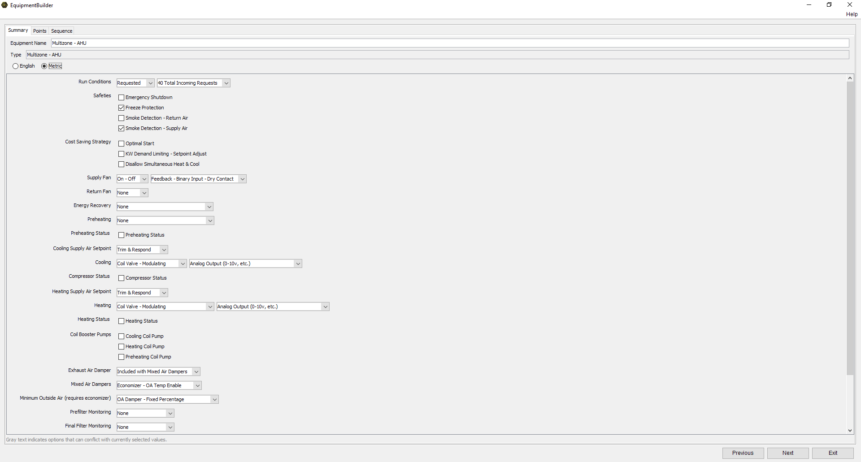
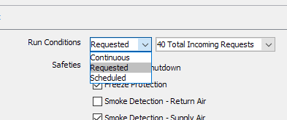
Using AI in the real world
Notes:
Impossible to illustrate the efficiency of an entire system as HVAC/equipment not selected at this time, and that is what impacts system efficiency –
we do however allow selection of parameters to control some efficiencies
Run conditions – can be set to:
continuous – on all the time
Requested – on demand from terminal units/other parts of the system/occupancy etc
Scheduled – based on time schedules for example
Cost saving– can be set to:
Optimal start – optimizer/compensator in old money
Overall KW limit – do not exceed, etc
Heat/cool – this is not for spaces – this is about dehumidification etc

Slide 10
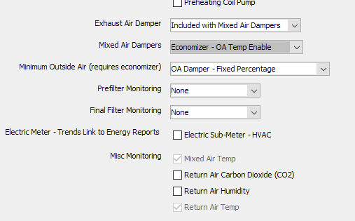
Using AI in the real world
Notes:
Run through of the current augmented intelligence systems
Selection of features of the AHU – drop down menus
Heat recovery
Cooling type – dx/coil, etc
Energy monotoring

Slide 11
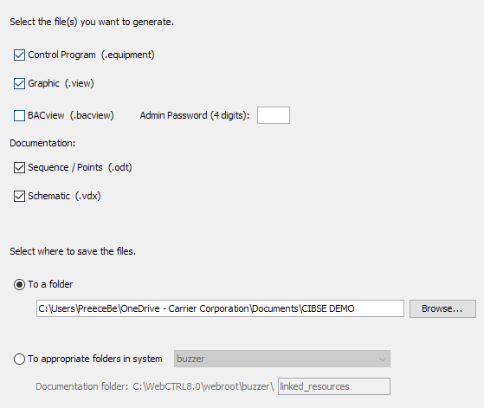
Using AI in the real world
Notes:
Select what you would like the AI to create
Logic
Graphic
Des-Ops and Points List
Schematic
Tell it where you want it to be stored

Slide 12
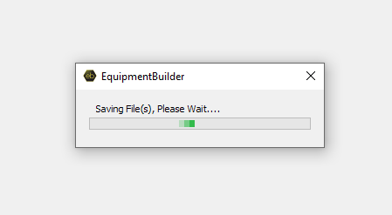
Using AI in the real world
Notes:
The system does its thing

Slide 13
Using AI in the real world
Notes:
Here are the files created

Slide 14
Using AI in the real world
Notes:
Here are the files on my laptop

Slide 15
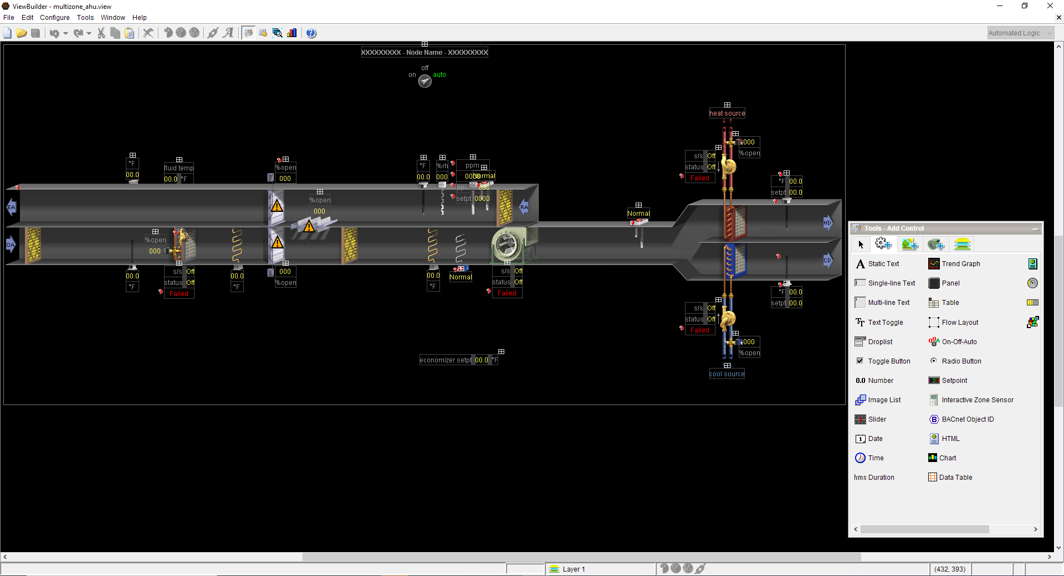
Using AI in the real world
Notes:
The graphic created by AI with all of the elements we asked for

Slide 16
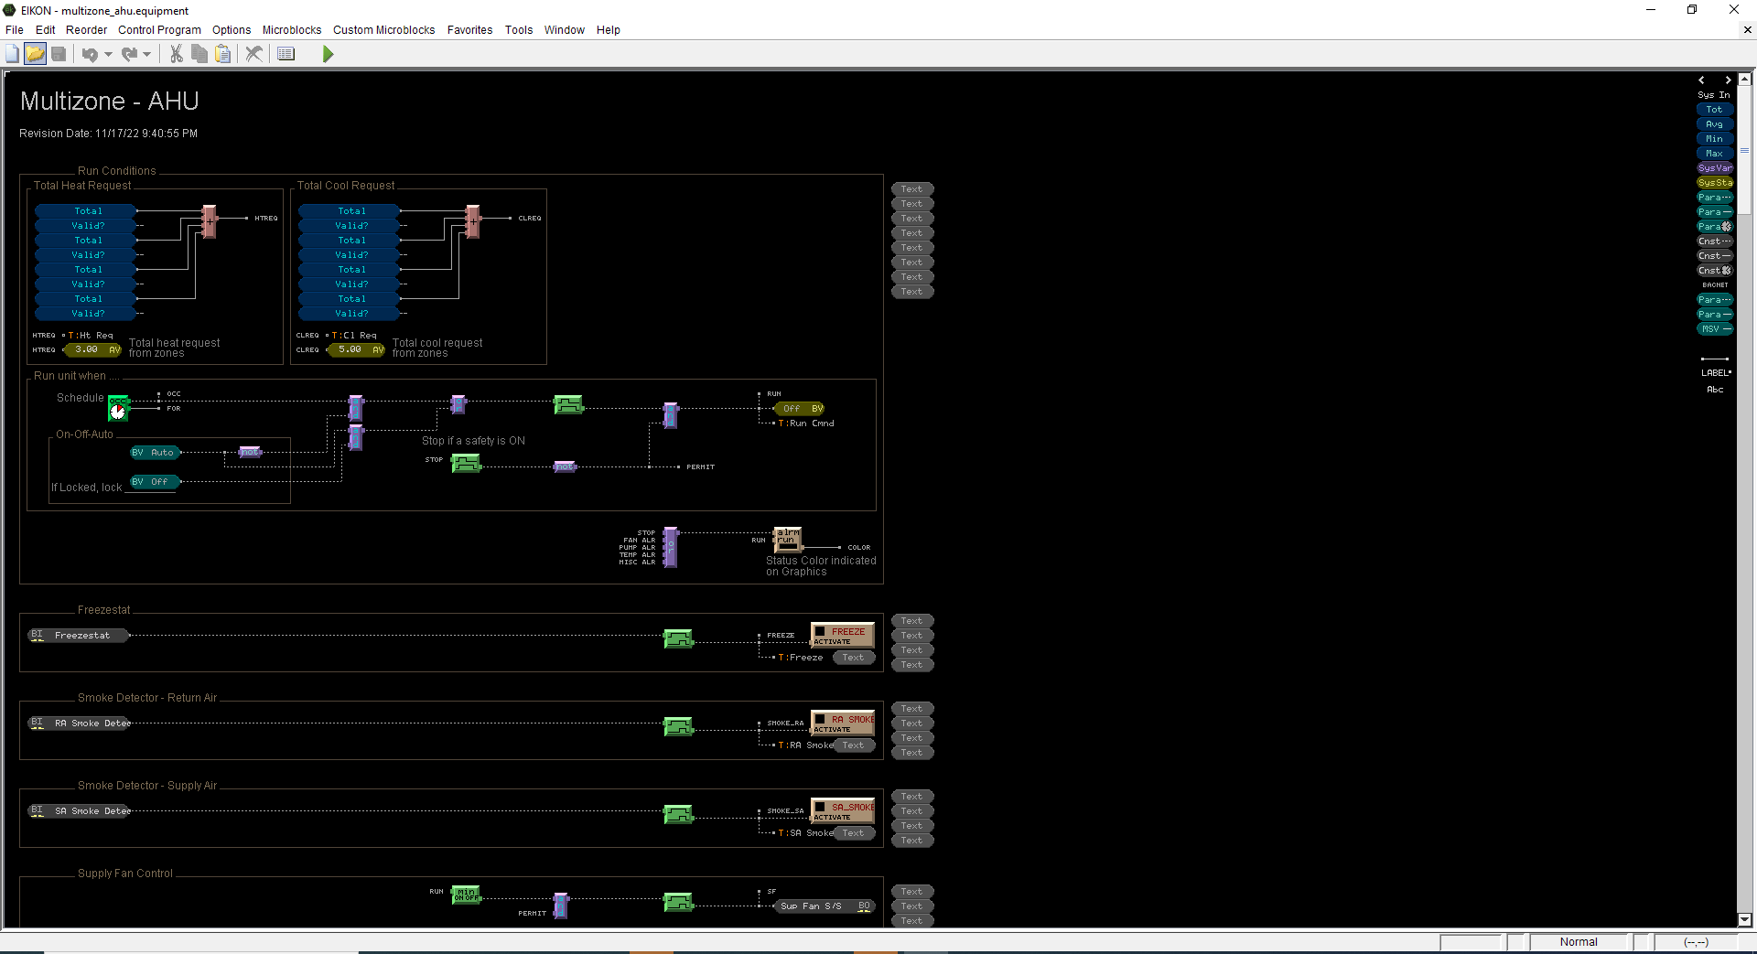
Using AI in the real world
Notes:
Heres the logic created..
Heres the schedule section run if schedule dictates hand off auto, safety switch – programming by AI!!!!!

Slide 17
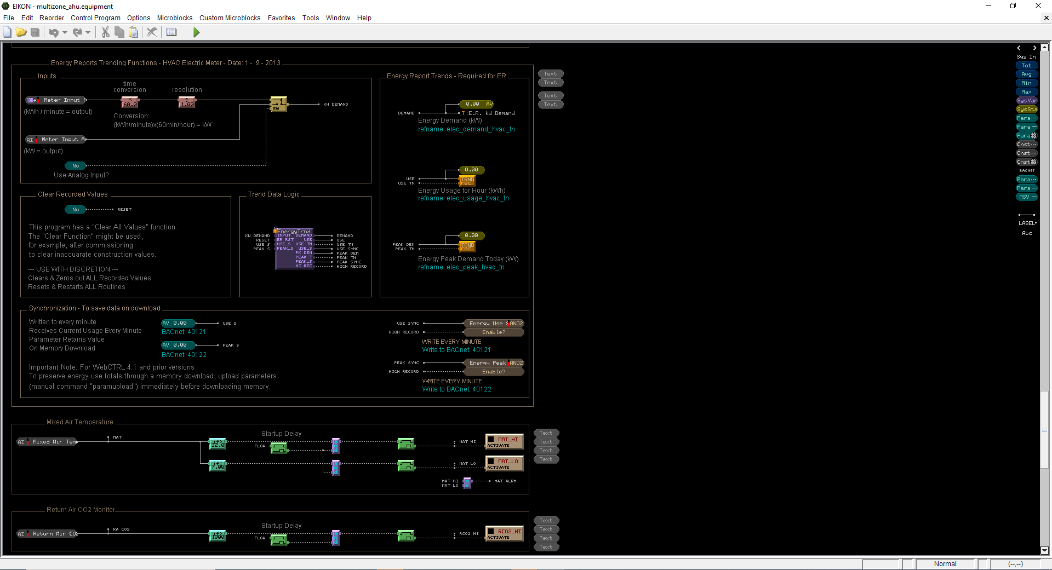
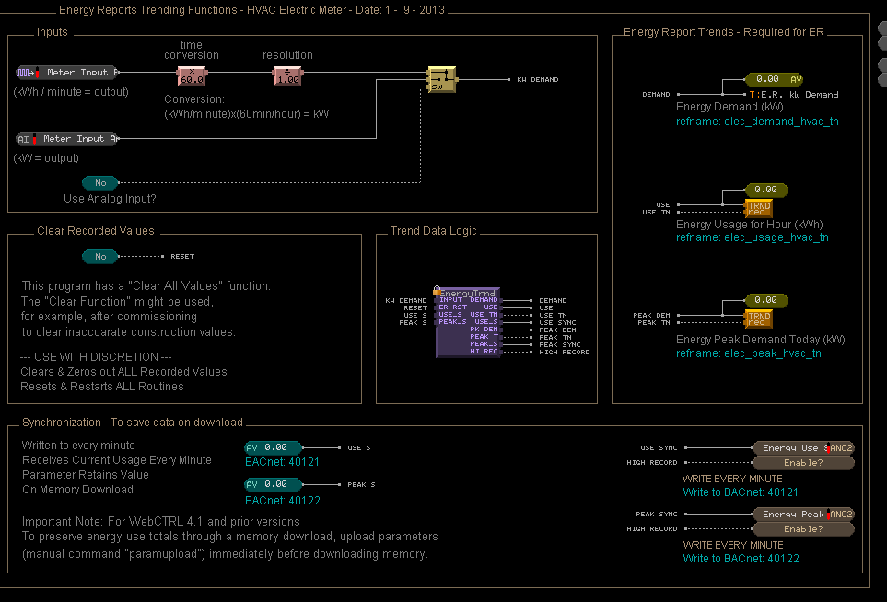
Using AI in the real world
Notes:
Energy metering section….
Energy meter integration. Done right. Done by AI
Trend data too – and all with a plain (ok American, but still) English description

Slide 18
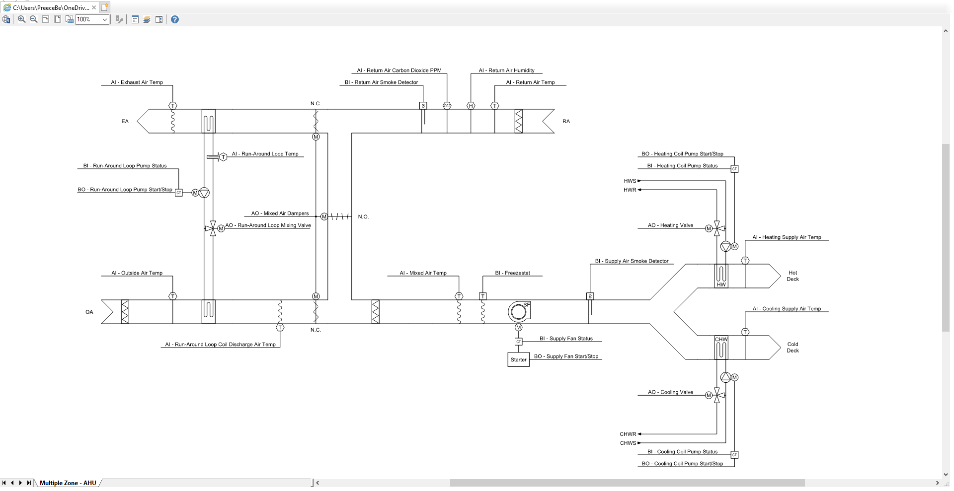
Using AI in the real world
Notes:
A full schematic generated by AI

Slide 19
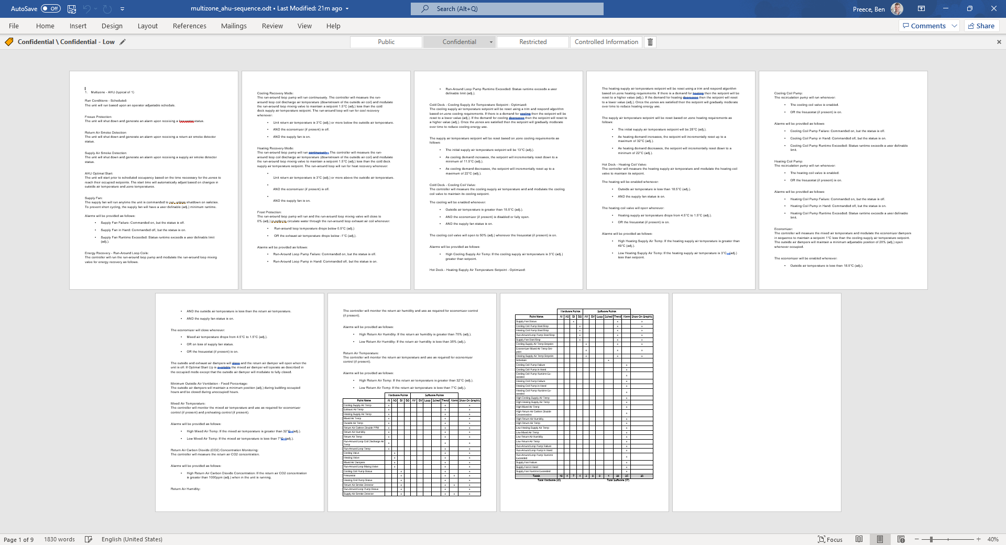
Using AI in the real world
Notes:
9 pages, 1830 words – AI did it!
Go to des ops and points list file in browser…
Show details and then return to ppt

Slide 20
What are the benefits
Speed – Project timescales
Ensuring compliance with best practice
Removes user error and individualistic traits from programs and graphics
Ensures conformance with naming conventions, etc for cloud level analytics
Ensures commonality across programs
Ensures commonality across Graphics
Reducing level of tech knowledge required
Notes:
Benefits roundup

Slide 21
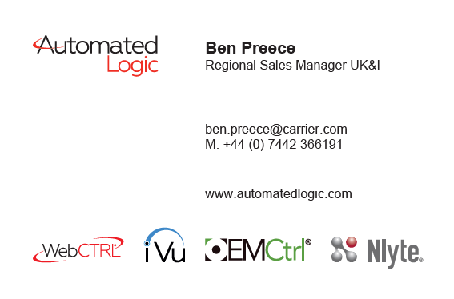
Notes:
Thanks for your time, any questions

Slide 22
Automation²
Using engineering software tools and augmented intelligence to drive productivity, efficiency and standardisation in the built environment sector.
Notes:
end

