Slide 1
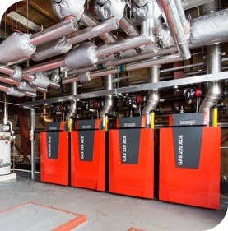
Road to Net Zero – Heat Pumps

Slide 2
  AGENDA
  Energy Transition and Legislation Drivers
  Blended - Approach to Net Zero
  Heat Pump – Technology
  Traditional Design / Installation
  DNO Connections
  Typical Schematics

Slide 3
  AGENDA
  Energy Transition and Legislation Drivers
  Blended - Approach to Net Zero
  Heat Pump – Technology
  Traditional Design / Installation
  DNO Connections
  Typical Schematics

Slide 4
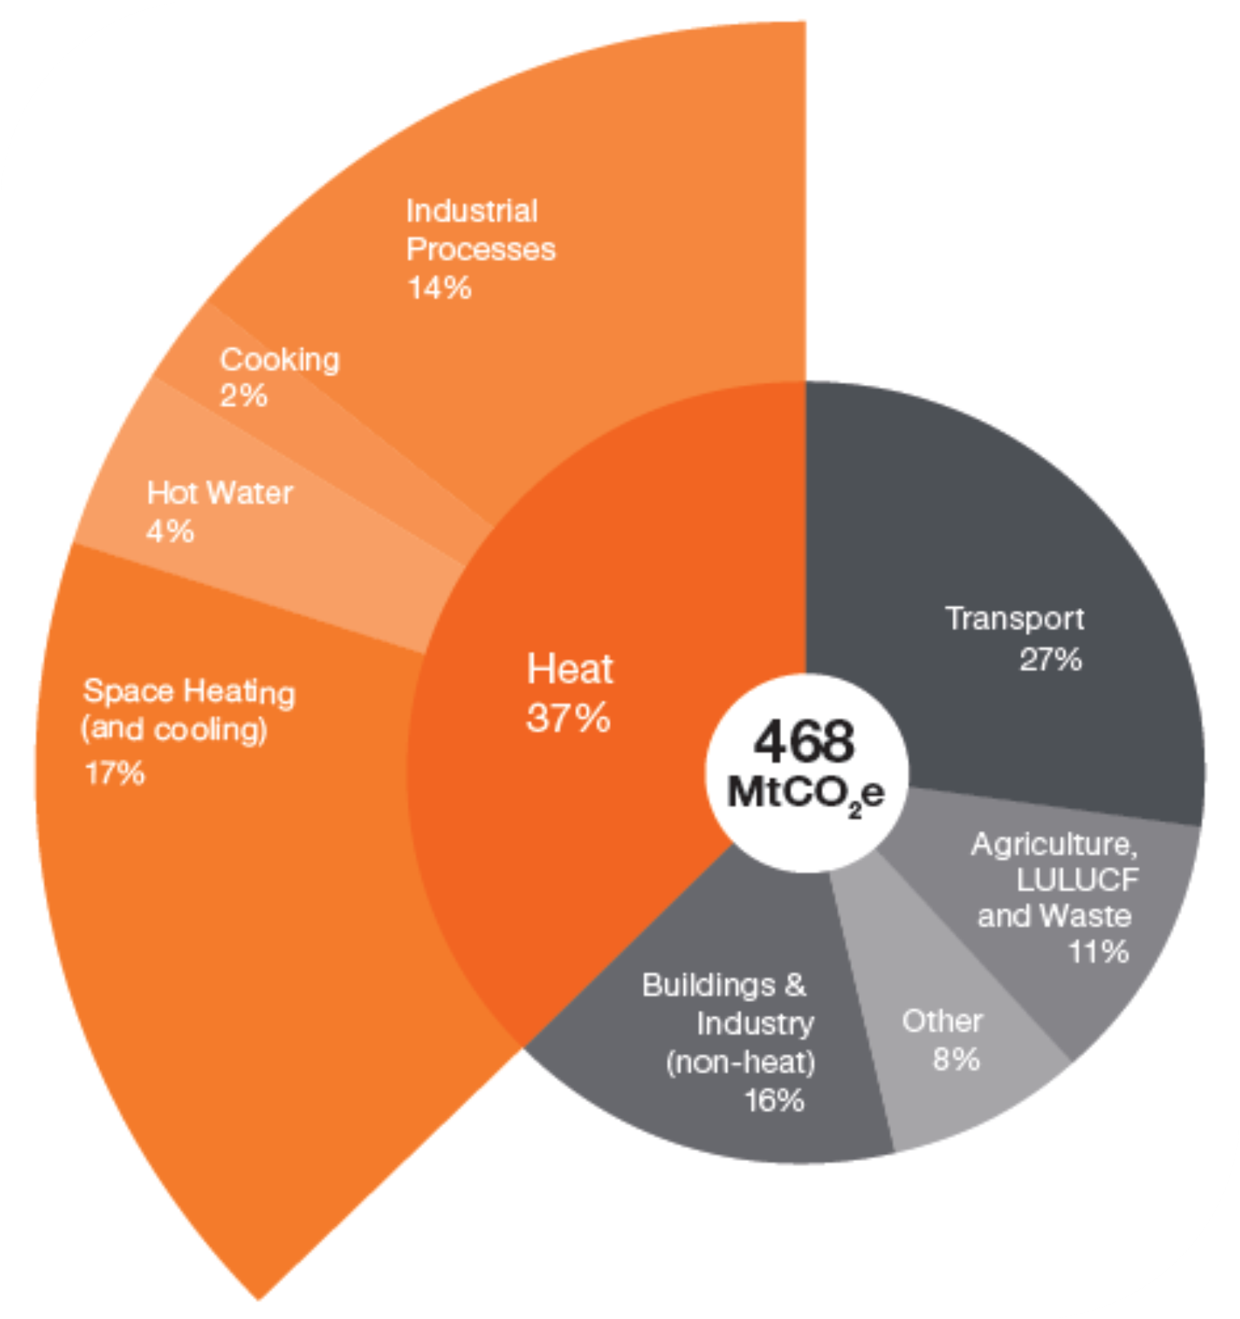
Energy Transition and Legislation Drivers
2019
UK government set a legally binding-target to achieve net-zero greenhouse gas emissions from across the UK economy by 2050.
Heating is responsible for over a third of our emissions. Meeting our net-zero target will require virtually all heat in buildings to be decarbonised by 2050, and heat in industry to be reduced to close to zero carbon emissions.
Notes:
The world environment is driving the need for change to a lower or net zero carbon economy and as such we need to change the way we think about energy. Customers are not building engineers so they need the support of the manufacturers and industry to impart the right knowledge so the end user is not inconvenienced by the new technology which could cost the consumer a lot of money.

Slide 5
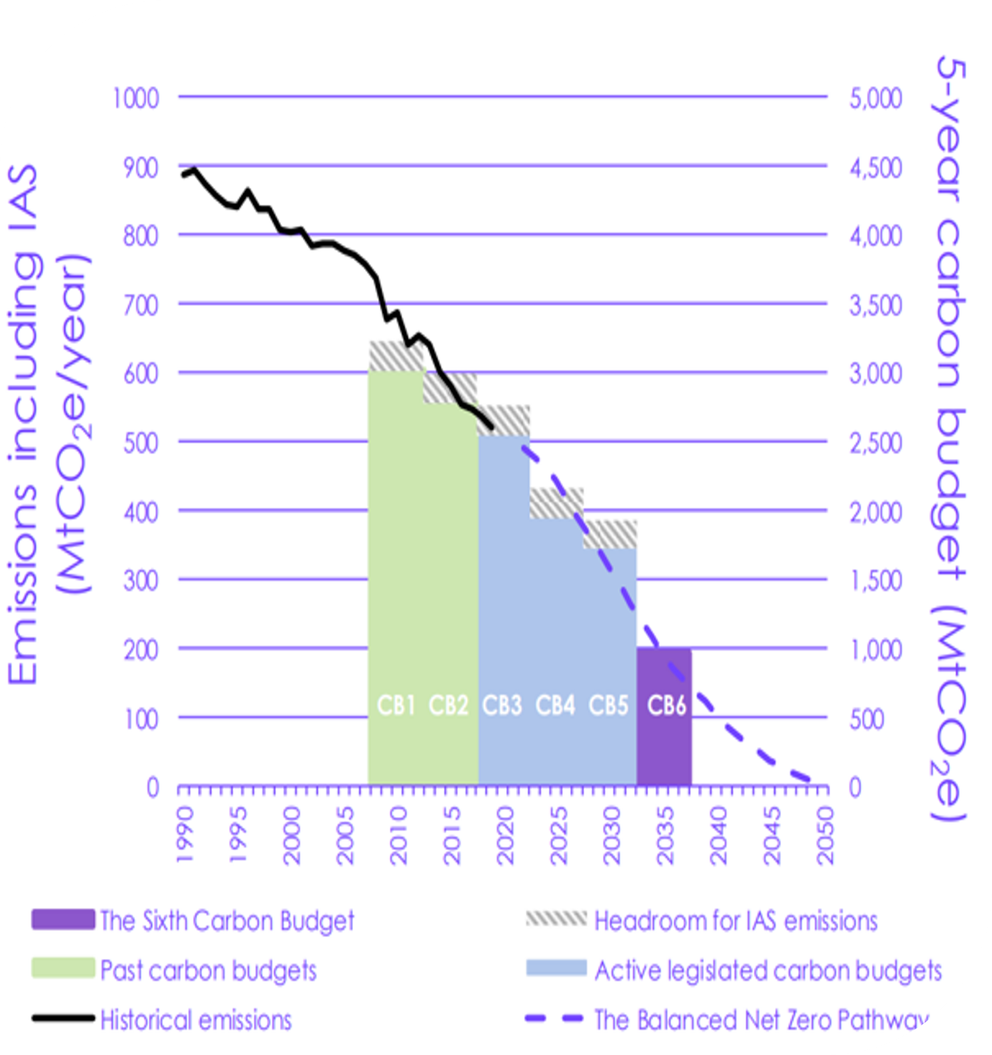
Energy Transition and Legislation Drivers
Legislated Carbon Budgets are in place to track progress towards the 2050 target
Much of the progress to date has not impacted directly on consumer’s homes and heating provision
Meeting carbon budgets 4 through 6 will require significant change in how we heat our buildings
Notes:
This details what UK carbon budgets are. A carbon budget is a cap on the amount of greenhouse gases emitted by the UK over a five year period. Budgets must be set at least 12 years in advance to allow policy-makers, businesses and individuals time to prepare. The CCC advises on the appropriate level of each carbon budget. This graph shows the reduction in emissions since 1990 and the UK’s target to 2025. The pathway meets the Paris Agreement stipulation of highest possible ambition. The pathway has recommended a 78% reduction in the UK territorial emissions between 1990 and 2035. In effect, it brings forward to UK’s previous 80% target by nearly 15 years to 2035.

Slide 6

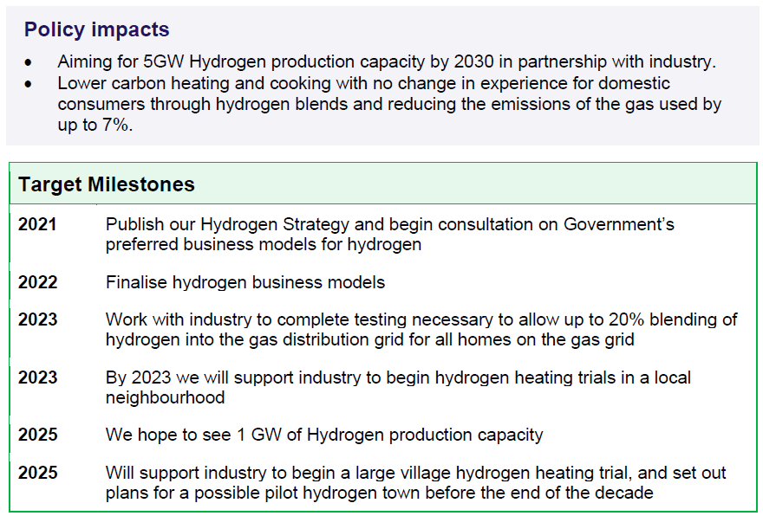
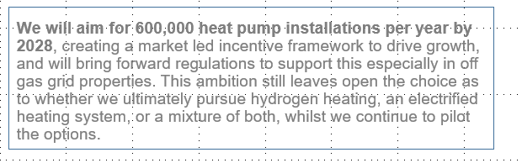
Energy Transition and Legislation Drivers
Notes:
This document has now been replaced by the Net Zero Strategy: Build Back Greener issued October 2021. This is the UK government’s ideal goal but it needs to be explained that 600,000 heat pump installations per year by 2028 is a tough target to reach as the grid network in the UK has to have an ambition of the same level and already we have heard of rejections to planning requests from developers and end users alike for the connection of large ASHP’s in concentrated areas of the UK so there needs to be closer agreement between the industry and suppliers of the products and the power with which to supply the electricity.

Slide 7

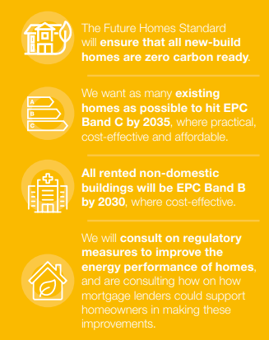


Energy Transition and Legislation Drivers
Notes:
The white paper has been released at an unprecedented challenge for the UK. It outlines the challenges we face as a UK economy as well as a Global one. This will require our society to change their attitude and understanding towards energy and heating as we move from fossil fuels to the electric economy with the industry working with government to ensure we all pass on valuable knowledge to the end user and so understanding what the white paper suggests is key to that transition.

Slide 8
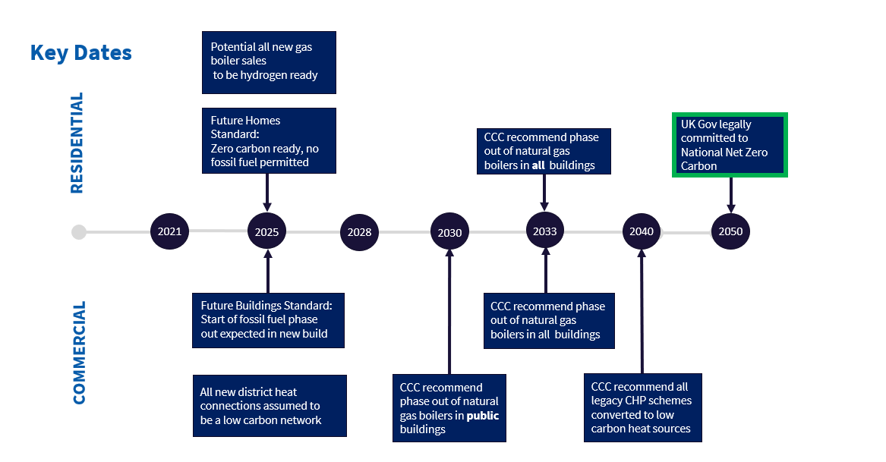
Energy Transition and Legislation Drivers
Notes:
This details in diagrammatic form the key steps to a net zero carbon commitment during 2050 with the key dates of 2025, 2030, 2033, 2040 and to total net zero in 2050

Slide 9
  AGENDA
  Energy Transition and Legislation Drivers
  Blended - Approach to Net Zero
  Heat Pump – Technology
  Traditional Design / Installation
  DNO Connections
  Typical Schematics

Slide 10
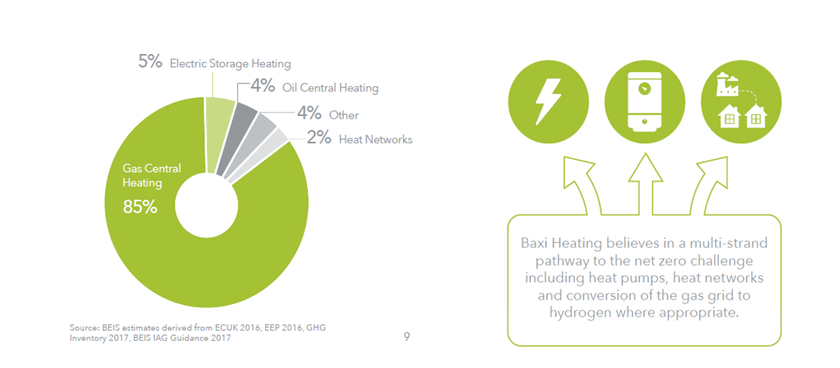
Blended - Approach to Net Zero
Notes:
This shows our company ethos from the old way of domestic and commercial heating looking forward to the new technologies supporting the pathway to a net zero carbon method our heating our homes and hot water via heat pumps, heat networks and the conversion from the fossil fuel gas grid to the new hydrogen technology as it develops and replaces the current fossil fuel grid. Within the group we have the solution to satisfy this requirement with all of the key components to succeed in driving the environmental change

Slide 11
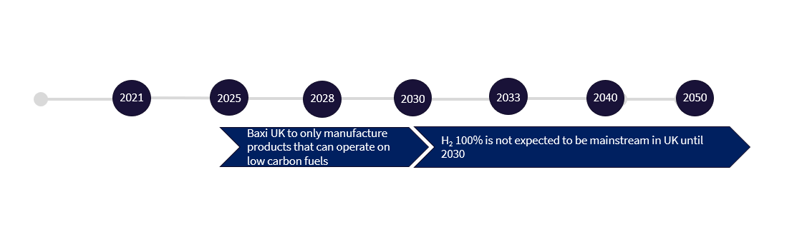
Blended - Approach to Net Zero
Notes:
Our approach to the net zero future begins right now. From 2025 we will only manufacture products that can run on low carbon fuels including the end goal of a 100% hydrogen fuel economy

Slide 12
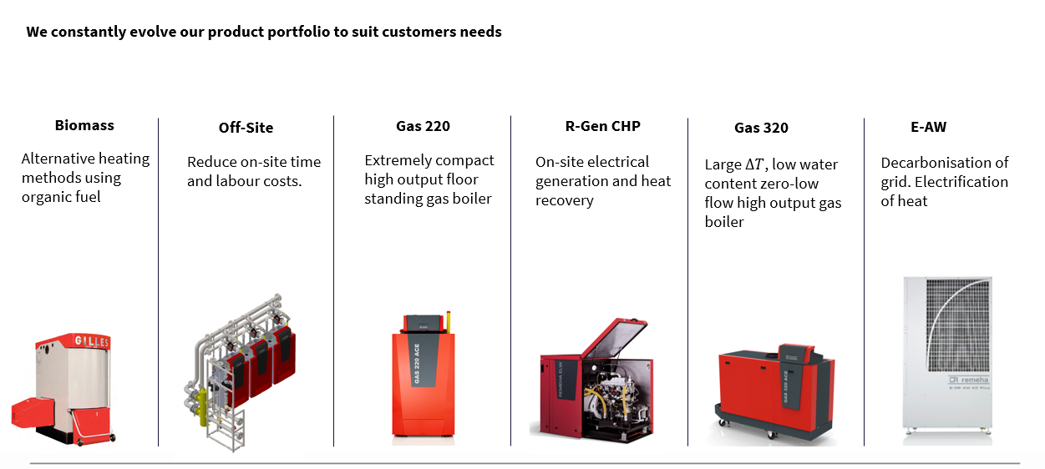
Blended - Approach to Net Zero
Notes:
Since the manufacture of heating appliances Baxi has been at the forefront of the evolving systems that have reduced emissions and as we move to a net zero future we are keeping pace and developing new products for our homes and new commercial buildings whilst pushing the boundaries of what we can achieve in making heating and hot water zero carbon

Slide 13

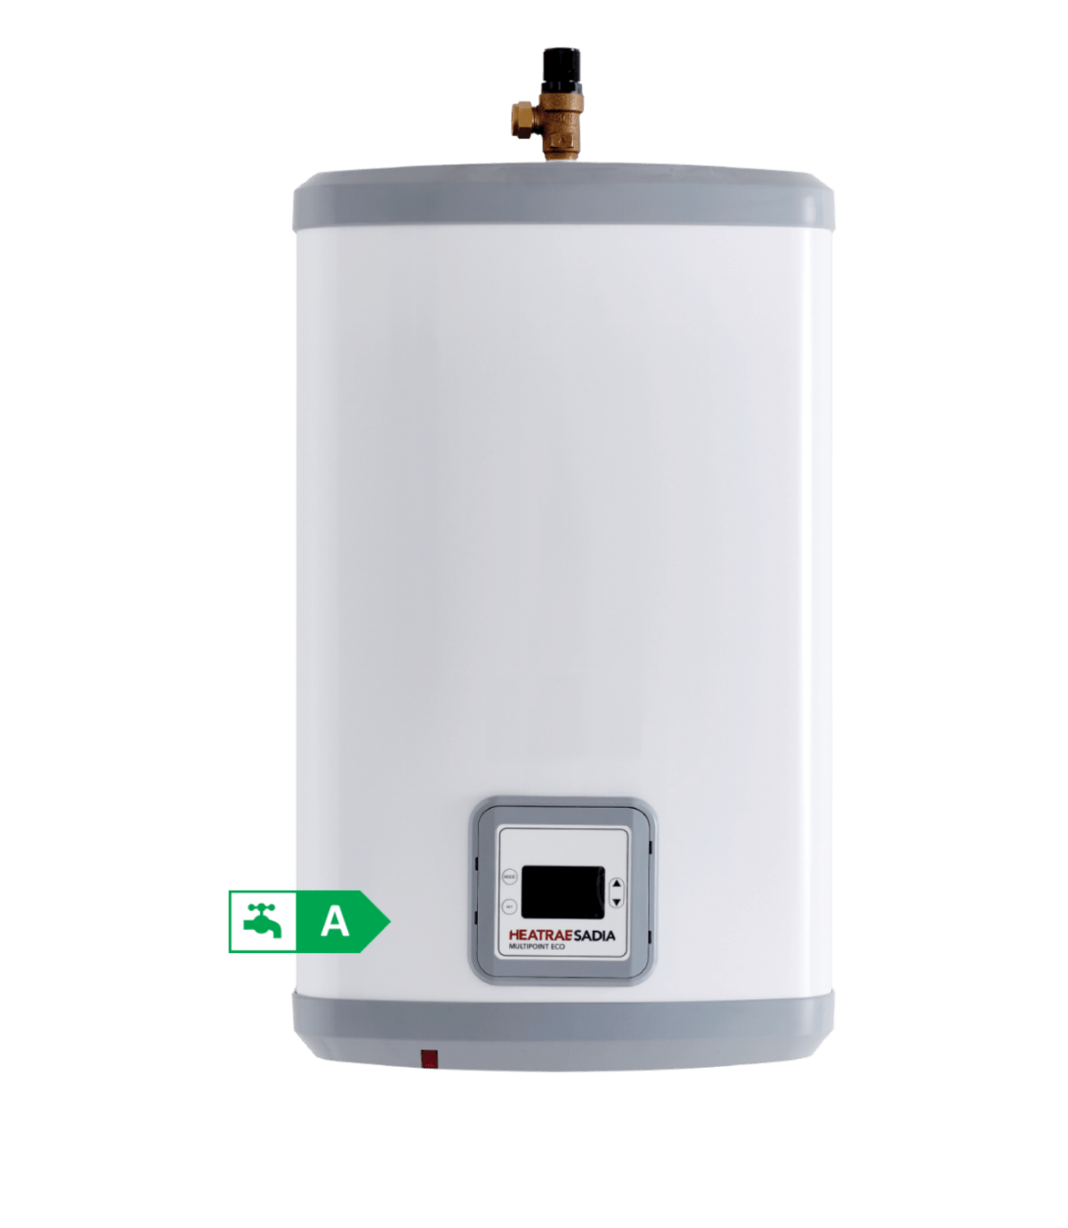




Blended - Approach to Net Zero
Notes:
Through the approach to the net zero we have developed appliances that can achieve the changes we have to make to save our planet. ASHP technology moving forward complimented by our range of 20% hydrogen ready boilers and on to the new future as we heat our homes and buildings with hydrogen

Slide 14
  AGENDA
  Energy Transition and Legislation Drivers
  Blended - Approach to Net Zero
  Heat Pump – Technology
  Traditional Design / Installation
  DNO Connections
  Typical Schematics

Slide 15
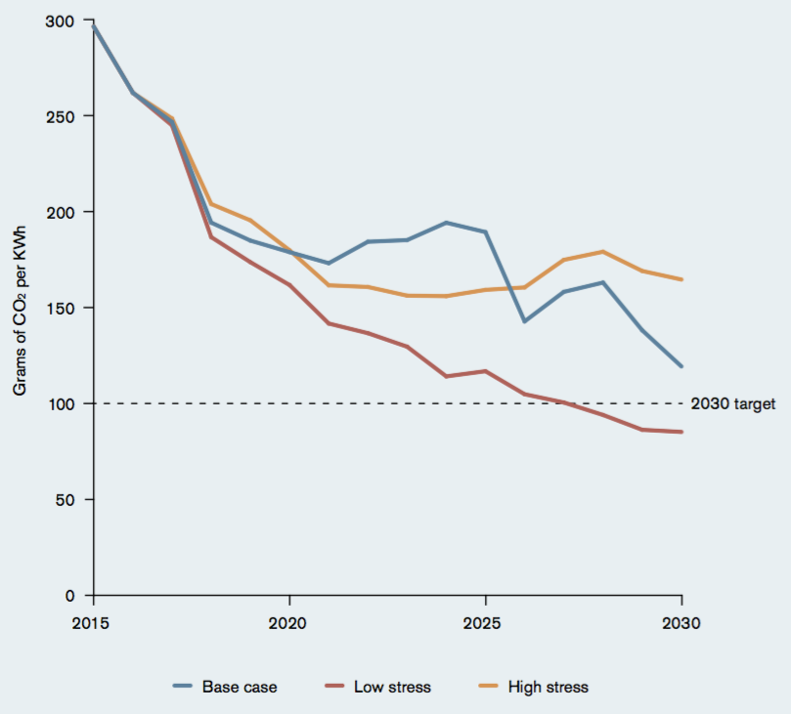
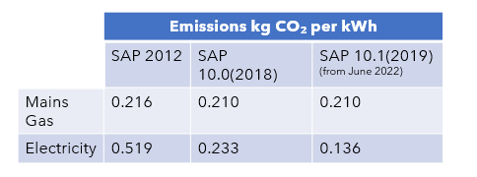
Heat Pump – Technology – Carbon Intensity
Why Heat Pumps?
Decarbonation electrical grid energy
Natural gas phase out
Up to 400% energy efficient
Notes:
As we reduce our reliance on fossil fuels we have the answers to produce hot water and heating for our homes and commercial buildings. As the grid reduces in emissions it opens up the gap against our reliance on fossil fuels by becoming greener as the technology speeds up towards net zero grid electricity without the need for fossil fuels in the energy mix

Slide 16
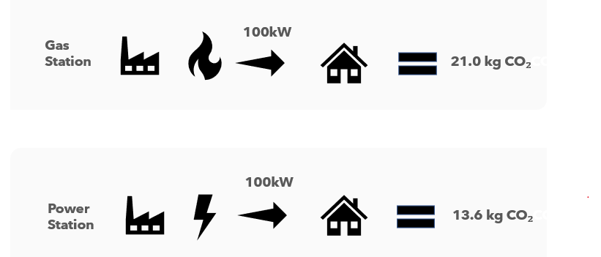
Heat Pump – Technology – Carbon Intensity
Notes:
ASHP when compared to the fossil fuel supplied heating show their true potential as the amount of carbon released into our atmosphere is reduced by at least 36% as our power supply reduces it’s reliance on fossil fuel powered stations to more environmentally friendly and more sustainable wind and solar powered electricity

Slide 17
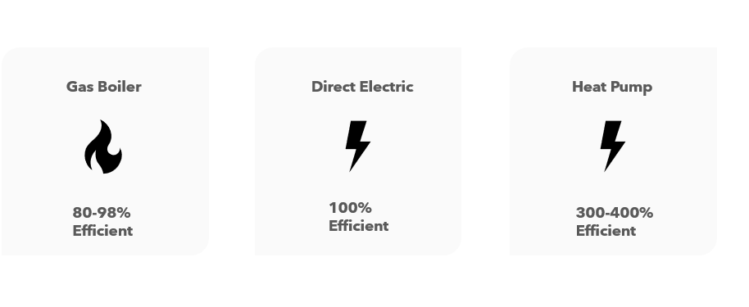
Heat Pump – Technology Efficiencies
Notes:
As we transition from the traditional fossil fuels electrified sources not only improve our environment bit ASHP are proving to be a lot more efficient as one energy enters the process and due to the efficient use of the air can produce up to 400% energy produced when compared to a traditional gas boiler at 80-98% efficient. When designed, installed as per the manufacturers instructions they are the new way to improve our planet

Slide 18
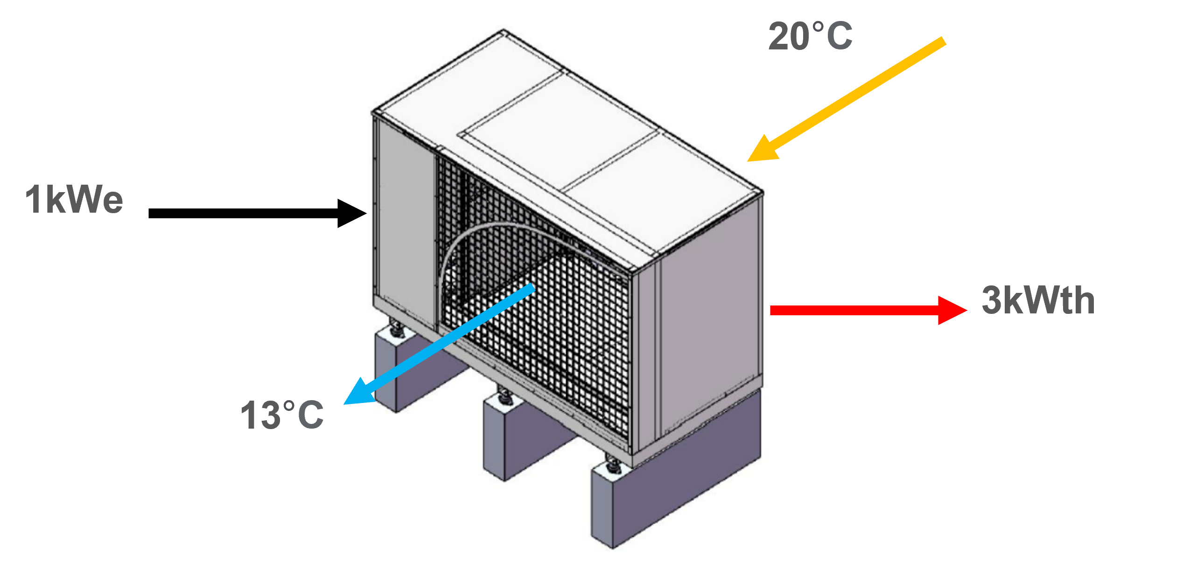
Heat Pump – Technology
How can a heat pump be > 100% efficiency?
Heat is taken from ambient air. This is the renewable aspect as this is ‘free
Notes:
Heat pump technology has been available for many years and has often been used in hybrid systems for heating and hot water since the early 2000’s but the technology has improved as the demands on it has increased. The electric Air Source Heat Pump draws ambient air in to the unit by using a variable-speed controller to keep the air moving at a comfortable velocity and in a typical setting can gain upto 4kWh thermal energy from 1kWh electric energy. They are optimized for flow temperatures between 30֯C - 40֯C and are suitable for well insulated buildings.

Slide 19
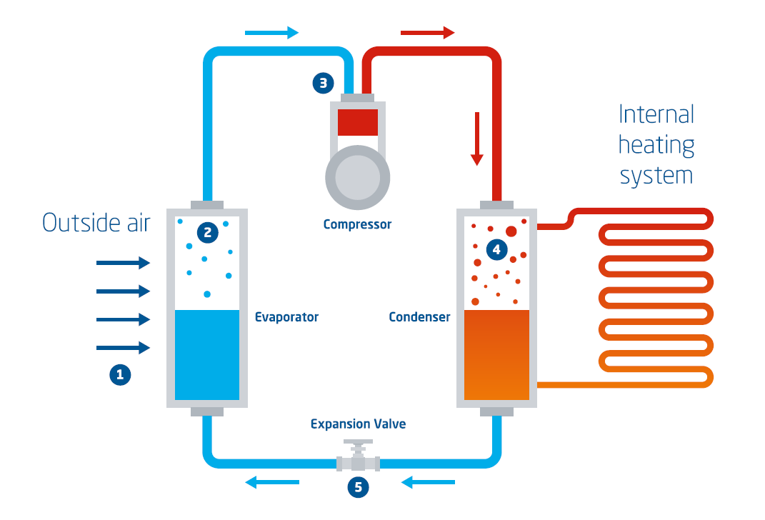
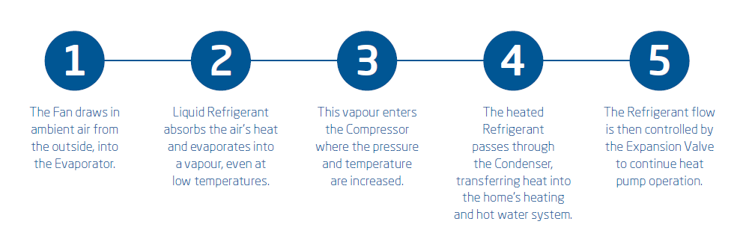
Air Source Heat Pump – Technology – Components
Notes:
How an air source heat pumps is that it uses the same technology as you kitchen fridge or freezer to move heat from one place to another. It uses the temperature of the air circulating outside of your property to warm a liquid refrigerant. The heat pump turns the refrigerant into a gas, compresses it and then turns it back into a liquid again which will generate heat energy and the cycle will start again.
What makes the heat pump sustainable is the air is outside is determined by the sun and local weather conditions and is therefore a renewable source of heat.

Slide 20
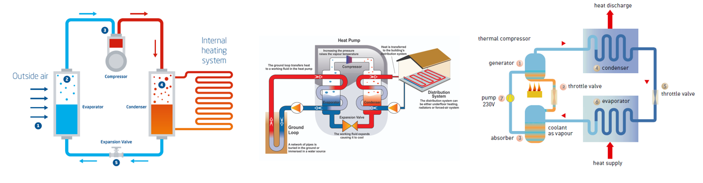
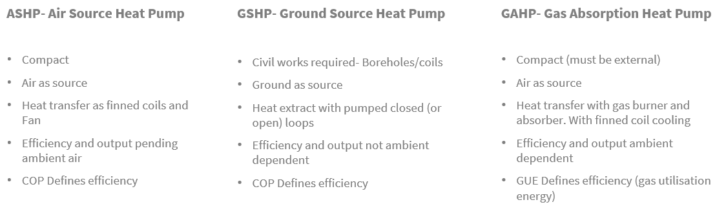
Heat Pump – Technology – Types
Notes:
Heat pump technology comes in several forms. ASHP already explained is from the air local to your building. GSHP rely on slinkies(underground pipes installed in either horizontal or vertical plains to collect heat and transfer it to the heat pump near the property) or the GAHP which relies on a gas supply to heat a flame which then has similar characteristics as the former ASHP and GSHP. The most efficient heat pump is the water or ground source heat pumps as the ground temperatures are often more stable. The cons are the cost of the study that takes place before the planning can be started plus the cost of the groundworks associated with either laying the pipework system out flat or drilling costs sinking a ‘’borehole’’ very deep into the earth

Slide 21
  AGENDA
  Energy Transition and Legislation Drivers
  Blended - Approach to Net Zero
  Heat Pump – Technology
  Traditional Design / Installation
  DNO Connections
  Typical Schematics

Slide 22
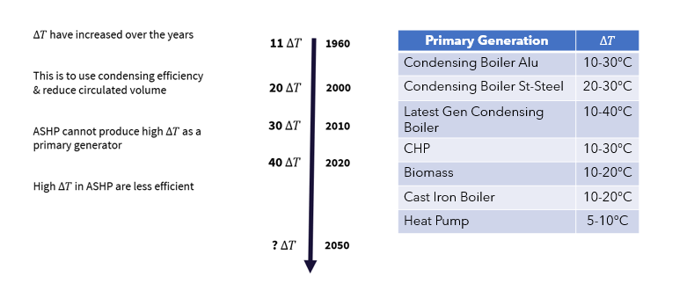
Typical Design – F&R $∆T$
Notes:
Traditionally in the UK there has been three main temperature ranges used for the design of heating systems but LTHW is the most common system in use. A typical flow temperature of 82֯C on the flow and 71֯C on the return have been used for the design of heating systems. These temperatures correspond to 180 and 160 DegF, a differential of 20DegF, respectively. The flow temperature of 82DegC provided a safe flash margin and a return temperature of 71DegC was sufficiently above the dew point of the flue gases which was particularly important in the days when fuels had a much higher sulphur content. A typical heating system of today is designed on 80DegC and a return of 60DegC widening the gap to 20DegC. The widening of the ΔT has a proportional reduction in required water flow rates which in turn reduces pipes sizes and pump duties. Heat emitters tend to be slightly larger in this scenario which reflects the reduction in Log Mean Temperature Difference (LMTD) between the water temperature and the temperature of the heated medium. Where renewable sources of energy are designed as the main lead source with a fossil fuel back up the temperatures can be further reduced to 50DegC and 30DegC respectively. Temperatures lower than the flue gases permit condensing of the water content of the combustion process thus releasing some of the stored latent heat in the steam.

Slide 23
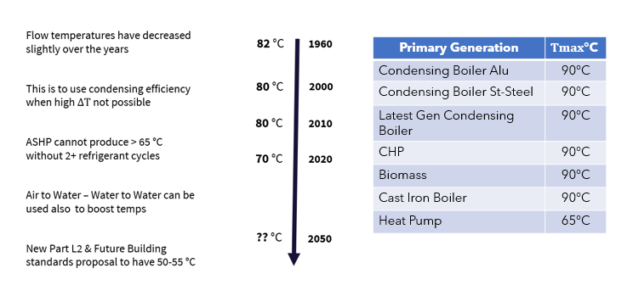
Typical Design – F&R Temperatures

Slide 24
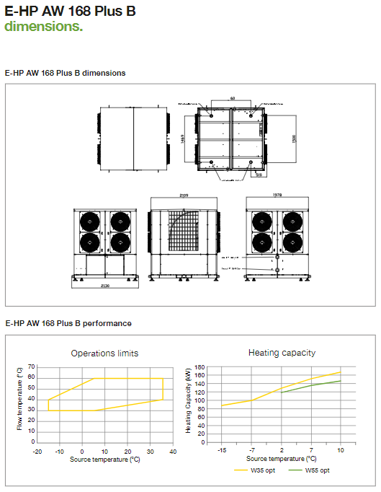
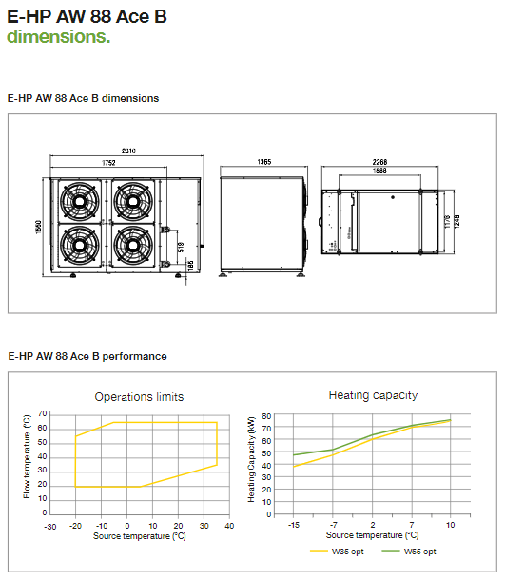
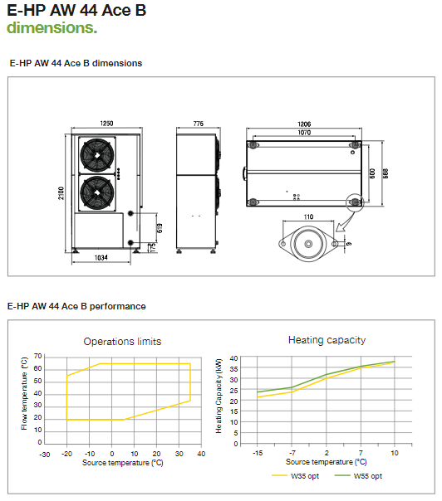
Typical Design – kW Outputs
Notes:
The above shows an overview of the ASHP physical dimensions so when planning the extra sizes need to be allowed for during the design phase to ensure the heat pump has a clean path of air flow. The graphs detail the operating limits of each of the ASHP at different external air temperatures vs the heating output

Slide 25
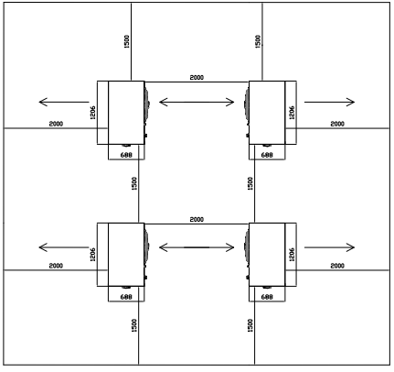
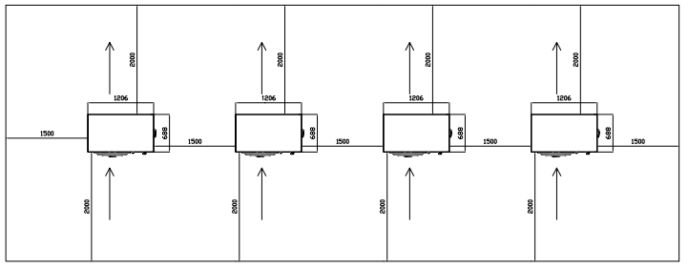
Typical Multiple Unit Installation
Notes:
The above shows the minimum clearances required around the heat pump to maintain adequate flow through the unit to ensure optimal heat transfer from the ambient air, when installing multiple units its importance to ensure the operation of 1 unit does not effect that of another by ensuring the discharged cold air is not drawn into other operational units, as this will significantly reduce the performance of the appliance and lead to inefficient and unreliable operation.

Slide 26
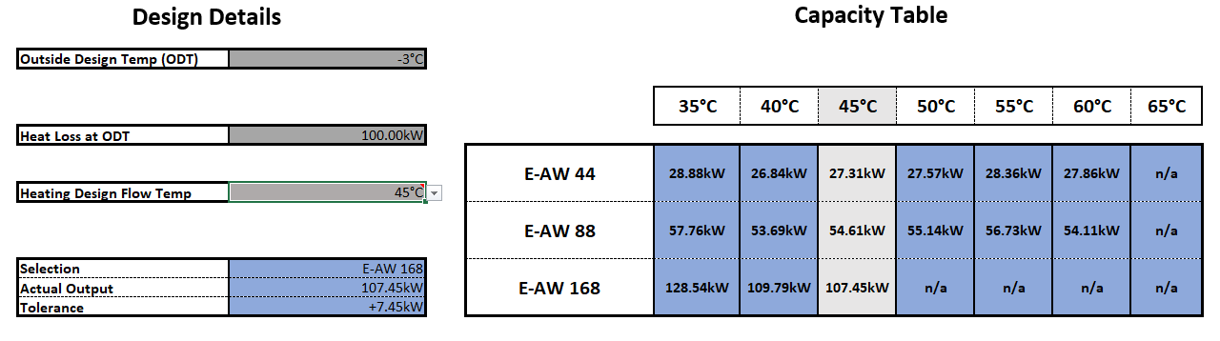
Typical Design – Internal Sizing Program
Notes:
The sizing program will allow our engineers to take the information supplied by the customer and carefully plot out the scenarios based on given air temperatures outside and the heating design temperatures required for the building our property. This will allow us to advise the correct sizing of the ASHP to give the customer the best option for his requirements whilst taking into account the most energy efficient system

Slide 27
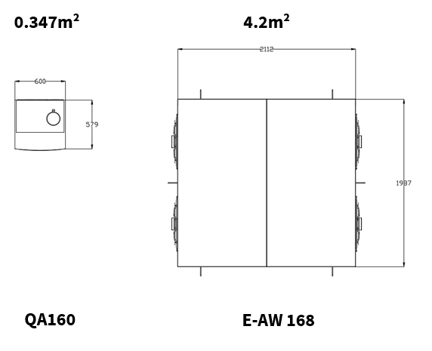
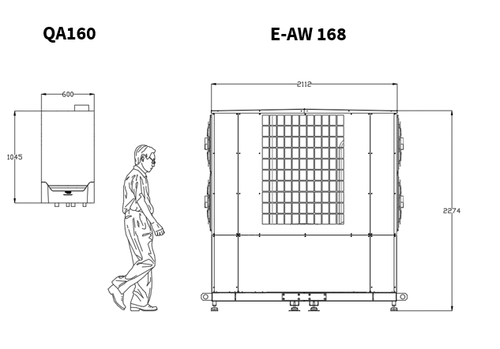
Typical Design – Dimensions
Notes:
Planning begins with the need to size the ASHP and to make allowances for the installation and servicing and repair when required of the installed product. ASHP by design are typically larger than corresponding gas boilers so this must be taken into account when discussing this with the designers and installers to ensure all conditions of the manufacturer are met so warranties will be protected

Slide 28

Typical Design – Capital Costs
Notes:
Because the size and complexity of an ASHP the cost difference between the traditional gas boiler of the equivalent heat output is approx. 10 times greater when purchasing an ASHP as illustrated

Slide 29
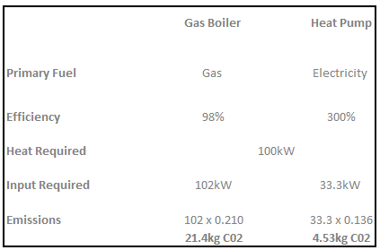
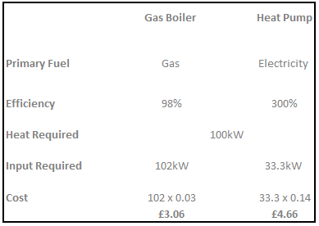
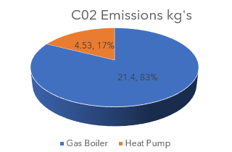
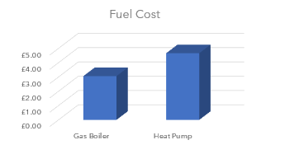
Typical Design – CO2 Saving and Running Costs
Notes:
The debate around the cost of a gas boiler versus an ASHP is starting to be noticed but as we change from the traditional to the lower carbon this is an unfortunate consequence of the need to change to save our planet. Both satisfy the need to produce heat, albeit in different ways. It is clear the ASHP will emit less CO2 than a fossil fuel burning gas boiler and as the electricity grid make changes to more renewable sources this equation will grow and the emissions of the ASHP will lower. As for expense the current spark gap between gas and electric is still quite wide and can be upto 5 times more expensive for electric compared to gas. This figure changes on a regular basis and will get narrower as time goes by so the benefit of using the ASHP over a gas fired boiler will become cheaper in real terms.

Slide 30
  AGENDA
  Energy Transition and Legislation Drivers
  Blended - Approach to Net Zero
  Heat Pump – Technology
  Traditional Design / Installation
  DNO Connections
  Typical Schematics

Slide 31
Electrical Connection Procedures
Notes:
One of the key parts of the total process of installing and owning an ASHP is the need to communicate with the DNO(Distribution Network Operator) or electricity provider. Though the UK Government are driving the change to electrification the DNO has a major part to play in the transition. In the early planning phases of the installation of ASHP the DNO will have to carry out a network impact assessment which will be looking at the local area and how much extra consumption can be placed on the grid network. In extreme cases this process can take upto 3-6 months to plan. So it needs to be carried out in the early phases of the project. Then it may be the local supplies may not be enough to sustain the extra consumption and impact to the local area so in some cases the DNO will either reject the application on the grounds of the capacity levels or will need to add more to the surrounding grid supplies which will require a big investment in money terms. These will have to be calculated into the project value

Slide 32
Network Connection
Notes:
The following are the processes which have to be carefully followed to ensure the DNO can provide the scheme with the appropriate level of support.

Slide 33
Network Connection
Notes:
As previous slide

Slide 34
Network Connection
Notes:
As previous slide

Slide 35
Network Connection
Notes:
As previous slide

Slide 36
  AGENDA
  Energy Transition and Legislation Drivers
  Blended - Approach to Net Zero
  Heat Pump – Technology
  Traditional Design / Installation
  DNO Connections
  Typical Schematics

Slide 37
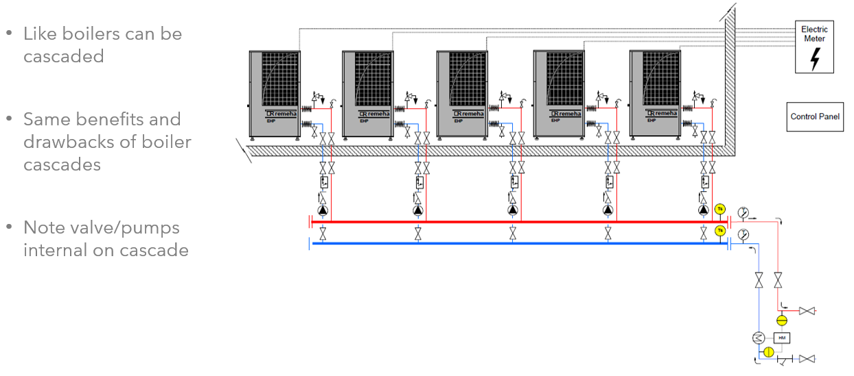
Typical Design - Cascade
Notes:
ASHP can cascaded up to an many as required by the building but considerations are cost, space required for the installation and more importantly the planning and agreement with the DNO

Slide 38
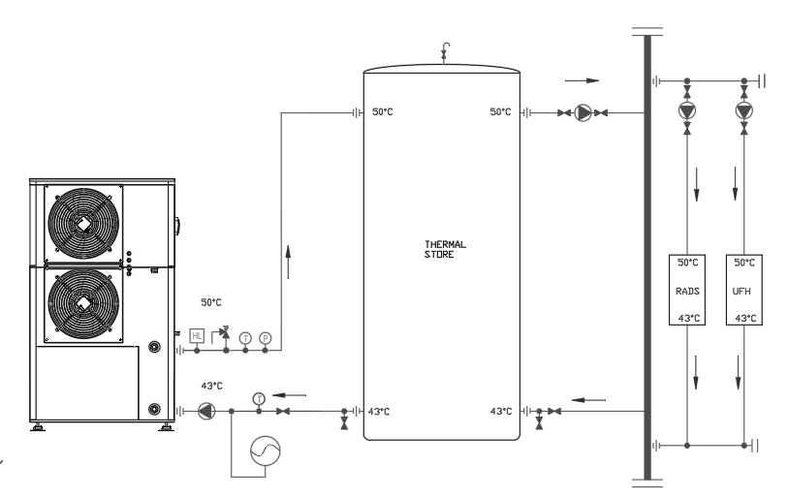
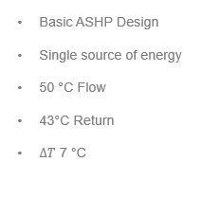
Typical Design – Source Method (Mono Valent)
Notes:
This shows the best method of integrating an ASHP with low flow and returns temperatures providing correctly sized large radiators or UFH

Slide 39
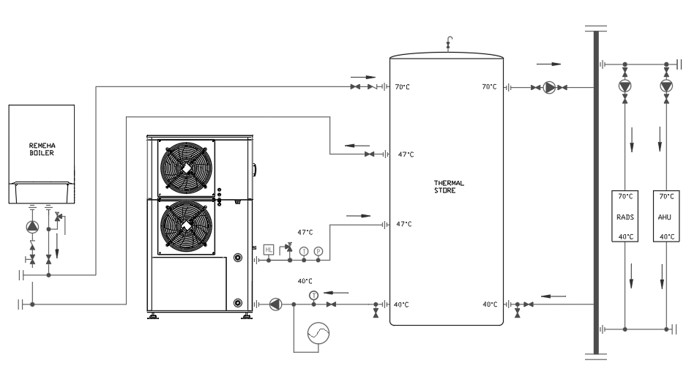
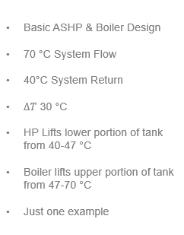
Typical Design – Pre-Heated Method (BI Valent/Hybrid)
Notes:
This scenario allows for the ASHP to be combined with traditionally sized radiators, UFH and gas boiler back up. This is an ideal make up for the winter period when lower than normal air conditions make the ASHP not as efficient as it needs to be so the gas boiler will take the main heat load with whatever the ASHP can provide. In the summer months the ASHP will take the main load due to lower temperatures required to either heat the building or the hot water system

Slide 40
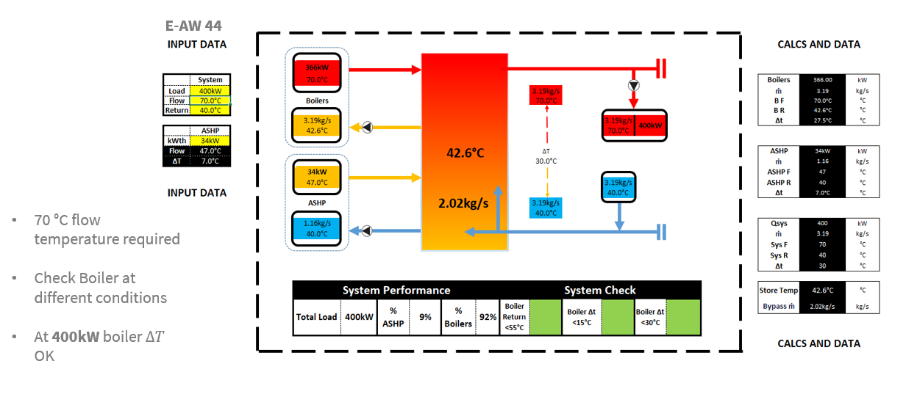
Typical Design – Pre-Heat Method Boiler Check
Notes:
This is a check calculation based on the previous set up where the system flow required is 70DegC and return is 40DegC and the ASHP can provide a flow temperature of 47DegC into the store. The mix between the lower level and the upper level will bring the temperature to approx. 42DegC which means the boiler can run with a ΔT of 30DegC which maintains the return temperature at 40DegC will within the boiler condensing temperatures making a highly efficient system to cover most if the building requirements. The ASHP flow temperature has to be remembered is based on the outside air temperature but the boiler can function within the building requirement of a 70DegC flow and 40DegC return

Slide 41
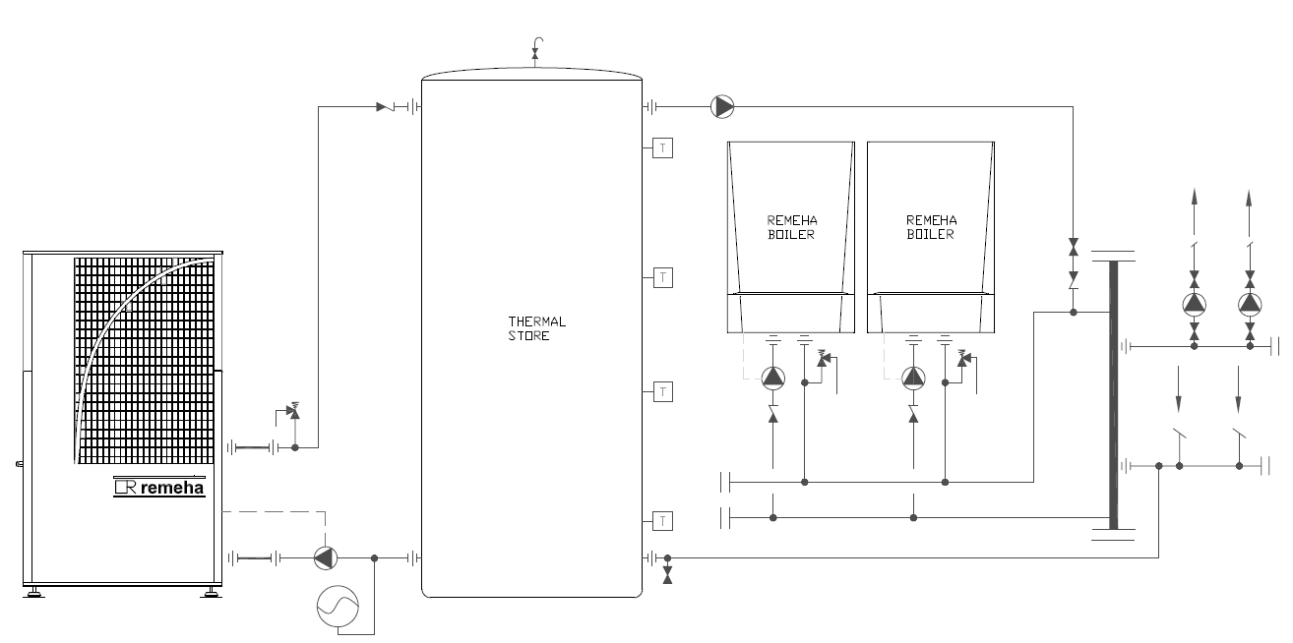
Typical Design – Pre-Heat Method (BI Valent/Hybrid)
Notes:
Another way of integrating ASHP on a Bi Valent / Hybrid system.

Slide 42
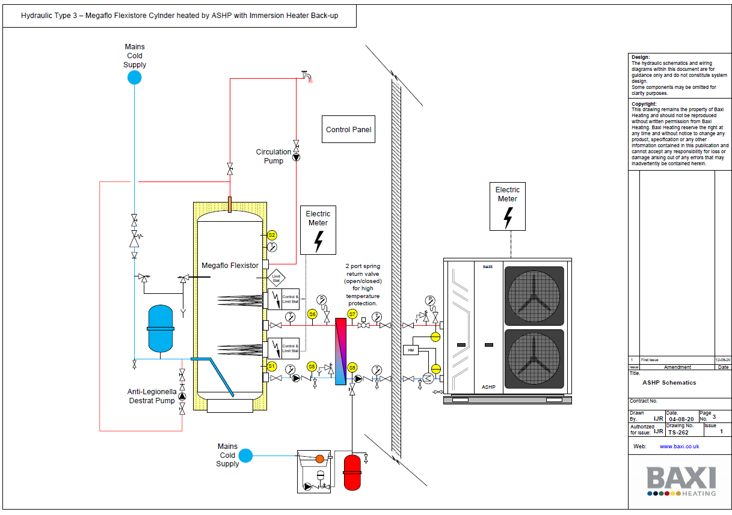
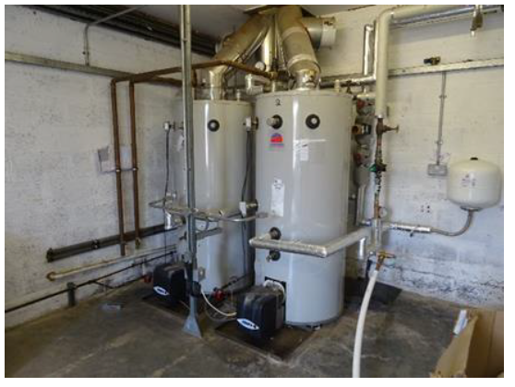
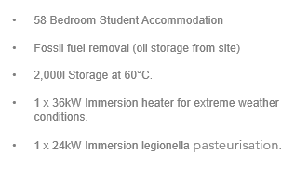
Typical Design – Domestic Hot Water
Notes:
This hot water design shows the replacement of two oil fired water heaters for the single ASHP connected to a heat exchanger inside the building and a 2,000 litre cylinder sized to cover the peak demand for hot water in a 58 bed student block. The main driver is to remove oil fired appliances from the scheme and replace with the low carbon ASHP. The sizing is based on a 90 minute peak period in the morning and later in the early evening. The air source heat pump is backed up with two immersion heaters at 26kW at the low point in the vessel and 36kW at the high point. These will be utilized on the event the outside air temperature is too cold or the peak demand requires support and for legionella control, of the hot water system

Slide 43
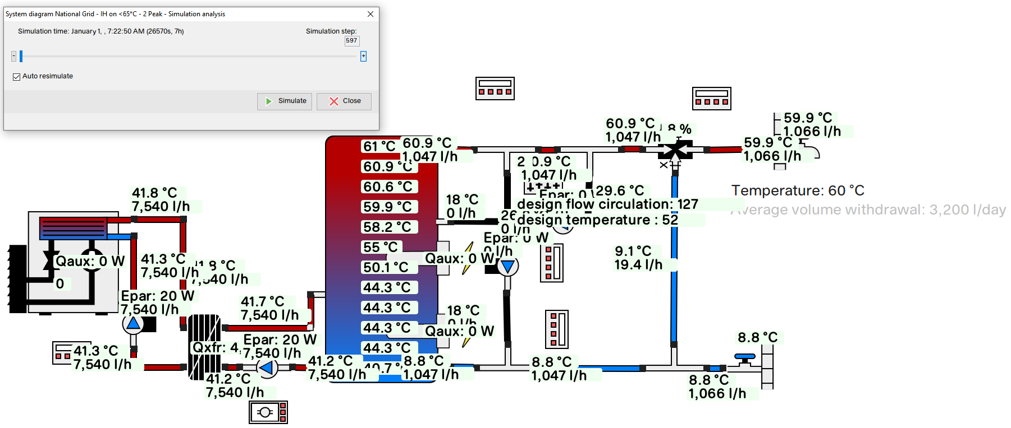
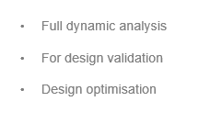
Typical Design – Simulation Software
Notes:
This simulation typically shows the benefits of the ASHP at different flow rates under the right conditions. The buffer vessel sizing is carefully chosen to match the peak demands required for the building hot water requirement. In most cases this would be adequate but when the air temperature drops the electric immersion heaters would be triggered to provide a hot water boost to 60DegC

Slide 44
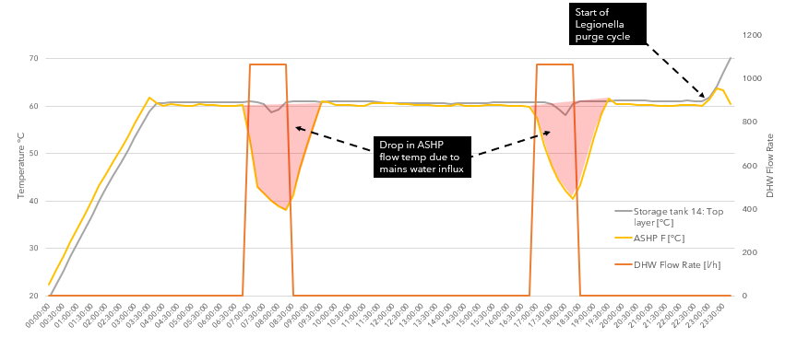
Typical Design – Simulation Software
Notes:
Continuance of the previous slide showing the peak in the hot water demand profile agreed with the customer

Slide 45
Typical Design – Simulation Software
Notes:
This is a continuance of the previous slide which shows the tow peaks and how the influence of the system requirement will impact the performance of the response from the ASHP to ensure the required peaks will be covered when required. The initial charge is the storage in the vessel at the beginning of the day. Once the available energy has been depleted the ASHP has a number of hours to recover for the next peak which will occur later in the day. If the temperature in the vessel is not reached by the ASHP, the immersion heater will come on to provide the boost in heat required to keep the hot water system at the required temperature level

Slide 46
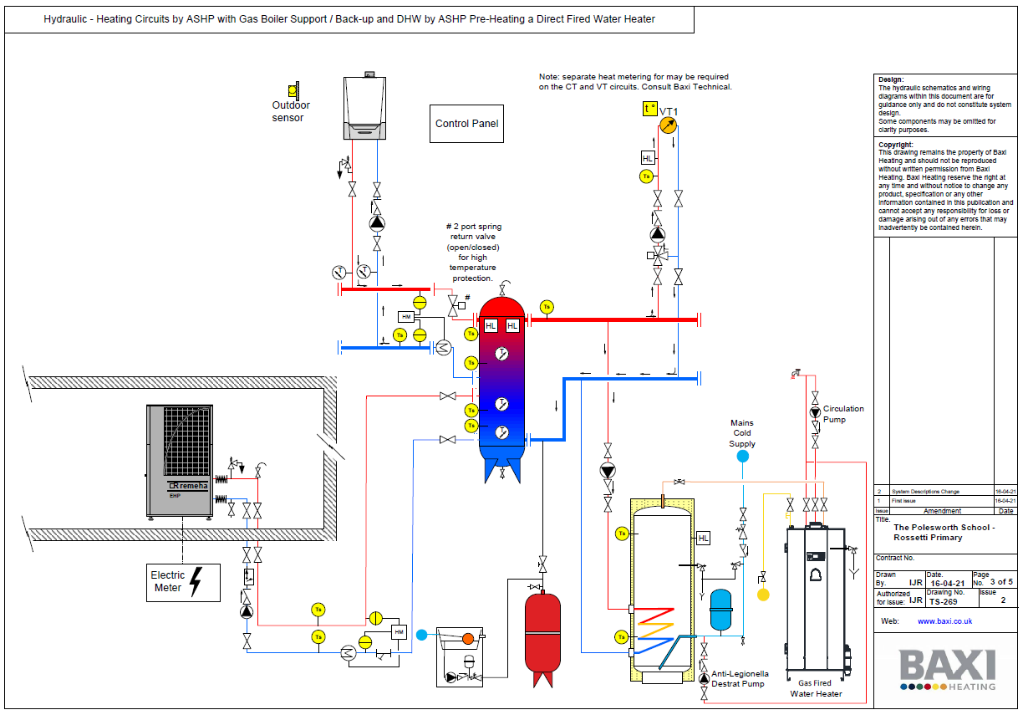
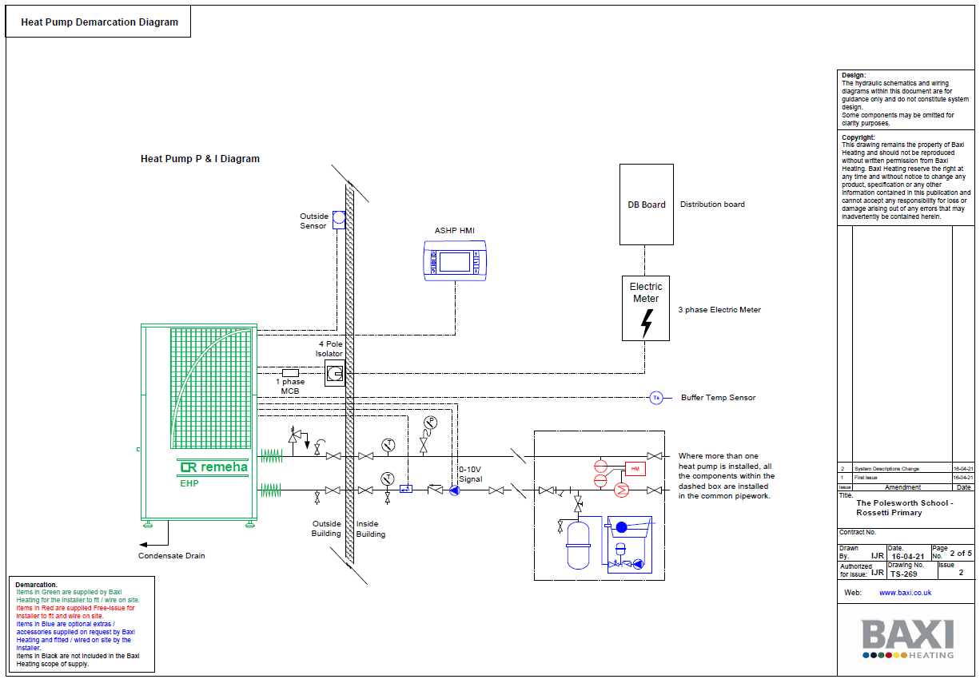
Typical Design – Polesworth School - Tamworth
Notes:
This scheme is due for start and consists of a Tri-Vaillant system consisting of a gas fired boiler, a gas fired water heater and an ASHP. The controls will be set up to allow the ASHP to run as first appliance with back up for heating from the wall hung boiler and if the hot water demand for the ASHP is not achievable the water heater will be triggered to provide a heat boost to the hot water system and to provide a legionella cycle as required by the client

Slide 47
  AGENDA
  Energy Transition and Legislation Drivers
  Blended - Approach to Net Zero
  Heat Pump – Technology
  Traditional Design / Installation
  DNO Connections
  Typical Schematics

Slide 48
APPENDICES

Slide 49
Site Survey - PQQ
Notes:
When considering ASHP technology we start the process with a PQQ form which allows us to build a picture for the consumer of what will be required to fully understand the key aspects of the building type and the needs of the customer. This is the first step in educating the owner in the requirements of changing from the traditional fossil fuel gas boiler or water heater over to the new low carbon technology

Slide 50
Site Survey - PQQ
Notes:
Continued from the previous document

Slide 51
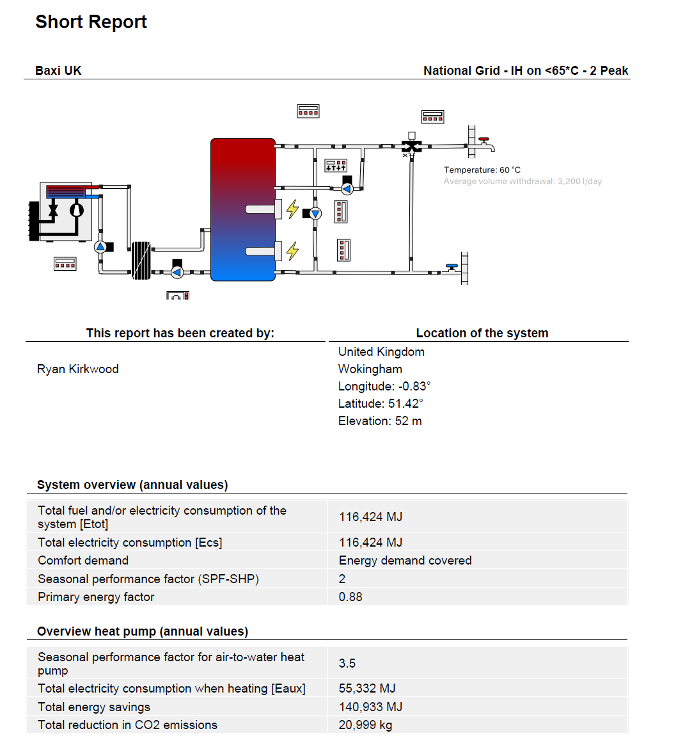

Typical Design – Simulation Software
Notes:
This simulation typically shows the benefits of the ASHP at different flow rates under the right conditions. The buffer vessel sizing is carefully chosen to match the peak demands required for the building hot water requirement. In most cases this would be adequate but when the air temperature drops the electric immersion heaters would be triggered to provide a hot water boost to 60DegC

Slide 52


Durham – Live Controller
Notes:
This is a live dial in to one of the ASHP in operation in Durham. The 44kW heat pump provides heat for low temperature heating and hot water in one of the biggest reclamation site in Durham. The unit has an onboard gateway which has been connected to a remote router with dial in so we can monitor the performance of the heat pump

Slide 53

Thank you for your time.
Any questions?

