Slide 1
Air Leakages in Air Handling Units: Guidelines for Improving Indoor Air Quality
CIBSE Dec 2021
David Black
Global Product Manager- Modular AHUs
FlaktGroup

Slide 2
David Black - Global Product Marketing Manager for Modular Air Handling Units
I’ve worked in the HVAC sector since 1986 for English, German and Swedish AHU manufacturers.
I am a CIBSE HVAC Group committee member and contributed material for the CIBSE Covid 19 ventilation guidance.

Slide 3
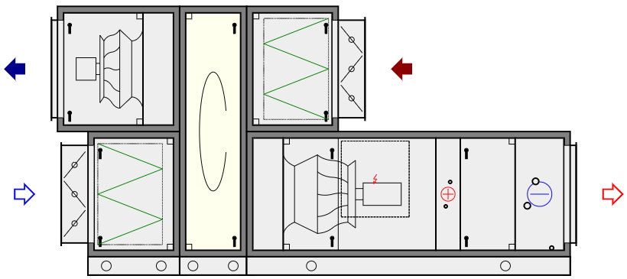
Leakage around the filter
Leakage in and out of the casing
Leakage through and around the HRS

Slide 4
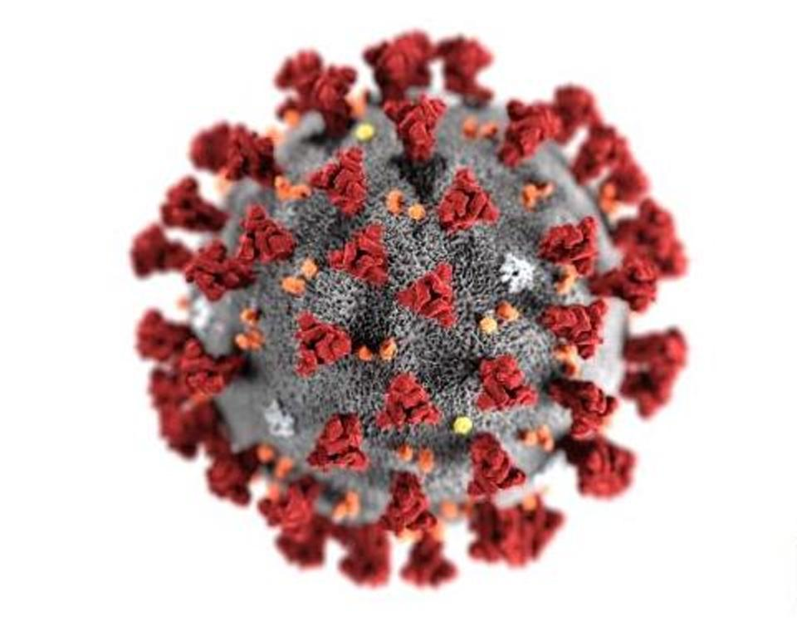
Feature | Plate | Heat Pipe | Rotary | Run Around Coil
Leakage | Slight | Slight | Considerable | None
Leakage possible in case of a defect | Yes | Yes | Yes | None
Supply and extract volume flow
SFPv
Heat recovery efficiency
IAQ

Slide 5
The best summary of the requirements
This Recommendation sets out the principles of good practice to limit the internal air leakage in air handling units.
It outlines the most important measures to be considered in the design of a unit to minimise the leakage.
The recommendation also presents guidelines on how to correct the declared performance due to leakages.
2.1 EN standards
The subject matter of internal leakages within the AHU is superficially addressed in a few EN standards.
The issue of leakages in heat recovery sections is raised in EN 16798-3, which deals with the design of ventilation and air condition systems. The standard provides general definitions of Exhaust Air Transfer ratio (EATR) and Outdoor Air Correction Factor (OACF).
EATR is the “level of carry over of extract air to the supply air”
EN 13053, which specifies requirements and testing for rating and performance of air handling units imposes on the manufacturer responsibility for avoiding leakages from the extract air stream to the supply air stream during the test of a unit with heat recovery.
However, the abovementioned standards are not harmonised in EU legislation and compliance with them is not mandatory. Moreover, they do not provide any requirements regarding internal leakages nor any testing method that might be applied by market surveillance authorities.

Slide 6
The best summary of the requirements
3.1 Exhaust Air Transfer Ratio (EATR) and Outdoor Air Correction Factor (OACF)
At present, the most established factors for characterising internal leakages are EATR and OACF (principally for rotors)
Both factors are defined in EN 16798-3 and are under revision in prEN 308.
They have been adopted in the Eurovent Certita Certification performance tests for a long time.
Ongoing works on the revision of EN 308 in CEN/TC 110 aim to extend their scope of application to other HRC
https://eurovent.eu/?q=content/eurovent-615-2021-air-leakages-air-handling-units-first-edition

Slide 7
What standards apply and what advice and verification is available?
prEN 308 May 2020 Heat exchangers - Test procedures for establishing performance of air to air heat recovery devices
prEN 1886:2021 Ventilation for buildings — Air handling units — Mechanical performance
Part L:2014 Clause 10.4 of the compliance guide.
EN 16798-3: 2019 Energy Performance of Building Part 3 Non-Residential
EN 16798-4: 2019 Energy Performance of Building Part 4 – Interpreting Part 3 Non-Residential

Slide 8
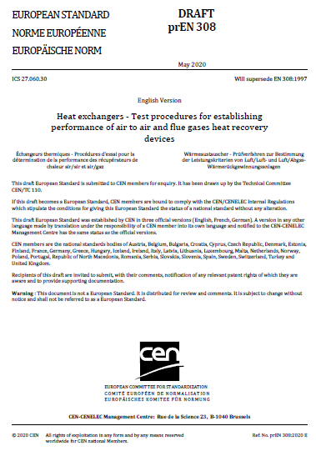
prEN308: May 2020 - heat exchangers key changes
This edition includes the following significant technical changes with respect to EN 308:1997
— In addition to laboratory tests of heat recovery components (HRC), laboratory tests for HRC fitted into air handling units and on-site tests of HRC are defined.
— Leakage testing has been refined. Exhaust air transfer ration (EATR) and outdoor air correction factor (OACF) are implemented and defined.
— Several terms and definitions are changed, e.g. categories of heat recovery components.

Slide 9
prEN308 described heat recovery components
cross flow or counter flow construction or a combination of these
designed for sensible heat transfer only
designed for transfer of sensible heat and humidity
This category is usually called “run around coil system” or as abbreviation “RAC”.
This category is usually called “heat pipe”. Heat pumps are not in this category
Rotary wheels are sometimes also called “thermal wheels” or “heat wheels”.
rotary wheel not intended for humidity exchange between the two air streams
rotary wheel determined for humidity exchange between the air streams

Slide 10
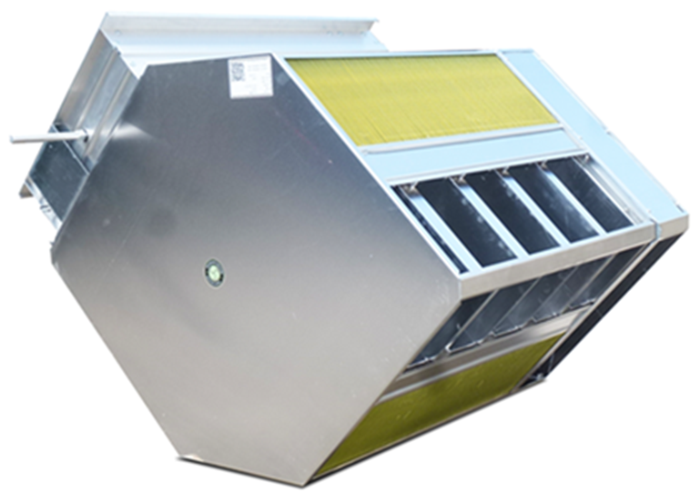
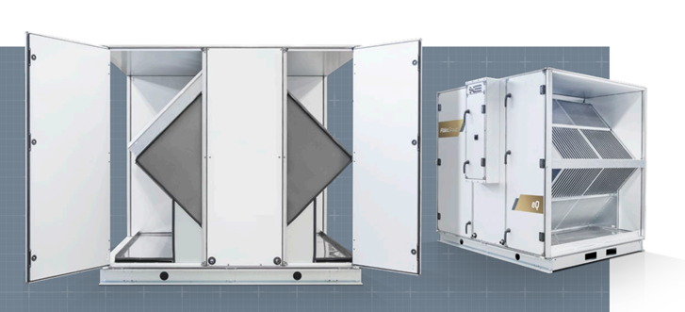
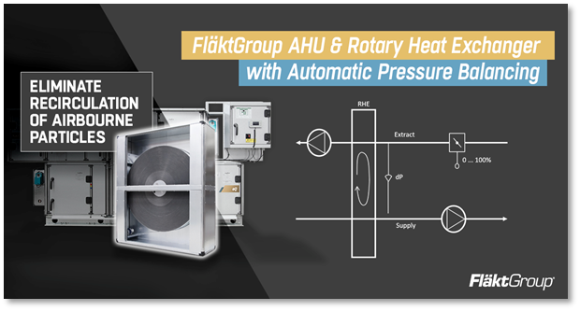
HRC1 – Cross & Counterflow plates
HRC2 – Run Around Coils and Heat Pipes
HRC3- rotors
prEN 308 May 2020
5.5.2 Internal leakage test. The test of static internal leakage applies for category HRC1 and HRC2 in which the internal nominal leakage rate determined by the pressure test is less than 3 %. If the static internal nominal leakage rate is higher, then the test of EATR is required.
Eurovent certification programme for Air to Air Plate heat exchangers -ECP 08 - 28/05/2020
Air leakage shall be checked according to EN 308:1997 and noted (in % with 1 decimal place). The following acceptance criteria are acceptable: Air leakage + 0.5 %
For HRC3 Eurovent REC 6-15 - Air Leakages in Air Handling Units - First Edition - 2021
A thermal wheel unit with fans drawing through the rotor, fitted with a purge sector and with pressure balance controls has an EATR <1% - In reality close to or equal to 0%.
https://www.cibse.org/networks/groups/hvac-systems/hvac-systems-group-past-presentations
https://www.youtube.com/watch?v=xU9M8HIVGPs&t=1368s

Slide 11
Casing

Slide 12
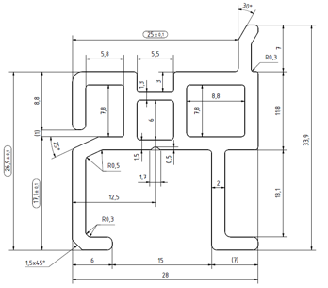
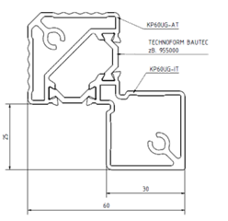
Casing leakage – Part L
Eurovent independently tests manufacturers units for leakage and
Tests results are available to view by following the link
https://www.eurovent-certification.com/en/

Slide 13
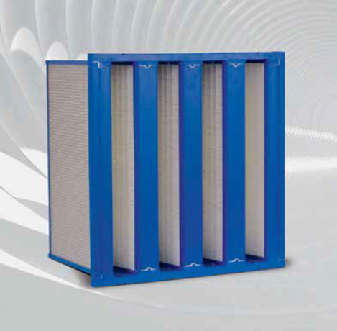
Filters

Slide 14
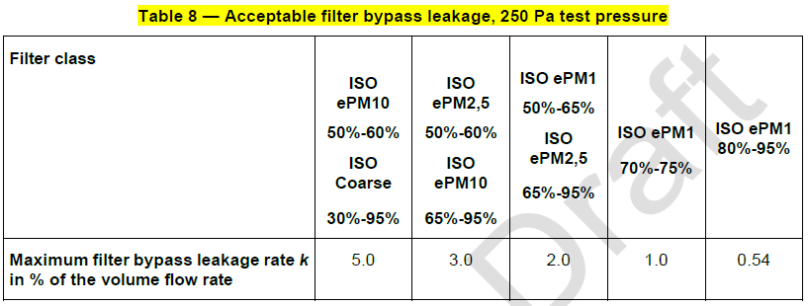
Filters – prEN1886
8. Filter bypass leakage
Air bypass around filter cells will decrease the effective efficiency of the filter, especially a high efficiency one, because the bypass air is not filtered. In addition, any inward leakage through the casing downstream of the filter has the same effect. Therefore for filters located upstream of the fan, the air tightness and area of the casing between the filter and the fan are factors that can affect the filter bypass leakage rate.

Slide 15
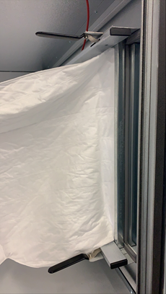
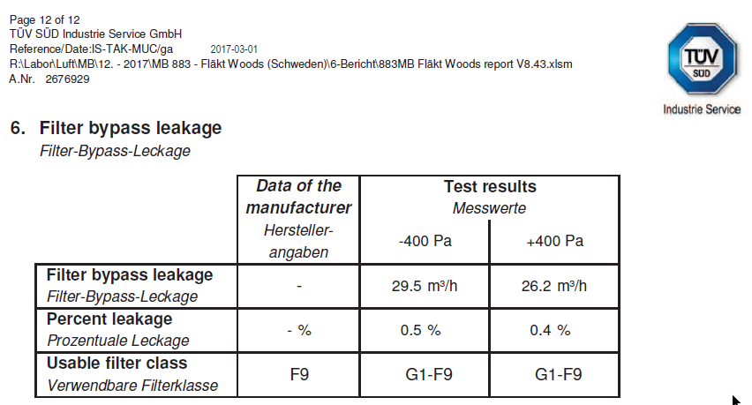
Filters – Eurovent certification criteria

Slide 16
Summary

Slide 17
Summary – AHU actions for optimal IAQ
Item | Relevant standard | comment
Meet Part L leakage | L2 standard in Part L 2014 | Eurovent independently verifies the manufacturers claim
Minimise filter bypass | EN | Eurovent tests and publishes the filter bypass leakage
Heat recovery efficiency | prEN 308:2020 | Eurovent tests the leakage. A Eurovent certified unit leaks less than a EN 308 certified product
Rotors – Correct fan position | Eurovent REC 6-15 - Air Leakages in Air Handling Units - First Edition - 2021
Fit Purge Sector | “ | Including all these options results in an EATR <1%
Include pressure balancing | “
Request EATR | prEN 308:2020 | A Eurovent certified manufacturer will soon be obligated to declare the EATR
European Standards | prEN308, EN16798-3, EN16798-4 & prEN1886 | Add to standard specification and refer specifically to the requirements contained within

