Slide 1
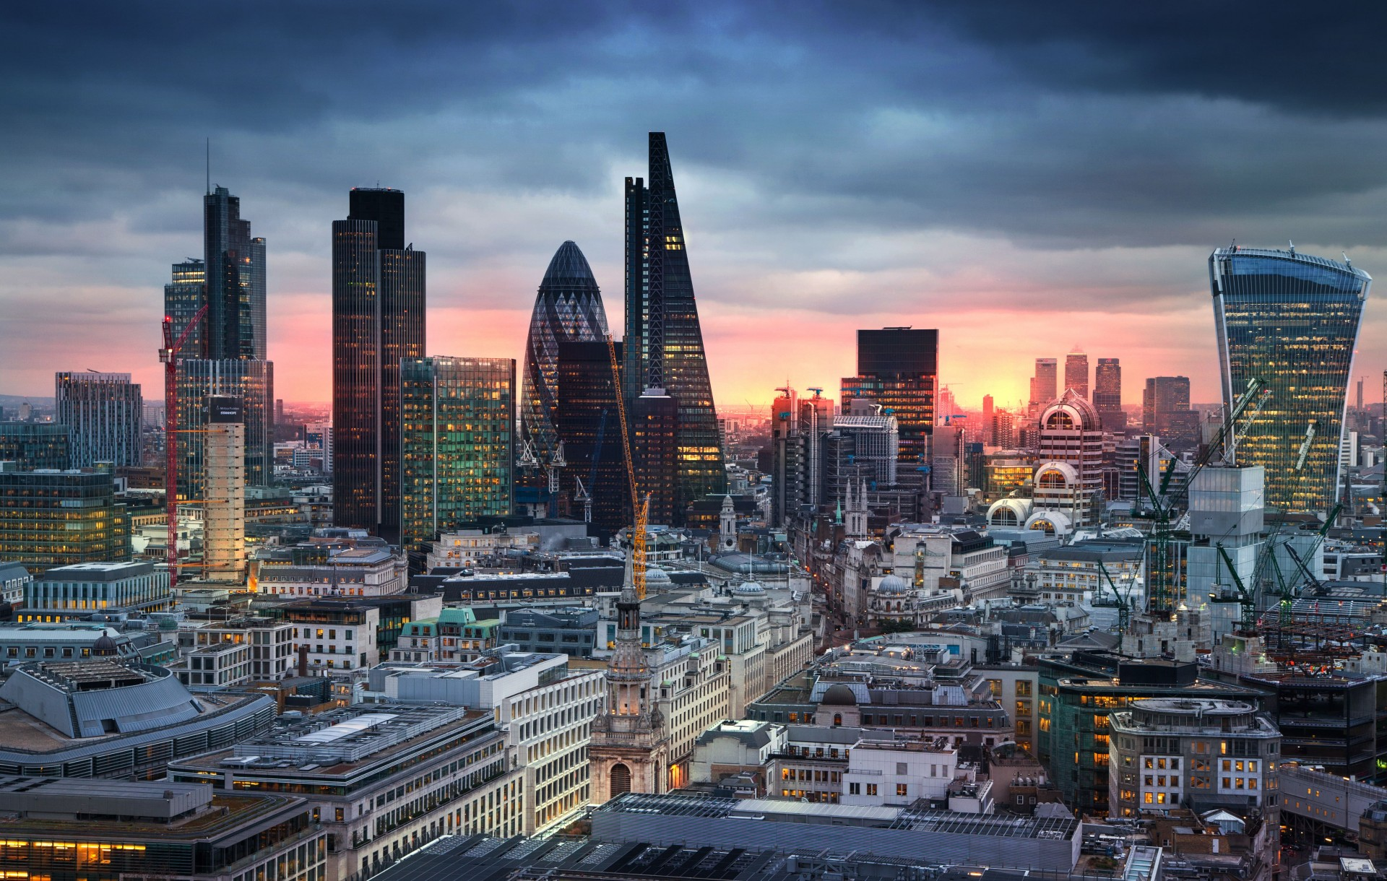
klimatise
Controlling buildings to save energy by using people as thermostats
Klimatise Cloud Thermostat software for low carbon and comfortable workspaces
Presented by:
Vic Tink: CTO
vic@klimatise.com
www.klimatise.com

Slide 2
klimatise
Cloud Thermostat
Problem Statement
Energy is used to make people comfortable, and yet:
39% employees report
temperature discomfort in offices
7.5% energy
is wasted on overcooling buildings in the
UK alone
1.3% emissions globally are due to overcooling buildings
Through poor temperature control, we are instead wasting energy, causing discomfort and hurting the planet.

Slide 3
Our mission
Fix temperature control and make every commercial building energy efficient & comfortable.
We use people as thermostats, because people know how they feel and where the problems in their workplace are.

Slide 4
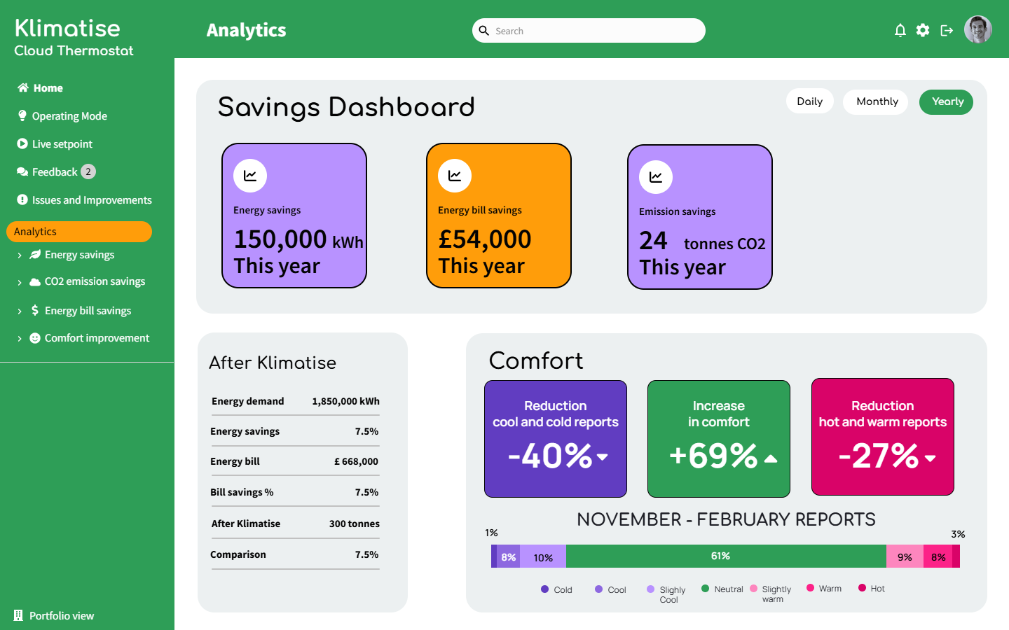
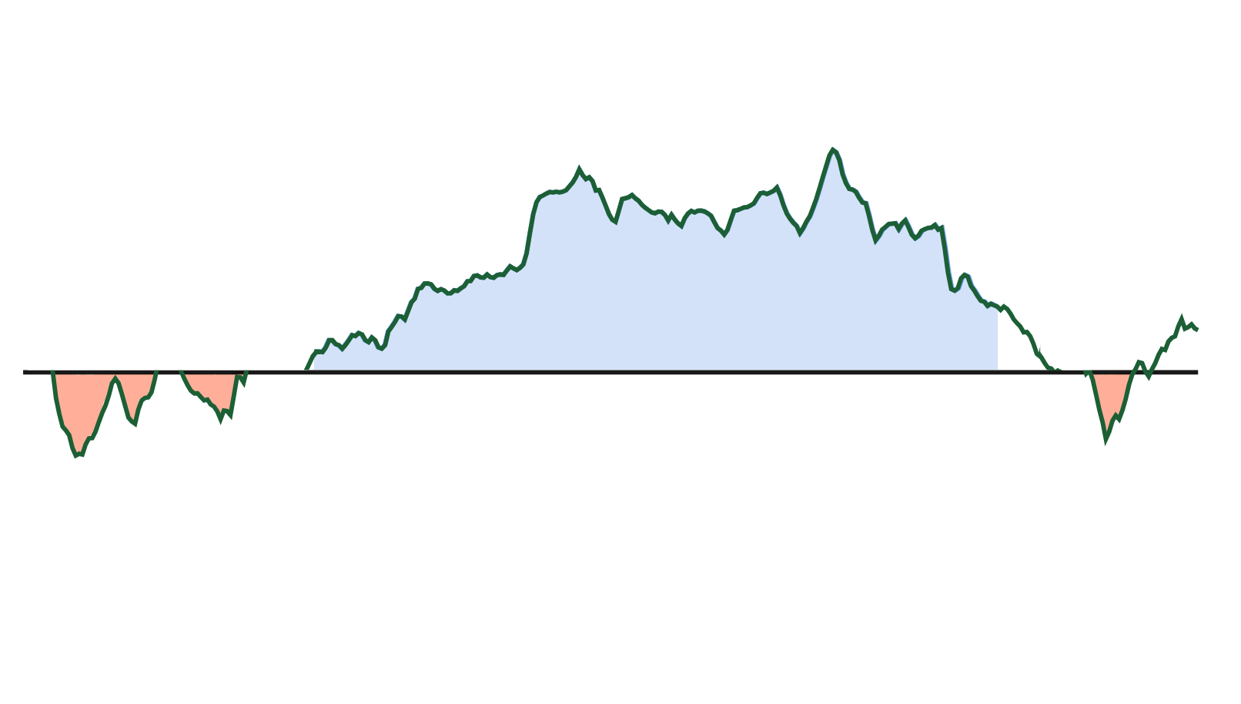
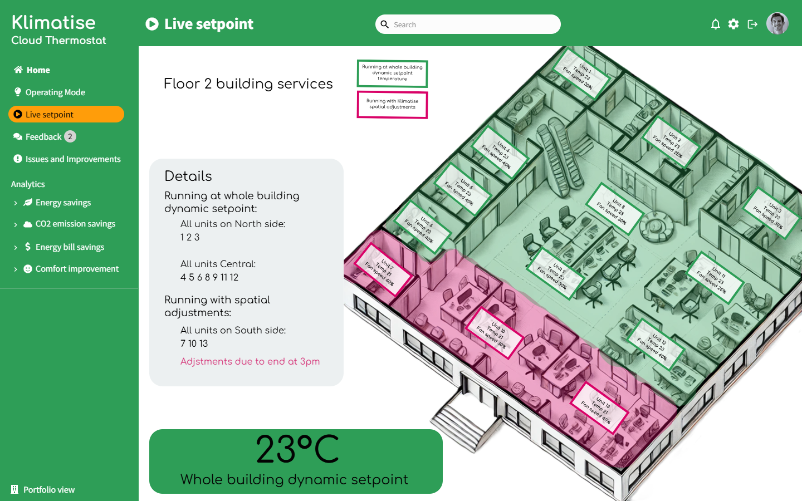
klimatise
Cloud Thermostat
Product
Klimatise Cloud Thermostat
User view
Dynamic micro climate settings
Impact & Savings Dashboard
Sensor data, energy metering, floor map
Gateway
Klimatise
Cooling & Heating (HVAC)
Occupant Comfort Feedback
Micro zone climates
BMS
Novel Thermal Comfort Model
Jan
Feb
Mar
Apr
May
Jun
Jul
Aug
Sep
Oct
Nov
Dec
Local network
Sensors
26
24
22
20
18
Temperature (°C)
Month

Slide 5
Klimatise
Cloud Thermostat
User research
How do people report that they are uncomfortable now?
User research
What would people expect from a great feedback system?

Slide 6
klimatise
Cloud Thermostat
User research
“I always feel like I am complaining, when I report that it is too cold. I would rather be anonymous. I’m really busy - I just want something quick and I’d like to see how my feedback is being used”
User research
Jessica Botha,
Business support manager
“I don’t feel listened to if I report problems, nothing changes. It is annoying having to go downstairs to tell anyone.
…I’m into into the energy saving stuff.”
David Malik,
Head of customer success

Slide 7
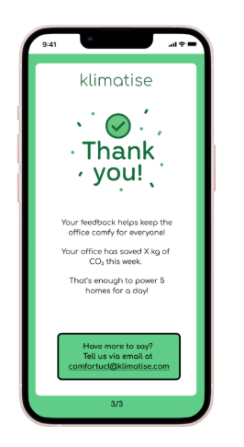
Klimatise
Cloud Thermostat
Design
Design
Design
User needs
Quick, simple and convenient
Anonymous, stigma free
Confirmation that their feedback has been received and acted on
Accept delays in change
Information about impact

Slide 8
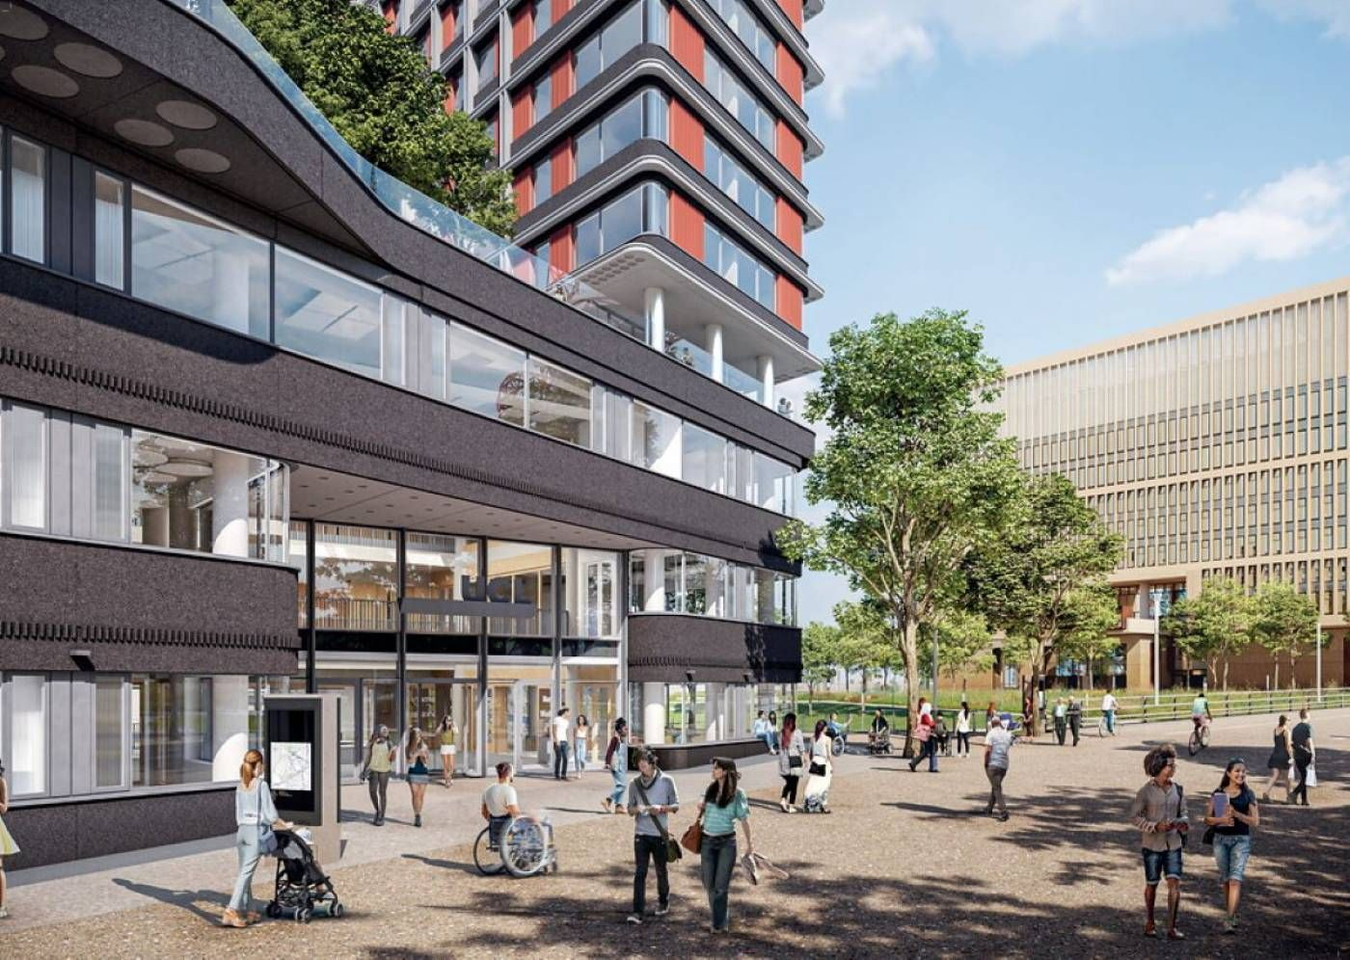
Klimatise
Cloud Thermostat
Testing
Testing
UCL One Pool Street
Newly built BREEAM Excellent rated building in the UCL East Campus
High energy bills

Slide 9
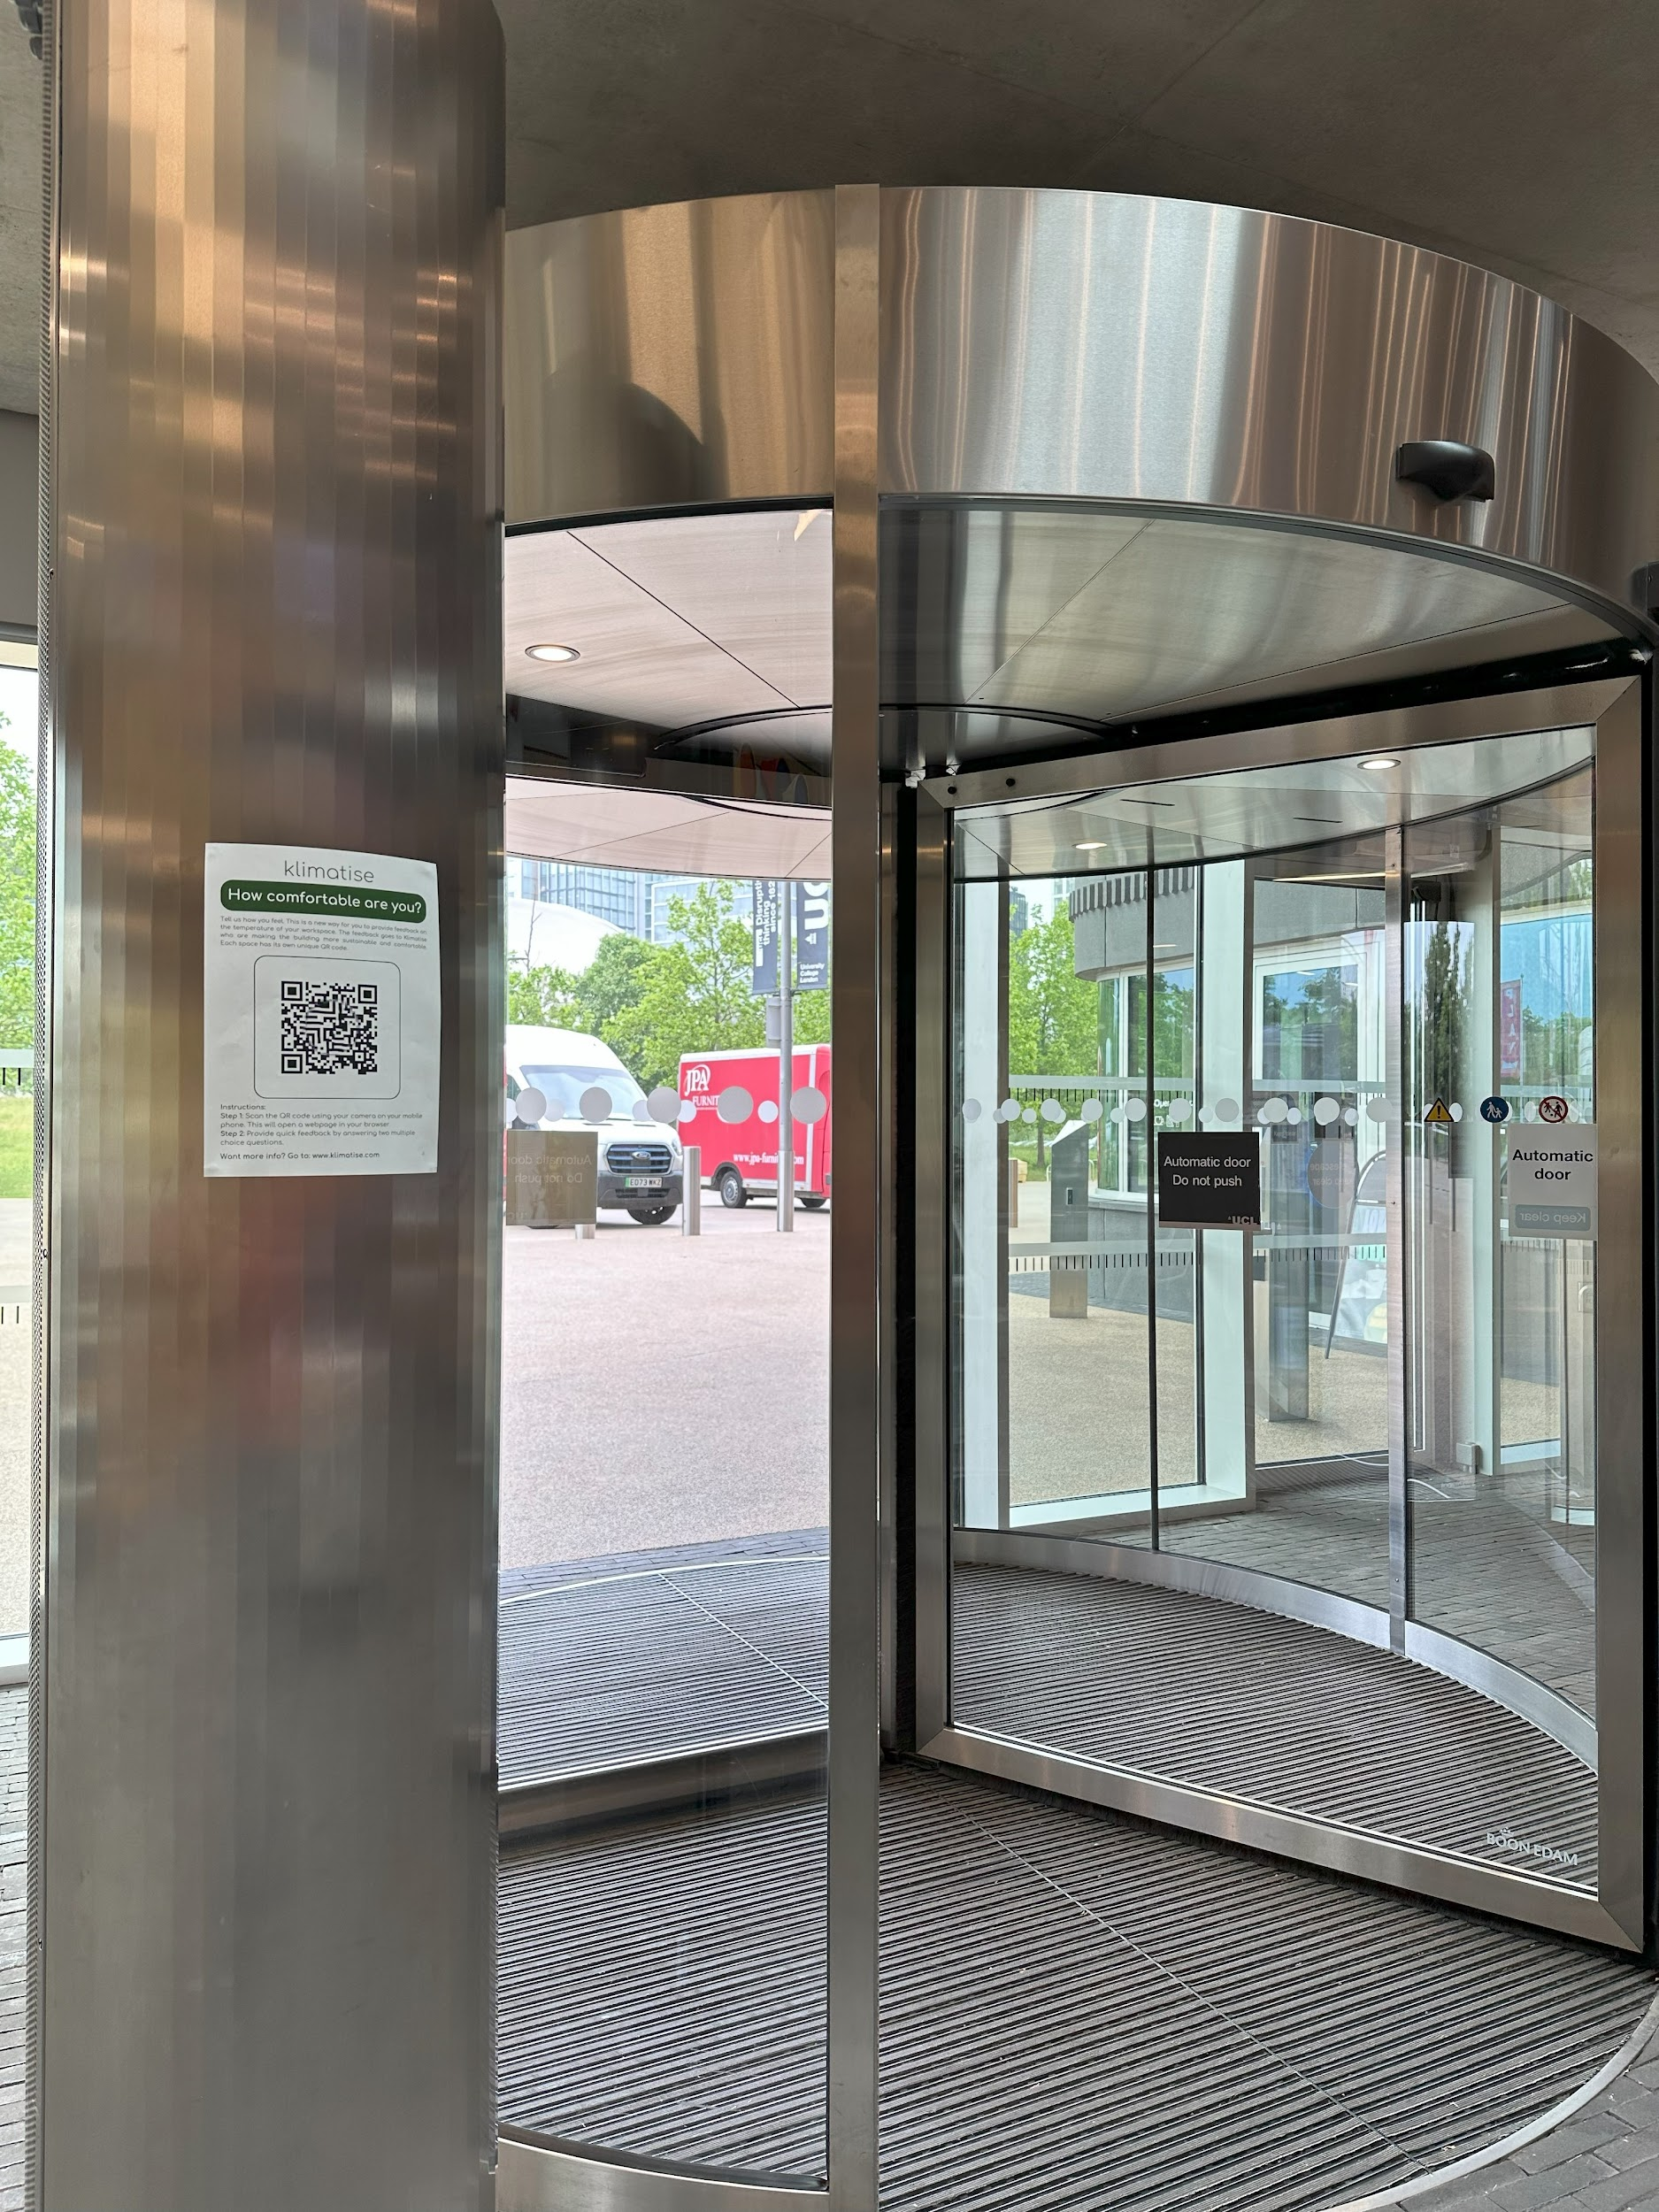
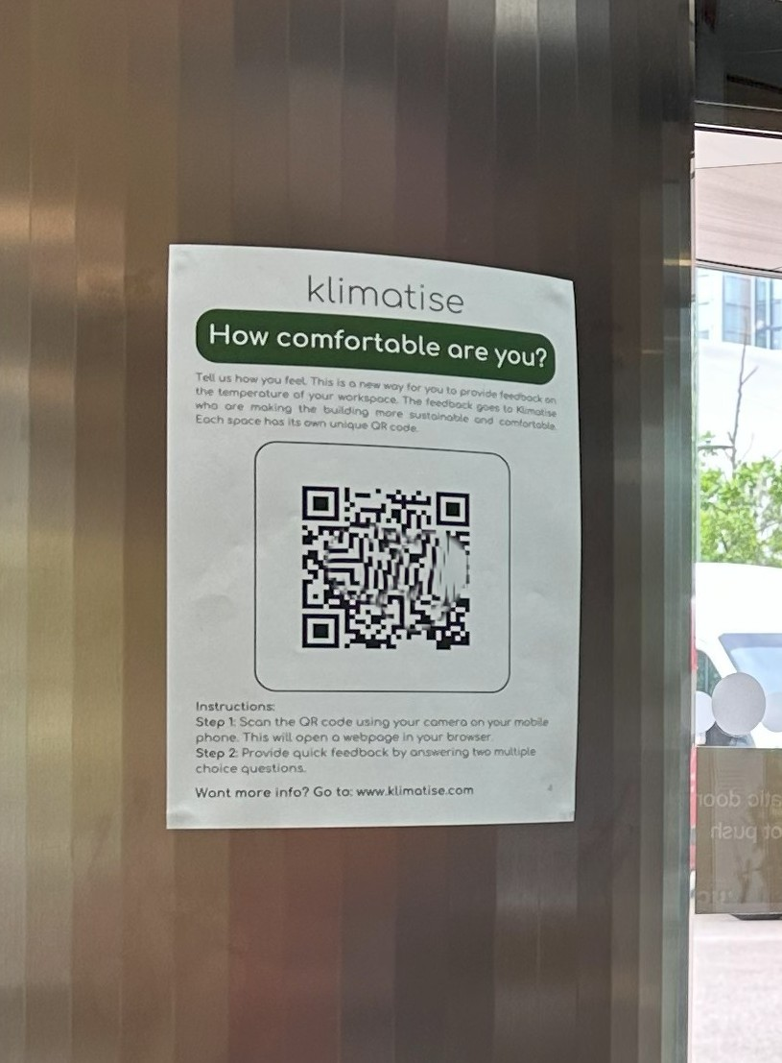
Klimatise
Cloud Thermostat
People as thermostats
People as thermostats

Slide 10
Klimatise
Cloud Thermostat
Response
Response
Almost everyone was ok.
Many people knew there was a reporting system.
Reports
Impact
Some users were testing
9 reports
Clusters - people talking?
Reports in one space
Micro adjustment
Issues identified

Slide 11
Klimatise
Cloud Thermostat
Summary
Issue now of reporting discomfort
People want to know they have been listened to
Summary
People like the idea of an app
People don’t tell you if they’re ok
Adjustments made to fix issues

Slide 12
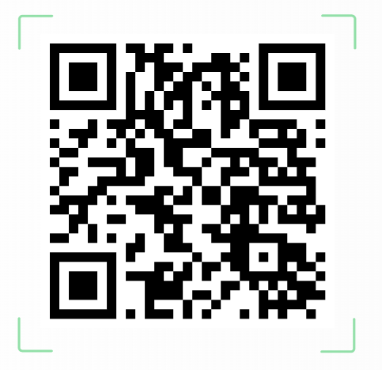
klimatise
Cloud Thermostat
Thank you!
Thank you!
We are looking for new projects and partnerships.
We would love to partner with you to make buildings low carbon by making people more comfortable.
Get in touch:
Follow Klimatise on LinkedIn
You can email me at vic@klimatise.com
Speak to me after the panel session

