Slide 1
Utility Recharging
Best Practice
Greg Tracy
Head of Client Services

Slide 2
INTRODUCTION TO EMS, BEMS, AND COMMERCIAL TENANT RECHARGING
Overview: Energy Management System (EMS) and Building Management System (BMS) are the backbone of modern energy efficiency in commercial buildings
What is a Building Network Operator (BNO) ?
The purpose of EMS/BEMS
Commercial Building Occupier Utility Recharging
What does ‘good’ look like?
The Optimised solution

Slide 3


WHY BUILDING NETWORK OPERATORS (BNO) STILL EXIST
WHAT ARE BUILDING NETWORK OPERATORS (BNO)?
  BNO’s manage utility distribution within multi-occupancy buildings.
  Handle the internal network beyond the fiscal meter, often a barrier to modernisation
CHALLENGES WITH BNO NETWORKS
  Legacy Infrastructure: Existing setups make it expensive and complex to replace
  Limited Integration: BNOs often don't support modern EMS/BMS integration, limiting energy efficiency and tenant utility recharging
WHY THEY PERSIST
  Financial and logistical constraints on building owners prevent upgrades
  Regulatory environments and outdated local policies

Slide 4
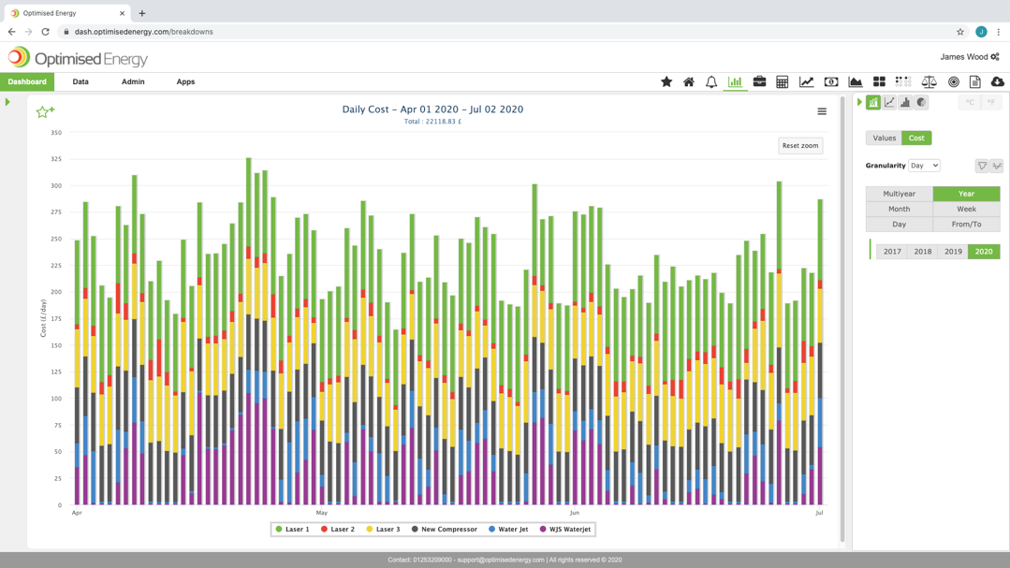
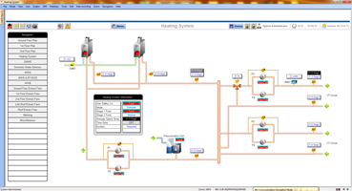
EMS and BMS OVERVIEW
WHAT IS AN ENERGY MANAGEMENT SYSTEM?
  Centralised platform that monitors energy use, provides insights on consumption patterns, and suggests ways to optimise energy performance based on these insights and historical data
  Focus on carbon reporting, energy and cost management
WHAT IS A BEMS?
  System designed to control and manage building operations like heating, ventilation, air conditioning (HVAC), lighting, and security
  Integration with EMS: BEMS enhances the EMS by providing detailed control over energy-consuming systems
PROBLEMS WITH OUTDATED SYSTEMS
  Systems not designed for tenant-specific recharging
  Lack of real-time utility tracking hinders accurate billing

Slide 5

COMMERCIAL BUILDING UTILITY RECHARGING
DEFINITION
Billing commercial occupiers for their actual utility consumption (electricity, gas, water, heating and cooling) within multi-tenanted commercial buildings, with shared central plant.
CURRENT INDUSTRY CHALLENGES
  Manual Billing Processes: Prone to errors and delays
  Inaccurate Data: Manual entry / fixed allocation methods lead to disputes
  Regulatory Gaps: Standards such as those set by RICS are often not met
RICS BEST PRACTICES:
  Accurate metering and transparent recharging processes – clear scope of services, pricing structure, timescales for invoicing and payment
  Real-Time interval data to ensure fairness and accountability

Slide 6
KEY CHALLENGES IN EMS/BEMS FOR COMMERCIAL RECHARGING
ISSUES WITH CURRENT SYSTEMS
  Many EMS/BMS systems are not configured for tenant-level data granularity
  Lack of Automation: Manual processes for splitting utility data between tenants
  Outdated Metering Systems: Existing meters might not support dynamic tracking of individual tenant usage
TENANT DISPUTES
  Inaccuracies in energy consumption measurement lead to billing conflicts
  Tenants may overpay or underpay due to rough estimations
CARBON REPORTING
  Without accurate energy consumption data, tenants can't meet carbon reporting requirements

Slide 7
DYNAMIC TENANT RECHARGING AND THE MASS MARKET APPROACH
DYNAMIC RECHARGING
  Moves away from static utility billing (i.e., dividing utility costs by floor area or fixed percentages)
  Bills tenants based on real-time or periodic actual consumption through means of fiscal and sub-metering
MASS MARKET APPROACH
  Most commercial buildings still use outdated fixed-rate billing systems, failing to reflect actual utility usage
  Why the Market is Slow to Change:
    Cost of Upgrading: Implementing advanced metering and automation systems is often seen as expensive
    Lack of Awareness: Building owners may not fully understand the value of dynamic recharging
BENEFITS OF DYNAMIC RECHARGING
  More accurate tenant billing
  Potential energy savings as tenants become more aware of their consumption

Slide 8
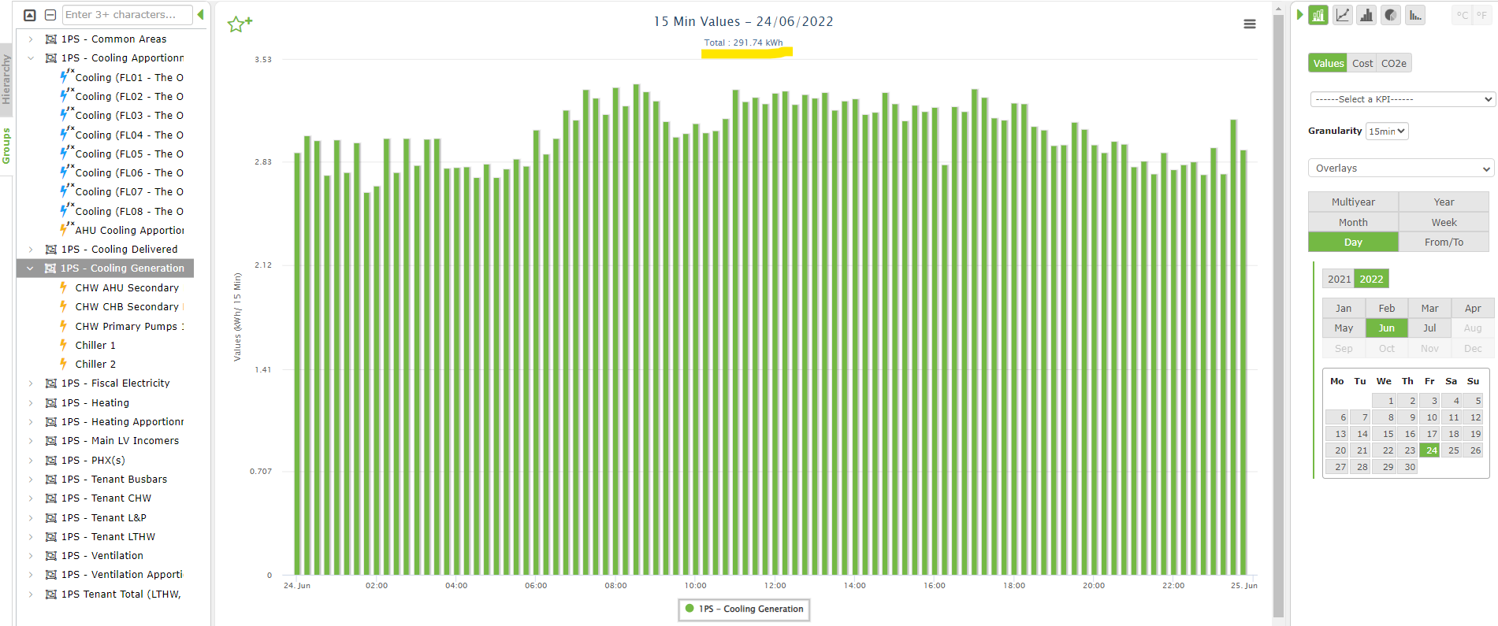
DYNAMIC TENANT RECHARGING EXAMPLE
15-minute monitoring of cooling generation group (Chillers x2, CHW Primary Pumps, CHB Secondary and AHU Secondary) prior to apportionment

Slide 9
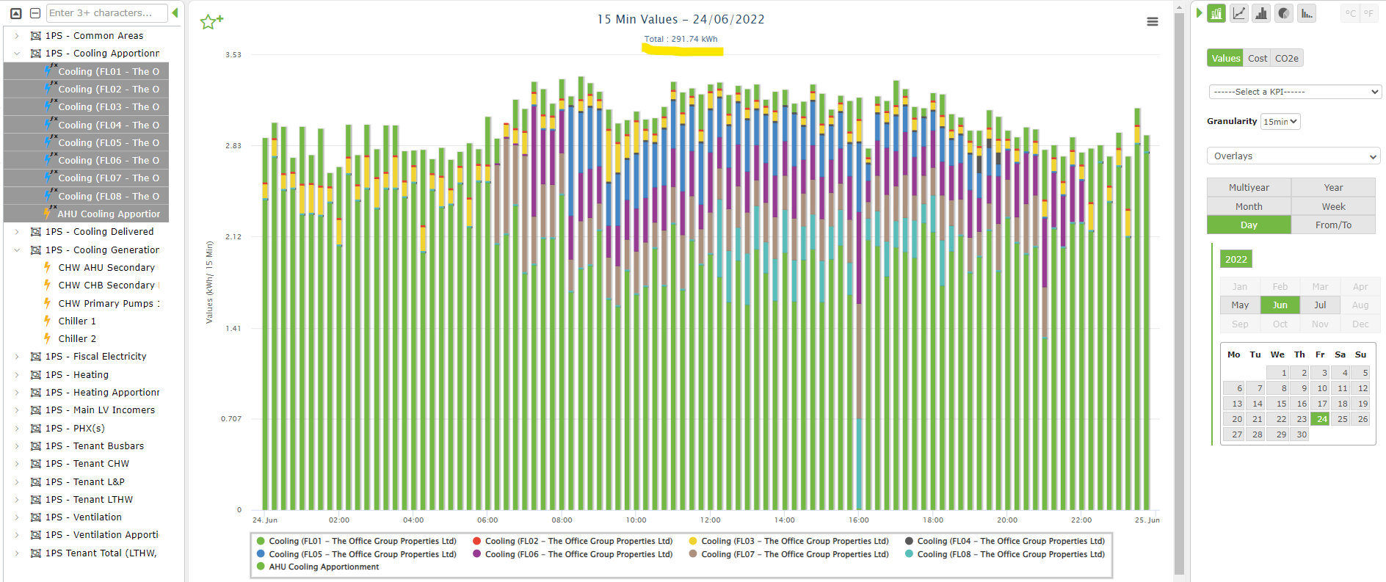
DYNAMIC TENANT RECHARGING EXAMPLE
The same cooling profile apportioned dynamically using on floor AHU demand across floors 1-8

Slide 10
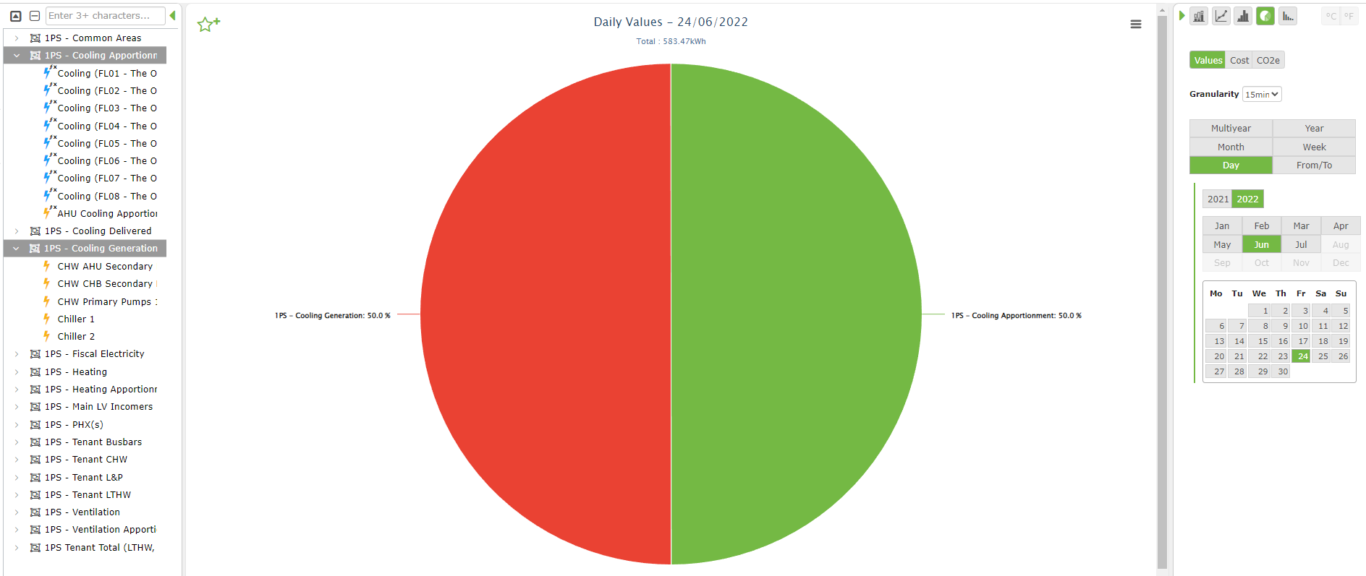
DYNAMIC TENANT RECHARGING EXAMPLE
Confirmation that the generation and apportionment groups align exactly.

Slide 11
THE BENEFITS OF AUTOMATED CARBON AND ENERGY REPORTING FOR TENANTS
OCCUPIER ACCESS TO CARBON REPORTING
  Tenants require access to accurate carbon data to meet regulatory obligations (e.g., ESOS, SECR)
  Automated systems provide monthly or even daily insights, helping occupiers manage emissions
COMPLIANCE DRIVERS
  Regulations like RICS, Heat Network Regulations, and NABERS require accurate and timely data
HOW EMS HELPS
  Ensures precise carbon reporting without manual data gathering
  Aligns with ESG (Environmental, Social, and Governance) goals, attracting eco-conscious tenants
COST AND WASTAGE IDENTIFICATION
  Real-time tracking of water, gas, and electricity use helps identify excessive consumption, reduce operational waste, and drive financial savings.

Slide 12
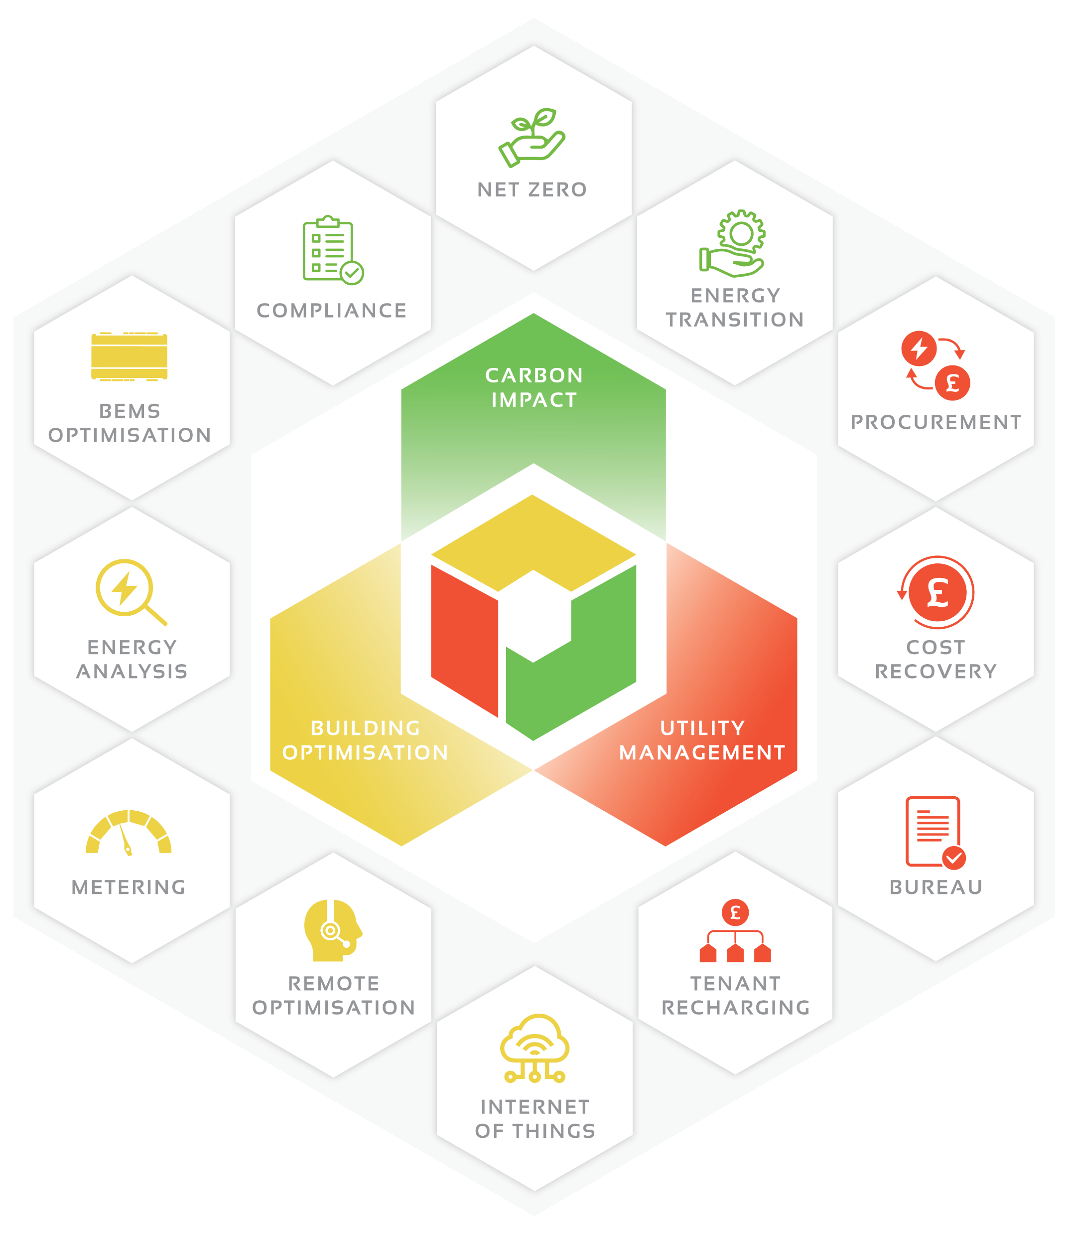
THE OPTIMISED SOLUTION
WHAT OPTIMISED OFFERS
  Advanced EMS/BMS solutions tailored for commercial buildings with multiple tenants.
  Focus on dynamic tenant recharging, automated carbon reporting, and energy efficiency
CORE FEATURES
  Seamless integration with existing systems and smart meters
  Automated billing processes for accurate, hassle-free tenant recharging
  Energy and Carbon Reporting: Streamlined reporting tools to meet regulatory and sustainability requirements

Slide 13
THE BENEFITS
  Reduce operational costs by eliminating manual processes and identifying wastage
  Improve tenant satisfaction with fair and accurate billing
  Achieve better compliance and enhance building value by offering sustainable energy solutions

Slide 14
Thank you

Slide 15
HOW OPTIMISED EMS/BEMS SYSTEMS WORK WITHOUT MANUAL DATA ENTRY
AUTOMATION THROUGH EMS/BEMS
  EMS integrates directly with utility meters to provide continuous, automated energy tracking
  BEMS optimises building operations, which also feeds data into EMS for comprehensive energy management
BENEFITS OF AUTOMATION
  Eliminates manual data entry errors
  Ensures timely and accurate tenant billing soon after the start of the month
  Seamless Integration: With IoT devices and smart meters, utility consumption data is directly tied to tenant recharging
SPEED OF REPORTING
  Quick and reliable reporting, allowing recharges and carbon reports to be generated soon after the billing cycle ends

Slide 16
BEST PRACTICES AND WHAT “GOOD” LOOKS LIKE IN EMS/BEMS
ACCURATE TENANT BILLING
  Real-Time Data: Use smart metering for electricity, water, and gas to track exact usage
  Automated Recharges: Generate utility bills for tenants without manual intervention
IDENTIFYING ENERGY WASTAGE
  Monitoring Systems: EMS continuously monitors for inefficiencies, leaks (water), or unnecessary consumption
  Reducing Costs: Quickly addressing wastage leads to significant savings over time
OCCUPIER SATISFACTION
  Tenants receive accurate bills and clear reports, reducing disputes and increasing trust
COMPLIANCE
  Systems comply with RICS standards and allow easy access to carbon data for occupiers to meet their sustainability goals

