Slide 1
Measuring Performance & Facilities Management
19 June 2025 | Congress Centre, London

Slide 2
Accountability and Industrywide Collaboration in Building Performance and FM
Impact of the Building Safety Act and Insights from M2P : B2P Session
David Stevens CEng FCIBSE
Notes:
Welcome everyone to today's session on accountability and collaboration in building performance and facilities management.
We'll explore the implications of the Building Safety Act and share insights from the M2P : B2P session

Slide 3
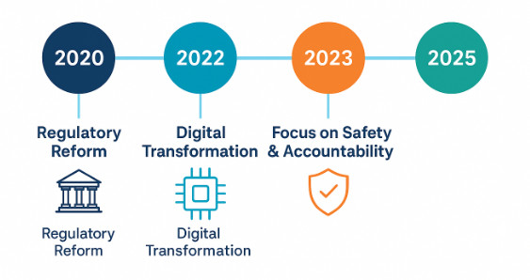
Context: A Sector in Transition
Regulatory Reform
Digital Transformation
Focus on Safety & Accountability
Notes:
The FM and building performance sectors are undergoing significant changes, driven by regulatory reforms like the Building Safety Act 2022, advancements in digital technologies, and an increased emphasis on safety and accountability.

Slide 4
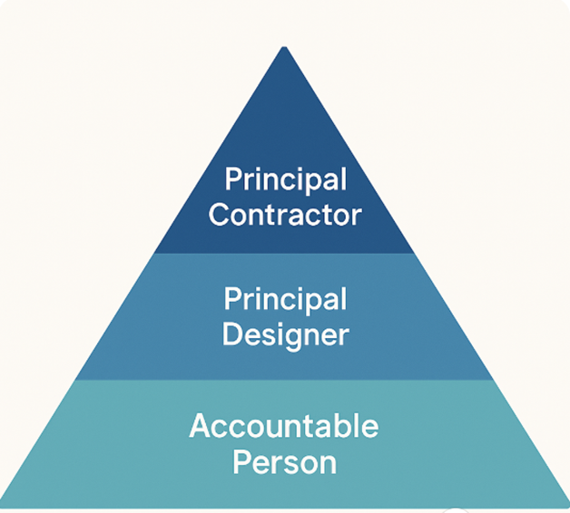
Accountability: From Concept to Compliance
(New) Duty Holders ; Accountable Persons, Principal Designer, Principal Contractor
Clearer responsibilities & mandatory information sharing
Introduction of the Golden Thread of Information
Notes:
In the UK, - well, E&W - The Building Safety Act introduces new roles with legal responsibilities to ensure building work meets safety standards.
This includes the Accountable Person, Principal Designer, and Principal Contractor.
A key aspect is the Golden Thread of Information, ensuring critical safety information is maintained throughout a building's lifecycle.
It establishes a legal framework for collaboration. Meer complaint aint enough

Slide 5
Industrywide Collaboration: From Silos to Systems
Notes:
We are seeing the emergence of structured collaboration models
Structured collaboration models are emerging to break down silos in the industry – as Vince said in his presidential address, engineering solutions must transcend borders.
These forums facilitate sharing strategic direction, innovations, and aligning on compliance and performance metric

Slide 6
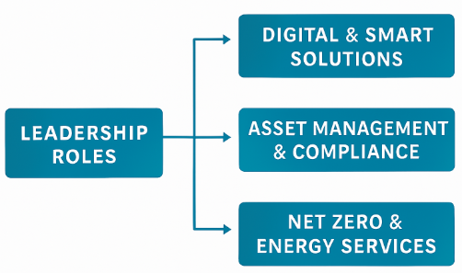
Operationalising Change: Tools and Structures
Designed to support a more agile and accountable FM function, capable of responding to both regulatory and client demands.
Notes:
FM Leadership roles are being redefined to support digital solutions, asset management, and sustainability goals.
This alignment ensures a more agile and accountable FM function responsive to regulatory and client demands.

Slide 7
Reflections from M2P : B2P
Notes:
Insights from the M2P : B2P session highlight the importance of integrating compliance into all stages of building management,
using data for benchmarking, and fostering trust through transparency

Slide 8
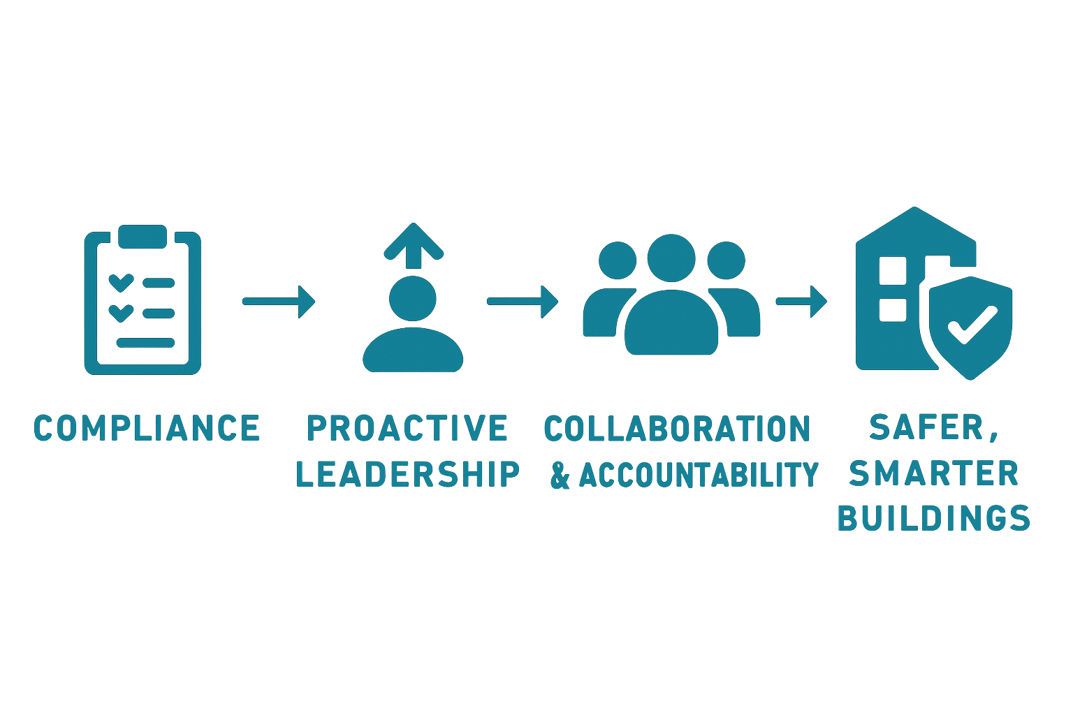
Closing Thought: From Compliance to Culture
The Building Safety Act is a cultural shift.
FM Professionals must lead proactively Implications for FM and Technical Services
Embrace collaboration & accountability for safer, smarter buildings
Notes:
The Building Safety Act signifies more than legal compliance; it represents a cultural shift.
FM professionals are called to move from reactive compliance to proactive leadership,
embracing collaboration and accountability to enhance building safety and performance.
This isn’t juts for FM professionals - to the designers and builders out here – You must design and Build from the mindset of the maintainer

Slide 9
Thank you to our sponsors

Slide 10
Measuring Performance & Facilities Management
Any questions?

