Slide 1
Engineering Performance is built on Team Performance
The human factors that enable great collaboration
&
Why this matters more than ever in a changing landscape
Tamsin Tweddell
Tamsin Tweddell
Building Team Performance | Engineering & Sustainability Leadership | Consultant & Coach

Slide 2
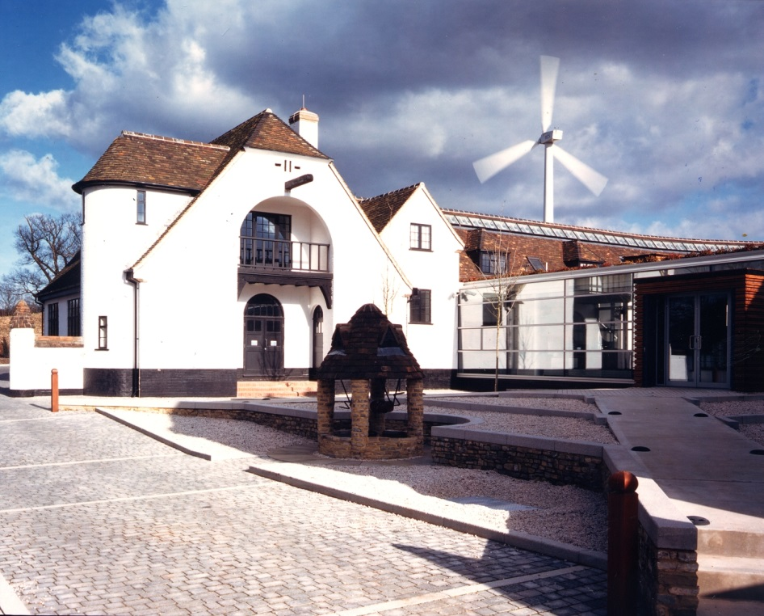
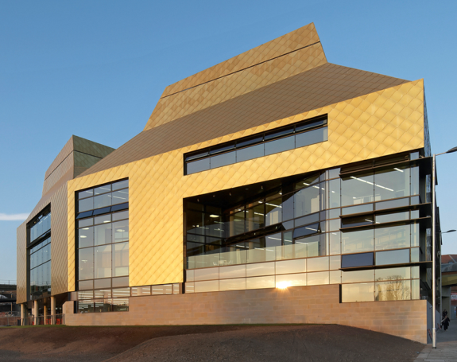
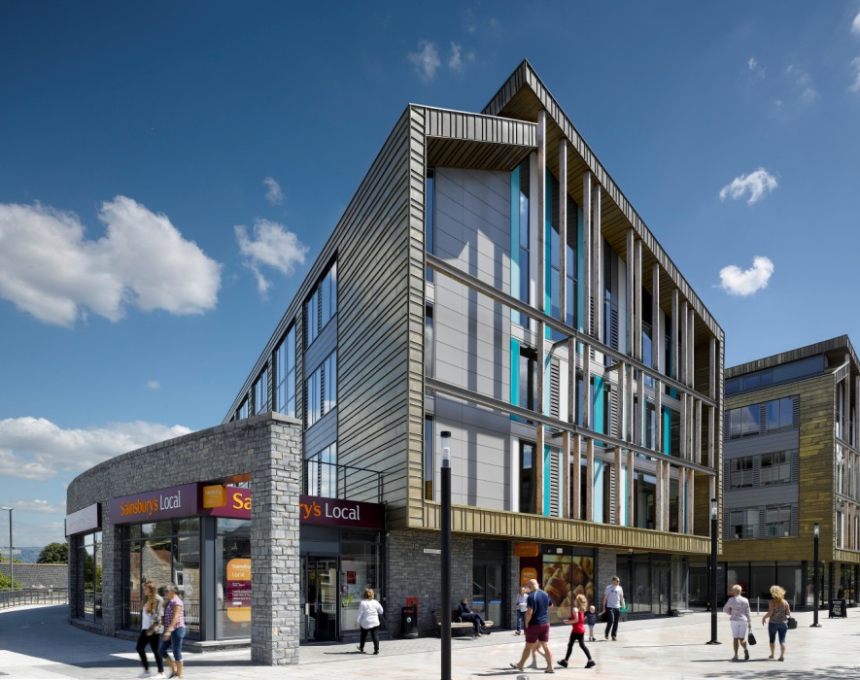
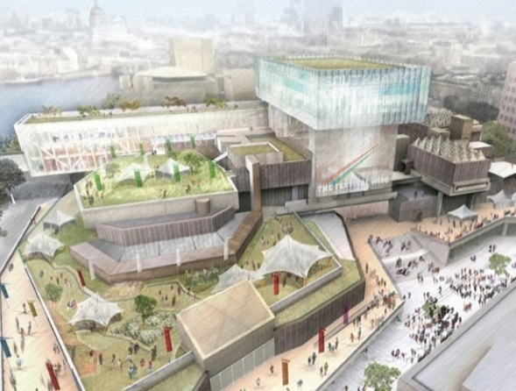
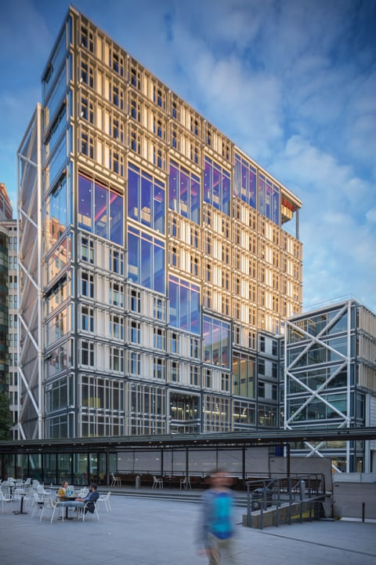
Tamsin Tweddell: My background
2000
2020
2025
Max Fordham: Building Performance
Team Performance
Max Fordham LLP: Senior Partner; Head of Sustainability & Building Performance
Beaufort Court
The Hive Library
Keynsham Civic Centre
Southbank Centre
LSE Centre Building
Tamsin Tweddell
Notes:
Timeline of 20 years in building industry (Max Fordham); building performance specialism; then 5 years outside
Bringing these lessons back

Slide 3
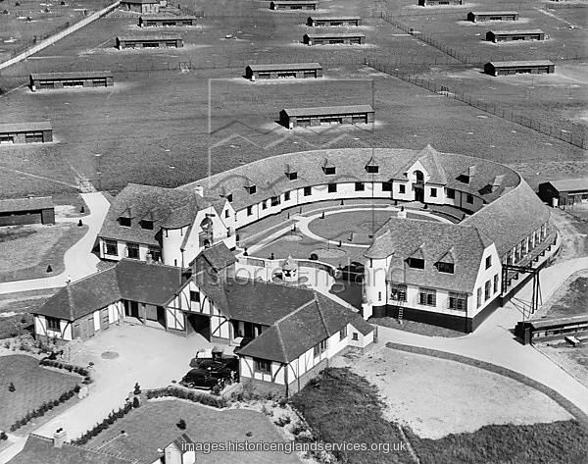
Beaufort Court 2003: Zero Carbon Building?
PR challenge led to openness & learning.
But what makes openness possible?
Tamsin Tweddell

Slide 4
Do better hospital teams make fewer medication errors?
Beaufort Court 2003: Zero Carbon Building?
“Better teams are more willing to discuss mistakes and learn from them.”
Research by Amy Edmondson, Harvard
Tamsin Tweddell
Notes:
Amy Edmondson
The best teams seemed to have the most errors. But that doesn’t make sense.
Maybe the best teams are more likely to REPORT their errors, and therefore to learn from them.

Slide 5
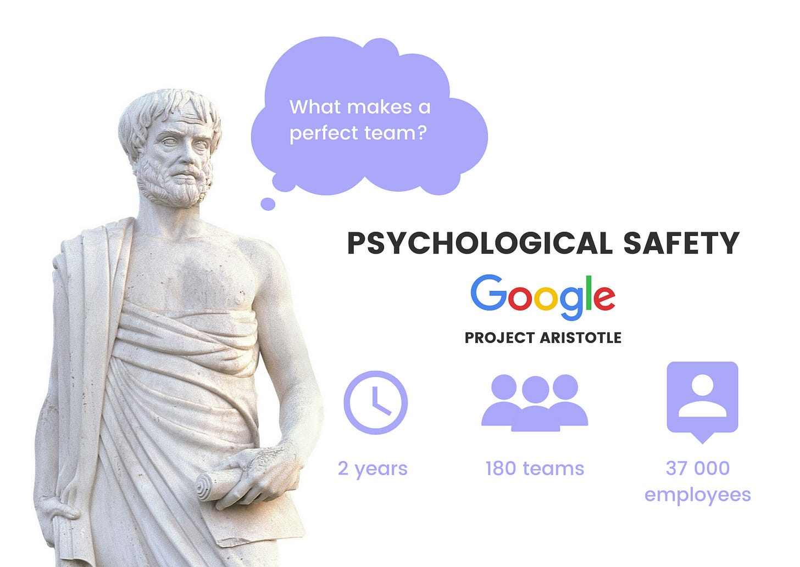
What makes a team effective at Google?
The whole is greater than the sum of the parts
Make it safe to speak up
= “Psychological Safety”
What makes an effective team?
PROJECT ARISTOTLE
2 years
180 teams
37 000 employees
Tamsin Tweddell
Notes:
Study 2012 to 2015. Published NYT 2016

Slide 6
LSE Centre Building, completed 2019
Respectful disagreement
Different disciplines can speak different ‘languages’
Need to break down silos
“The magic happens at the interfaces”
Tamsin Tweddell
Notes:
Amy Edmondson
The best teams seemed to have the most errors. But that doesn’t make sense.
Maybe the best teams are more likely to REPORT their errors, and therefore to learn from them.

Slide 7
Why change makes collaboration essential
In stable environments, silos can work. But not in change
No one has the full picture anymore
Complex problems tend to cross boundaries
You can’t adapt if no one is speaking up
Expertise must be paired with curiosity & learning
Tamsin Tweddell
Notes:
Amy Edmondson
The best teams seemed to have the most errors. But that doesn’t make sense.
Maybe the best teams are more likely to REPORT their errors, and therefore to learn from them.

Slide 8
Key takeaways: What can you do?
Make it safe to speak up
Actively bring different perspectives together
Stay curious & ask questions
LISTEN to people
Tamsin Tweddell
Notes:
Amy Edmondson
The best teams seemed to have the most errors. But that doesn’t make sense.
Maybe the best teams are more likely to REPORT their errors, and therefore to learn from them.

Slide 9
Technology alone doesn't deliver performance. People do.
Tamsin Tweddell
Building Team Performance | Engineering & Sustainability Leadership | Consultant, Team Coach & Mentor
https://www.linkedin.com/in/tamsintweddell/
Tamsin Tweddell

